Slide 1
Staff Training: External Reviews of Academic Units
Presented by the Office of the Associate Vice-President, Academic Planning

Slide 2
Overview of 2020-2021 Reviews
Fall 2020 reviews were postponed until 2021.
Site visits for 2021 will be conducted remotely to align with current social distancing and travel restrictions. Therefore no travel bookings will be needed.
VPAC is conducting 14 external reviews in 2021 due to the condensed review schedule. We will do our utmost to work with units to ensure the reviews are at a time that works for them, within these scheduling limitations.
The policy and procedures were updated in October 2020 after consultations in fall 2019 and spring 2020. Three new procedural documents and a Connect site were created as a result of these consultations.
All documents are available on the Quality Assurance page of the VPAC website.

Slide 3
External Reviews of Academic Units – What’s changed?
The following feedback emerged from consultation sessions in fall 2019 and spring 2020:
The AC1145 policy and procedure documents were long; some parts seemed to contradict. The procedures were part of the Senate document and could not be updated without Senate approval.
The AC1145 policy and associated procedures were 21 pages; this has been reduced to 4 pages that are reviewed by Senate. There are 3 associated documents (self-study, reviewer guide, and checklist) to aid units which can be updated as necessary without reintroducing to Senate.

Slide 4
External Reviews of Academic Units – What’s changed?
The following feedback emerged from consultation sessions in fall 2019 and spring 2020:
Site visits were required to take place in person:
“The Academic Program Review Committee should be present together in Victoria for a minimum of two full days. The great majority of their time will be scheduled to be spent on campus.”
Due to the current travel restrictions, a caveat was added to the policy to allow for virtual site visits if necessary:
“Normally, the external review team conducts a site visit of two to three days; any alternative arrangements will require the agreement of the chair or director, dean, Associate Vice-President Academic Planning and approval of the Provost.”

Slide 5
External Reviews of Academic Units – What’s changed?
The following feedback emerged from consultation sessions in fall 2019 and spring 2020:
Expectations for writing the self-study report were confusing; the template was long and purpose of questions was not always clear.
The self-study template was reduced by over 1000 words (from 7 pages to 5). Questions were condensed and rewritten for clarity. Questions from “Faculty and Staff Characteristics” section were re-categorized into more relevant areas.

Slide 6
External Reviews of Academic Units – What’s changed?
The following feedback emerged from consultation sessions in fall 2019 and spring 2020:
The process for distributing the self-study to the reviewer team and to VPAC was labour-intensive and expensive. It required units to print individual copies of the self-study, including appendices, for each reviewer and university executive.
A Connect site has been created in order to eliminate the need for units to print their reports, except in cases of reviewer request.

Slide 7
External Reviews of Interdisciplinary Units
Interdisciplinary units go through a condensed review process due to their size. It aligns with the principles of the policy but it less complex than a typical unit.
If you are supporting an interdisciplinary unit, please reference the Interdisciplinary External Review Guide, available on the Quality Assurance page of the VPAC website.

Slide 8
External Reviews of Academic Units Self-study
Responsibility of unit leader (i.e., chair/director)
Components:
Units are asked to use academic unit data, the University Strategic Plan, Faculty Strategic Plan, and the Planning Tools Data Packet to answer questions in the following areas:
Section 1: History, Development, and Future Plans of the Academic Unit
Section 2: Quality of and demand for the Academic Program(s)
Section 3: Quality of the Student Experience and the Learning Environment
Section 4: Quality of Student Outcomes
Section 5: Quality of Research and Scholarly Activity
Section 6: Resources and Infrastructure
Section 7: Opportunity Analysis for the Academic unit and Future Directions
Section 8: Questions for Reviewers (Optional)
Please indicate which groups have been consulted in the self-study process:
Faculty Members
Sessional Instructors
CUPE and PEA
Staff
Students
Other

Slide 9
External Reviews of Academic Units Reviewer Guide
Responsibility of review team (ultimately, reviewer chair)
Review teams are asked to use academic unit self-study materials, the University Strategic Plan, Faculty Strategic Plan, and the Planning Tools Data Packet to answer questions in the following areas:
Section 1: Development and Future Plans of the Academic Unit
Section 2: Quality of and demand for the Academic Program(s)
Section 3: Quality of the Student Experience and the Learning Environment
Section 4: Quality of Student Outcomes
Section 5: Quality of Research, Scholarly Activity and Scholarship on Teaching
Section 6: Resources and Infrastructure
Section 7: Additional Questions Identified by the Academic Unit, Dean or AVPAP

Slide 10
External Reviews of Academic Units Checklist
Feedback received from units in spring 2020 who recently conducted APRs indicated that units found instructions confusion and hard to follow.
The AC1145 Procedures document and the Admin and Logistical Info document were condensed into one checklist.
The External Reviews Checklist outlines both the timeline and responsibility associated with each step of the External Review process.
The primarily audiences of this document are the chair, unit administrative assistant, and the review team.

Slide 11
External Reviews of Academic Units Checklist Summary
Notes:
VPAC contacts units to notify them of upcoming review in the coming academic year and discusses next steps.
The unit organizes an internal committee to write the self-study document.
The unit submits:
5-10 proposed reviewers to fill the 2 external and 1 internal positions. (Please rank by preference if applicable.)
3 potential date ranges for a 2-3 date site visit (remote for 2021).
Name of administrative person supporting the review at the unit level (e.g. chair’s assistant).
AVPAP will select from the proposed reviewers and contact them to confirm availability. They will appoint 2 external and 1 internal reviewers, including a chair of the review committee.
The Special Projects Assistant, Academic Planning will send confirmed review committee members and date of review to the unit.

Slide 12
External Reviews of Academic Units Checklist Summary
Notes:
AVPAP sends a formal letter of invitation to each reviewer along with a link to the Connect site/instructions for affiliate access. These will be saved on Connect in the Administrative folder for reference.
Academic unit leader/chair submits the self-study to the dean for their approval.
The dean forwards the self-study to the AVPAP with their approval. AVPAP will review the document and either provide feedback or approve.
The department administrative assistant coordinates with the chair, dean’s office, and Special Projects Assistant to complete a draft itinerary (see Itinerary Template on the Connect site).
Special Projects Assistant organizes 2 mandatory meetings with the AVPAP at the beginning and end of the site visit.

Slide 13
External Reviews of Academic Units Checklist Summary
Notes:
The department administrative assistant forwards the complete itinerary to the Special Projects Assistant (vpacapal@uvic.ca) for approval.
The department administrative assistant books travel (if site visit is in person – n/a for 2021)
Once approved, the self-study is added to the Connect site by the Special Projects Assistant, who sends the Reviewer materials folder Connect link to the review committee (this is the only folder to which reviewers will have access).
Special Projects Assistant emails approved Self-study folder on Connect site to the Provost, AVPAP, AVP Research, Dean of Graduate Studies, and Dean of Faculty for their reference.
AVPAP will contact the student representatives (provided by the chair/unit) to send key information and welcome.

Slide 14
External Reviews of Academic Units Checklist Summary
Notes:
AVPAP contacts the review committee to resend key information (i.e. the link to the Connect site) a few days before the review.
Department or dean’s office to provide a secure room for reviewers (if review is in person – not applicable for 2021)
During the review, interactions with the review committee are expected to be cordial but please refrain from booking social events.
The role of the internal reviewer is to act as a host to the external members, familiarizing them with UVic practices.
On the last day of review (typically either 2-3 days in legth), the review committee meets with the AVPAP, faculty dean, and Dean of Graduate Studies.

Slide 15
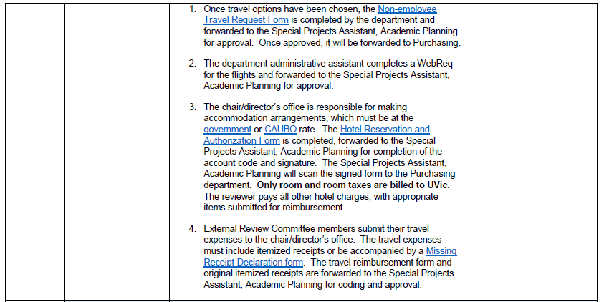
External Reviews of Academic Units Checklist Summary
Notes:
After the site visit is complete, the AVPAP sends the review committee a thank you note and outlines timeline to return completed review.
The external review committee submits the complete report to the AVPAP and Provost, who forward it to the faculty dean, Dean of Graduate Studies, chair/director. And VP Research.
Special Projects Assistant organizes an honourarium for each reviewer.
After the final report is received, the chair/director completes a response and the Action Plan document and submits to their dean for review.
The dean completes a separate response and submits both their and the chair/director’s responses and the Action Plan document to the AVPAP for review.
The unit should expect to review the action plan at regular meetings at 1, 3 and 5 year marks, prior to the next review.

Slide 16
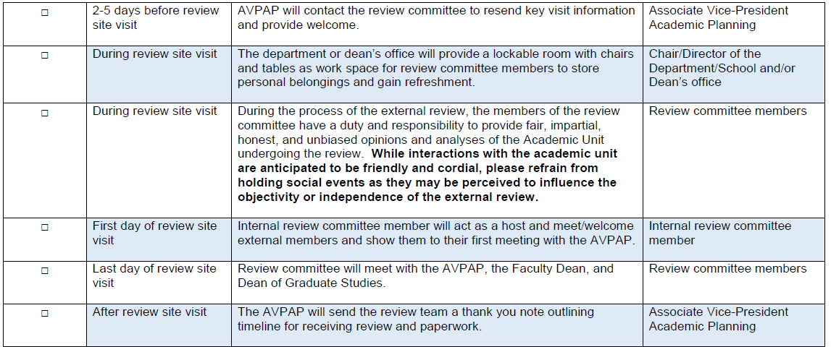
External Reviews of Academic Units Checklist Summary

Slide 17
External Reviews of Academic Units Checklist Summary

Slide 18
External Reviews of Academic Units Connect Site
Feedback received during consultations with chairs and directors in Spring 2020, included the suggestion of a singular communication tool, such as Connect. Therefore, the VPAC office in conjunction with University Systems worked on creating a Connect page for every unit, which will be made available to units which have upcoming external reviews.
If your unit doesn’t have a review upcoming for the next year but you would like early access, please contact vpacapal@uvic.ca.
The Connect page will include relevant documents such as the policy, associate documents, and the University Strategic Plan. There will also be space for units to upload their self-study document and appendices.
You will only be able to see your unit(s)’ folders.
The review team will be granted affiliate status via the VPAC office so that they can access the Reviewer Guide, Self-study Document, and other relevant background information. They will send their final report directly to the VPAC office.

Slide 19
External Reviews of Academic Units Connect Site
1) Contains AC1145 policy, self-study template, reviewer template, checklist
2) Approved self-study document – only upload once approved by dean and AVPAP (email the draft)
3) Administrative folder for unit’s use containing itinerary template. Space for drafts and finalized itinerary/documents.
4) For use by the review committee (with affiliate access). Includes policy and reviewer template. Finalized itinerary and self-study to be duplicated here.
5) Faculty external review tracker – shows review and milestone meeting timeline

Slide 20
Questions?
For further assistance with the External Reviews of Academic Units, please contact vpacapal@uvic.ca.
For more information about upcoming reviews, please see the Quality Assurance page of the VPAC website: https://www.uvic.ca/vpacademic/resources/howto/quality-assurance/index.php

