Slide 1
Academic Leadership Initiatives:
External Reviews of Academic Units
Presented by the Office of the Associate Vice-President, Academic Planning

Slide 2
External Reviews of Academic Units – What’s changed?
The following feedback emerged from the consultation sessions:
The AC1145 policy and procedure documents were long; some parts seemed to contradict.
The AC1145 policy and associated procedures were 21 pages; this has been reduced to a 4 page policy with integrated high-level procedures. There are three associated documents that are housed on the Quality Assurance page on the VPAC website.

Slide 3
External Reviews of Academic Units – What’s changed?
The following feedback emerged from the consultation sessions:
Site visits were limited to in-person:
“The Academic Program Review Committee should be present together in Victoria for a minimum of two full days. The great majority of their time will be scheduled to be spent on campus.”
Now there is greater flexibility in scheduling site visits:
“Normally, the external review team conducts a site visit of two to three days; any alternative arrangements will require the agreement of the chair or director, dean, Associate Vice-President Academic Planning and approval of the Provost.”

Slide 4
External Reviews of Academic Units – What’s changed?
The following feedback emerged from the consultation sessions:
Expectations for writing the self-study report were confusing; the template was long and purpose of questions was not always clear.
The self-study template was reduced by over 1000 words (from 7 pages to 5). Questions were condensed and rewritten for clarity with the option to ask reviewers customized questions.

Slide 5
External Reviews of Academic Units – What’s changed?
The following feedback emerged from the consultation sessions:
The process for distributing the self-study to the reviewer team and to VPAC time-consuming and inefficient. It required units to print individual copies of the self-study, including appendices, for each reviewer and university executive.
A Connect site has been created in order to eliminate the need for units to print their reports, except in cases of reviewer request.

Slide 6
External Reviews of Academic Units Self-study
Units are asked to use academic unit data, the University Strategic Plan, Faculty Strategic Plan, and the Planning Tools Data Packet to answer questions in the following areas:
  Section 1: History, Development, and Future Plans of the Academic Unit
  Section 2: Quality of and demand for the Academic Program(s)
  Section 3: Quality of the Student Experience and the Learning Environment
  Section 4: Quality of Student Outcomes
  Section 5: Quality of Research and Scholarly Activity
  Section 6: Resources and Infrastructure
  Section 7: Opportunity Analysis for the Academic unit and Future Directions
  Section 8: Questions for Reviewers (Optional)
Please indicate which groups have been consulted in the self-study process:
  Faculty Members
  Sessional Instructors
  CUPE and PEA
  Staff
  Students
  Other

Slide 7
External Reviews of Academic Units Reviewer Guide
Feedback received from units and review teams and the Ministry indicated that a more structured review response would be appreciated. This will also assist with integrating the recommendations into academic resource planning. The reviewer guide mirrors what is asked in the self-study.
Review teams are asked to use academic unit self-study materials, the University Strategic Plan, Faculty Strategic Plan, and the Planning Tools Data Packet to answer questions in the following areas:
  Section 1: Development and Future Plans of the Academic Unit
  Section 2: Quality of and demand for the Academic Program(s)
  Section 3: Quality of the Student Experience and the Learning Environment
  Section 4: Quality of Student Outcomes
  Section 5: Quality of Research, Scholarly Activity and Scholarship on Teaching
  Section 6: Resources and Infrastructure
  Section 7: Additional Questions Identified by the Academic Unit, Dean or AVPAP

Slide 8
External Reviews of Academic Units Checklist
The External Reviews Checklist outlines both the timeline and responsibility associated with each step of the External Review process.
The primarily audiences of this document are the chair, unit administrative assistant, and the review team.
You will also see on the slide that there are spaces for a 3 and 5 year review.

Slide 9
External Reviews of Academic Units Connect Site
Feedback received during consultations with chairs and directors in Spring 2020, included the suggestion of a singular communication tool, such as Connect.
The Connect page will include relevant documents such as the policy, associate documents, and the University Strategic Plan. There will also be space for units to upload their self-study document and appendices.
You will only be able to see your unit(s)’ folders.
The review team will be granted affiliate status via the VPAC office so that they can access all the materials relevant to the final review. They will send their final report directly to the VPAC office.

Slide 10
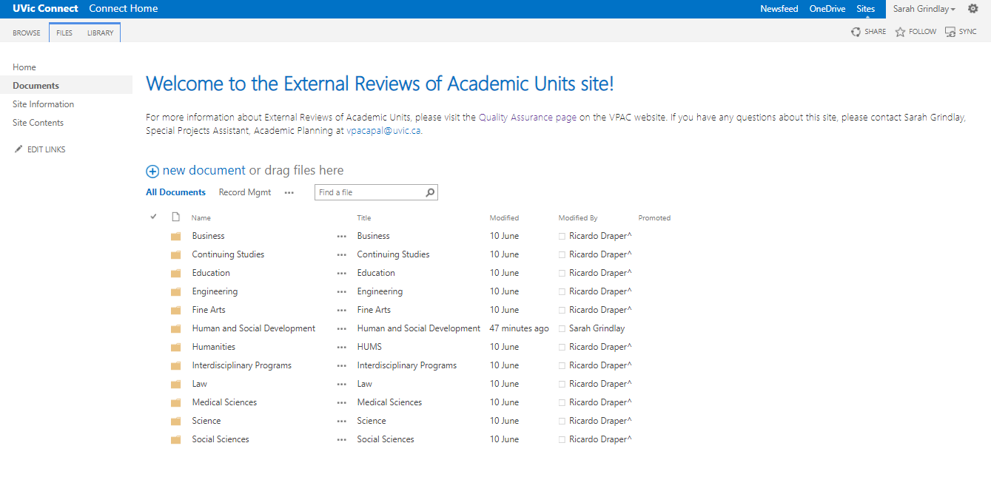
External Reviews of Academic Units Connect Site

Slide 11
Questions?
For further assistance with the External Reviews of Academic Units, please contact vpacapal@uvic.ca.

