Slide 1
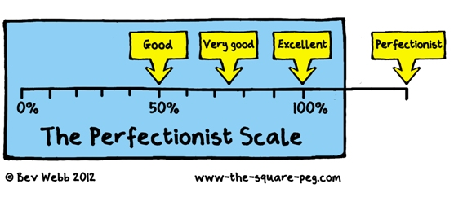
Perfectionist writers by madeline walker and Gillian saunders centre for academic communication December 5, 2018
I write one page of masterpiece to ninety-one pages of s*#t. I try to put the s*#t in the wastebasket.
–Ernest Hemingway

Slide 2
Agenda
What is perfectionism?
Negative effects of perfectionism
Tips for getting started and avoiding procrastination
Positive aspects of perfectionism
Tips for managing perfectionism
Notes:
g

Slide 3
What is “perfectionism”?
a disposition to regard anything short of perfection as unacceptable; especially: the setting of unrealistically demanding goals accompanied by a disposition to regard failure to achieve them as unacceptable and a sign of personal worthlessness -Merriam Webster
Three types of perfectionism:
self-oriented
other-oriented
socially prescribed
Lower your standards until you are able to write.
– Donald Murray, The Craft of Revision
Notes:
Add definitions g

Slide 4
Are you a perfectionist?
The thought of being average is awful for me.
If I make a mistake, people will think less of me.
My supervisor/family/friends have high expectations of me.
If I do one thing perfectly on the first try, everyone will expect me to always produce the same results.
I feel proud of my work if it receives praise from others.
Notes:
anecdote each about perfectionism

Slide 5
Take a few minutes to chat with the person next to you. Then share with the group.
What is your experience with perfectionism?
How do you think perfectionism might affect your writing process and outcomes?
Notes:
G –

Slide 6
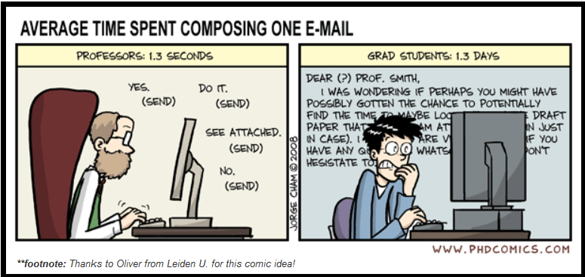
How does perfectionism negatively affect writers?
Procrastination
Paralysis
Anxiety
Depression
"Piled Higher and Deeper" by Jorge Cham www.phdcomics.com
Notes:
Two kinds – adaptive and maladaptive

Slide 7
Perfectionism linked to fear of failure
“Fear of failure may motivate the behavioral components of perfectionism that aim to help the person meet his or her unreasonably high standards; for example, careful checking, reassurance seeking, correcting others, and excessive consideration before making a decision.”
(Shafran & Mansell, 2001, p. 880)
Fear of making mistakes
Notes:
Two kinds – maladaptive and adaptive

Slide 8
Tips for avoiding procrastination and getting started
Construct a dedicated writing spot where all you do is write (but you can write elsewhere)
Commit to a regular habit of writing, and start small
Focus on one thing at a time
Break large tasks into small steps and use time boxes (e.g., Pomodoro 25 minutes)
Write the first draft without looking too closely at style, grammar, or punctuation
Carry a notebook to jot ideas and reflections
Meet frequently with your supervisor; connect with other writers
Notes:
Madeline

Slide 9
My ideal writing environment
Location
Time of day
Duration of stay
Noise level/type of noise
Other
Notes:
M think-pair-share

Slide 10
Do you have any other suggestions?
Notes:
m

Slide 11
How might perfectionism positively affect writers?
Your dissertation should be the worst piece of research that you ever write – not that your dissertation should be bad, but all of your subsequent research and scholarship should be better.
-Peg Boyle Single, Demystifying Dissertation Writing
Notes:
Gillian
If we never told ourselves we can do better, we’d never be good at anything.

Slide 12
Adaptive Perfectionism
Adaptive perfectionism is characterized as a normal, healthy type of perfectionism and is defined by deriving satisfaction from achievements made from intense effort…
but tolerating the imperfections without resorting to the harsh self-criticism that characterizes maladaptive perfectionism (Stoltz & Ashby, 2007).
At its best, perfectionism can result in
High personal standards
Striving for achievable goals
Getting work done on time and meeting deadlines

Slide 13
Tips for managing perfectionism and gettin’ ‘er done
What does “good enough” look like for you?
Which kinds of imperfections are acceptable, and which are absolutely unacceptable?
Set limits for
When editing will take place
How often editing will take place
How much time will be spent
Who else will give feedback, and when
Ask for feedback often, and get used to receiving it without feeling “judged.”
Practice accepting imperfection (once you’ve identified what’s “good enough.”
Acknowledge effort, and focus on the process, not the outcome.
You most likely need a thesaurus, a rudimentary grammar book, and a grip on reality. This latter means: there’s no free lunch. Writing is work.
–Margaret Atwood

Slide 14
Is perfection worth aiming for?
Things like spelling and citations are non-negotiable. These really DO need to be perfect in a final copy.
Depending on your discipline, aspects of writing such as grammatical accuracy and academic tone may vary in terms of what is considered “perfect” and “good enough.” Make sure you’re aware of the standards within your own discipline.
Does your supervisor recommend or require that you hire an editor?
What is the purpose of this piece of work? Will imperfections prevent it from achieving its purpose? What kinds of imperfections aren’t acceptable? How will you know when it’s good enough?

Slide 15
“Good enough” vs. “Perfect”
 | PRETTY DARNED GOOD | PERFECT
e.g. Spelling | Under five typos, capitalization errors, or misspelled words per 20 pages | Zero typos, capitalization errors, or misspelled words
Supervisor’s Reaction | Some constructive feedback, a few errors noted, one more revision recommended, with a little help from the CAC for catching punctuation issues and revising introduction for clarity and coherence | Tears of joy, speechlessness, defense waived
Clarity
Other
Notes:
This may change from draft to draft, or according to purpose – in a first draft, maybe 10 typos/errors are acceptable. When you send a final copy in for publication, maybe only two. Maybe none.

Slide 16
Thank you for coming! Questions?
And now that you don’t have to be perfect, you can be good.
– John Steinbeck

