Slide 1
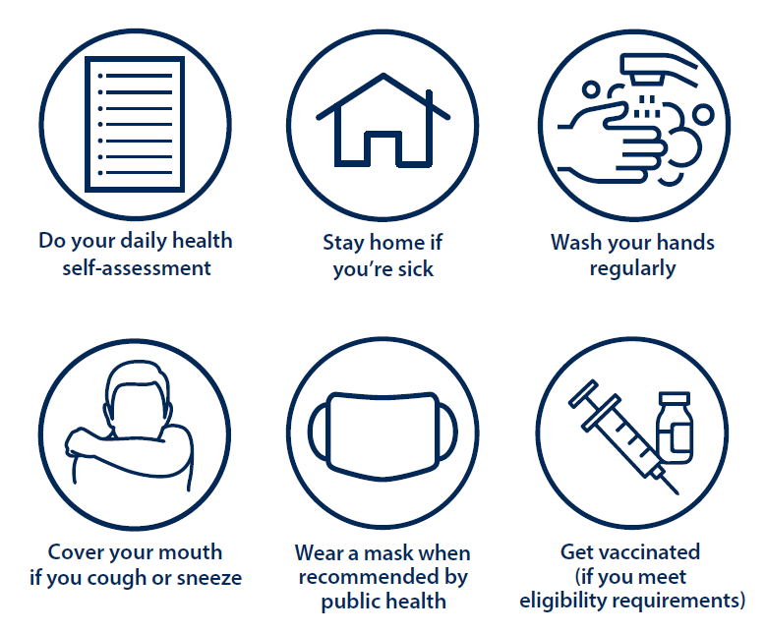
Stay Healthy & Safe
UVic is committed to providing safe and healthy environments for all members of the university community
For more information: uvic.ca/covid19
Notes:
UVic is committed to providing safe and healthy environments for all members of the university community
We each play a role in this
Do a daily health assessment. If you are ill or have new or worsening symptoms of COVID-19 please stay home
Wash your hands regularly
Cover your mouth and nose when you cough or sneeze
Wearing a mask is now a personal choice; however, masks are still strongly encouraged on campus in indoor public spaces where people may be in close proximity or anywhere people feel more comfortable to do so.
Getting vaccinated is the most important step you can take to reduce severity of illness. The university encourages everyone who is eligible and able, to consider vaccination to protect yourself and others.
For more information visit uvic.ca/covid19

Slide 2
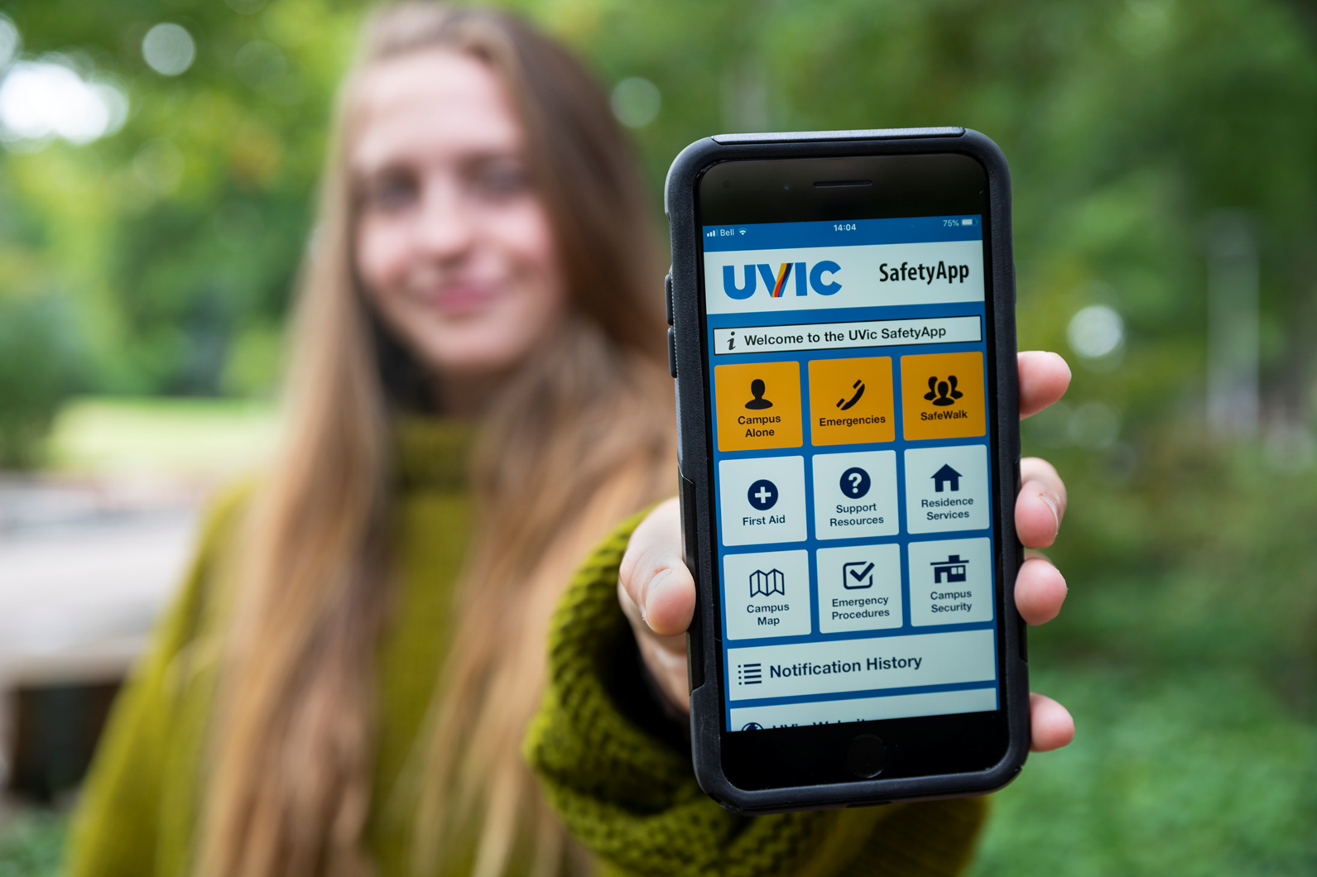
UVic SafetyApp
Download the UVic SafetyApp
Fastest notification of significant emergency or disruption
Friend Walk feature
Important information & emergency numbers in the app
Visit uvic.ca/alerts for more information
Version date: May 31, 2022
Notes:
Please download the UVic SafetyApp
This app is the fastest way to receive notification of a significant emergency or disruption on campus
The app may be used to warn the campus community about an active shooter, large gas leak, snow closure or other disrupting event where you need to take action
The app also has information and emergency numbers quickly available
Check out the Friend Walk feature – this features allows a trusted friend to virtually follow you on a walk
Download the app at the Apple App Store or Google Play
Once downloaded make sure to go into the app to enable notifications
For more information visit uvic.ca/alerts

Slide 3
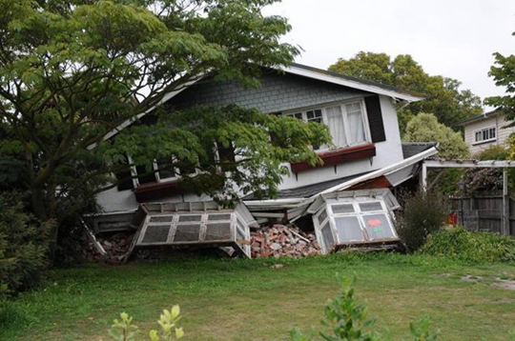
Earthquake
Protect yourself during an earthquake
Drop, Cover, Hold On!
For more information visit : uvic.ca/earthquake
Notes:
The Victoria region has a 1 in 3 probability of a damaging earthquake occurring in the next 50 years
We encourage you to take basic steps to be prepared for an earthquake
During an earthquake your best option to protect yourself is Drop, Cover, Hold On!
For more information visit uvic.ca/earthquake

Slide 4
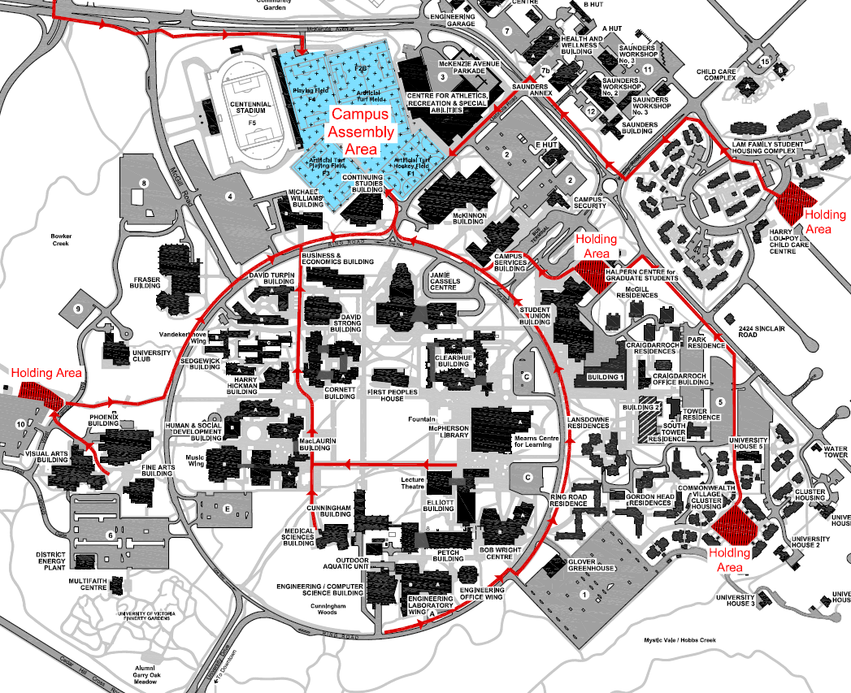
Evacuation
Immediately evacuate building when fire bells ring
Encourage others to leave
Muster outside - away from the building
Following a major earthquake go to the Campus Assembly Area (fields between CARSA and stadium)
For more information visit : uvic.ca/evacuation
Notes:
There are some emergencies when evacuation is required
When fire bells ring always assume there is a real emergency, take immediate action and evacuate
You may not see smoke or fire – this does not mean there is no emergency. Take action immediately. As you leave encourage others to leave as well – seconds count.
During the emergency follow the directions from UVic staff in safety vests, Campus Security officers and emergency officials
Once outside muster away from the building. Stay off routes fire trucks use to reach the building.
If a major damaging earthquake occurs while you are at UVic leave the building after the shaking has stopped and go to the Campus Assembly Area in the fields between CARSA and the stadium. The map on this slide shows this area in blue.
To learn more visit uvic.ca/evacuation

Slide 5
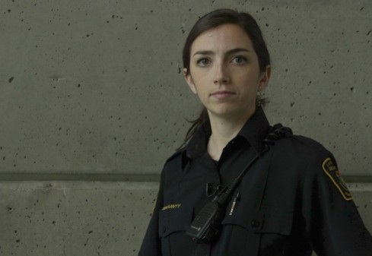
Active Threat
Take immediate action!
Options:
Get out
Hide
Fight!
Watch the video at uvic.ca/activethreat
Notes:
An active threat is an emergency event in which an individual with a weapon poses an immediate danger to safety on campus. Active threats may use firearms or other weapons to cause harm.
Active threat events are not common. However, because these events are so serious it is important that you have this information to help you make decisions in the moment.
If you believe an active threat is occurring take immediate action!
Your options are:
Get out!
Hide!
Fight!
Learn more about how to respond to an active threat - watch the video at uvic.ca/activethreat

