Slide 1
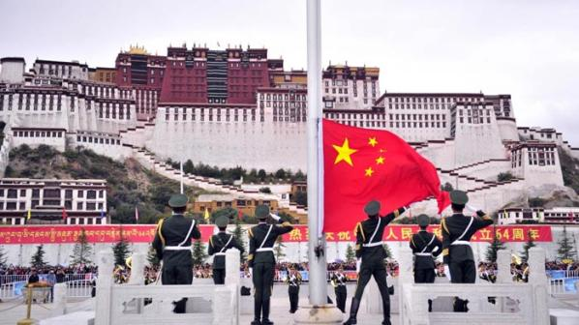
“The Dragon and the Snow Lion: China’s Relationship with Tibet”

Slide 2
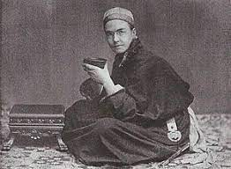
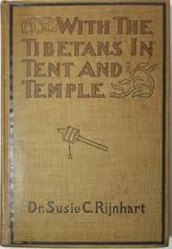
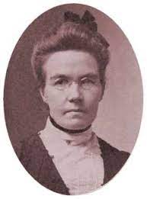
Canada and Tibet:
Susanna "Susie" Carson Rijnhart, 1868 – 1908, Chatham, Ontario
One of the first woman allowed to study medicine at Trinity College in Toronto, (1889):
The Ist Western women to enter Tibet :
From the late 19th Century to the early 20th Century: Tibet was a place of Canadian missionaries.

Slide 3
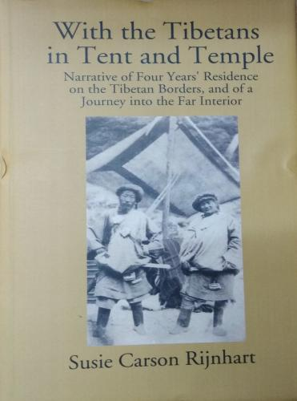
On a lecture tour of Canadian churches, Dr Rijnhart was described as “a Canadian heroine” with a “most thrilling story of missionary exploration, sacrifice, and possible martyrdom.”

Slide 4
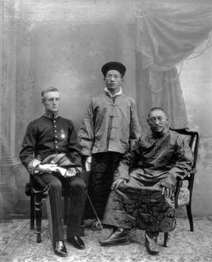
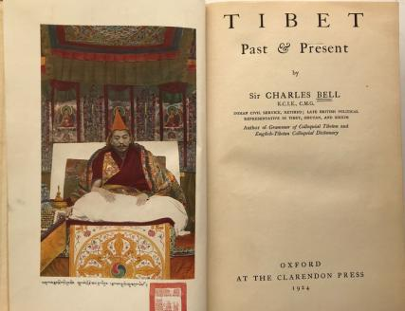
Prominent Victorian connected with Tibet
1870 –1945) was the British Political Officer
for Bhutan, Sikkim and Tibet. In 1921 Bell retired Civil Service and moved to Victoria, BC

Slide 5
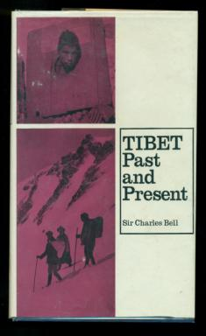
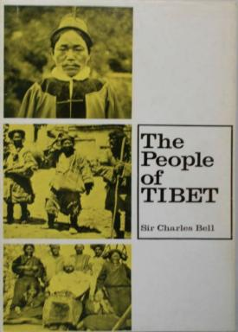

Slide 6
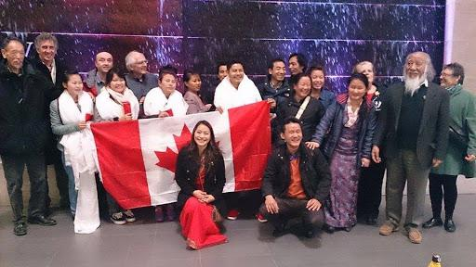
Twice Diaspora Tibetans in Canada:

Slide 7
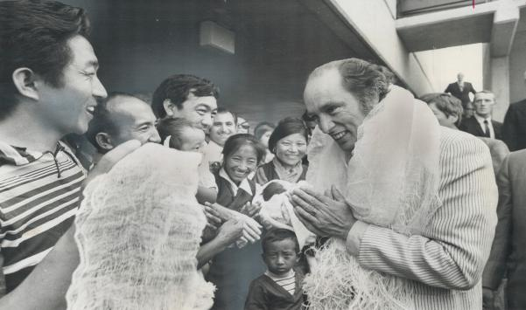
The Prime Minister Pierre Trudeau welcomes Tibetans:
In June 1969, Canada became a signatory to the 1951 un Convention Relating to the Status of Refugees
In March 1971, the first Tibetan refugees arrived in Canada. This small group of newcomers to Canada became the first non-European refugees accepted into the country. At the time, the settlement of these refugees called for Quebec, Ontario, Alberta and British Columbia to accept an equal number of refugees.

Slide 8
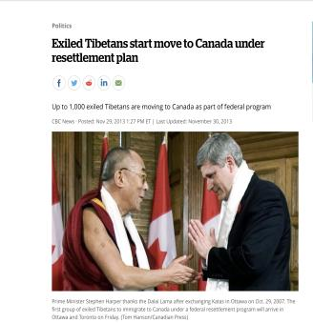
Three stages:
The first group 1970 (humanitarian gesture)
The second stage 1990-2010 (Migration
The third stage, 2010- Present (Private Sponsorship)

Slide 9
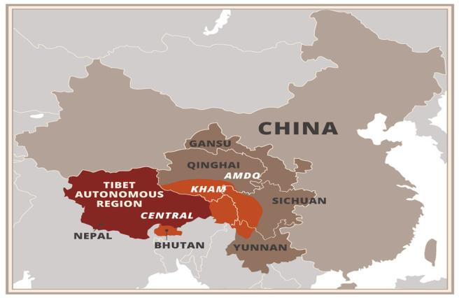
Bo བོད་ Tibet “Xizang 西藏”.

Slide 10
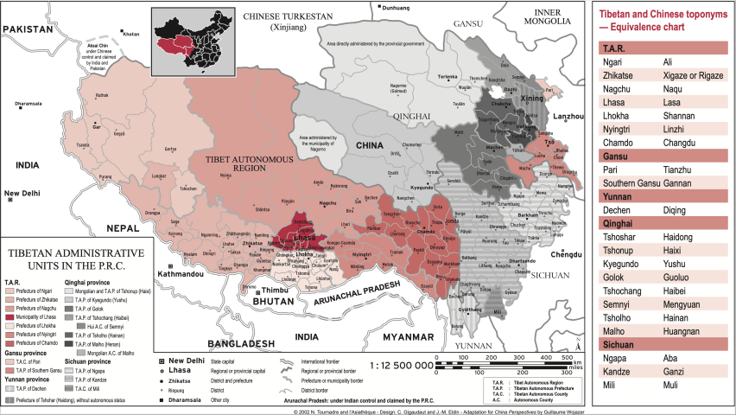
https://www.chinafile.com/reporting-opinion/viewpoint/how-much-does-beijing-control-ethnic-makeup-of-tibet

Slide 11
Han/Chinese population 91.96 percent
8.04 percent belong to minority ethnic groups

Slide 12
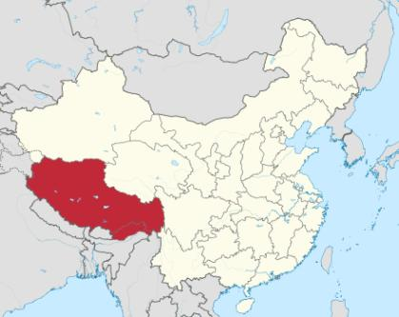
“Xizang西藏”.
In August the ministry of propaganda issued a directive to gradually replacing “Tibet” with ”Xizang” in external propaganda:
Refers only Tibet Autonomous Regions:
Tibetan Population 2020:
TAR: 3137.901
Qinghai: 2021.170
Sichuan: 1990.585
Gansu: 367.006
Yunnan 387.511

Slide 13
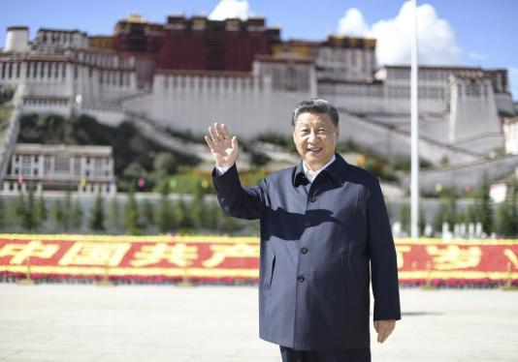
July 23 2021 Xi Jinping became the first President of China to visit Lhasa :

Slide 14
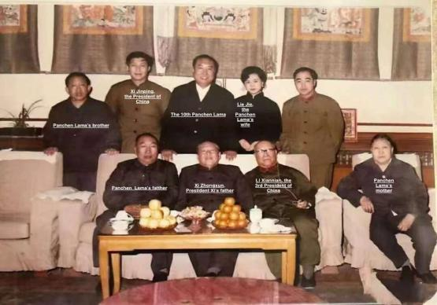
Xi Jinping’s family with the Panchen Lama’s family, 1979

Slide 15
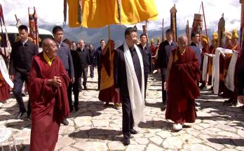
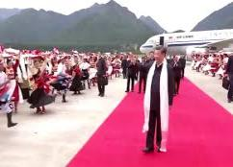
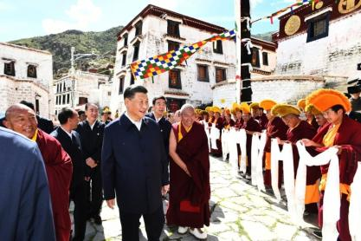
July Xi Jinping became the first President of China to visit Lhasa.
Xi’s visit timed to coincide with the 70th anniversary of the 17 Point Agreement
Marking the centenary celebration of the founding of CCP

Slide 16
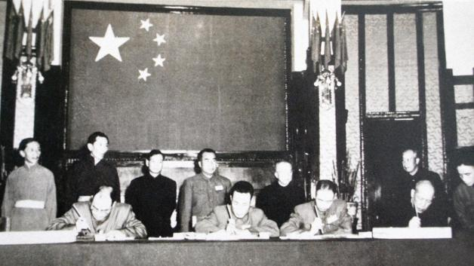
The Seventeen Point Agreement: The formal title, Agreement of the Central People's Government and the Local Government of Tibet on Measures for the Peaceful Liberation of Tibet, Signed in 23 May 1951

Slide 17
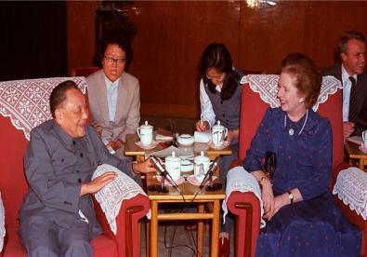
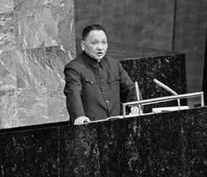
Deng was the architect of the 17th Point Agreement, at the Deng was the Political commissar of SW Military Region, that army that invaded Tibet.
The 17 Point Agreement is almost identical to Hong Kong Basic Law signed with Britain by Deng Xiaoping and Margaret Thatcher

Slide 18
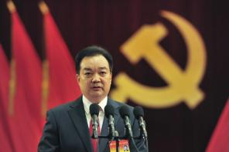
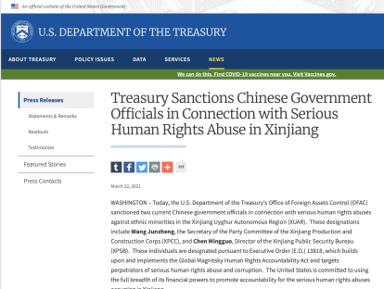
The latest Development :
On 18th of October, Wang Junzheng asenior official sanctioned by the United States, Britain, the European Union and Canada for his role in China’s far western Xinjiang region has been appointed the First Sec of CCP in Tibet, (the top job).

Slide 19
What are the issues?
Minority areas: Resource Rich, Resource extraction, Low population density
Migration/ Settler Colonialism/ Sinicization/ Population transfer.
Economic disadvantage, imbalance growth
4) Chinese elite, no connection with minority issue
5) International dimensions. Human Rights Global Diaspora/ Soft Power/ China’s image.

Slide 20
Key themes:
1947-1960 Sovereignty. Securing frontier (China signed a major border agreement with neighboring countries
1960-1967 Reform/
1967-1979 Socialists Transformation
1979-1990 Autonomy Revisioned, (Hu Yaobang’s apology)
1990-2000 Economic Development (Western Development, 西 部大开发;)
2000-Present Integration and Assimilation/Civic Citizenship

Slide 21
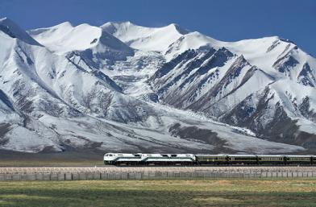
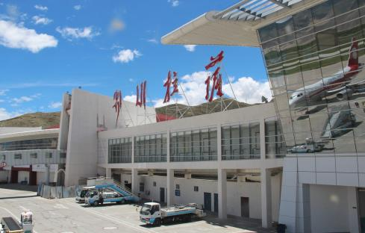
PRC/ CCP’s Paradigms
1) Liberation/Unification
2) Emancipation
3) Development

Slide 22
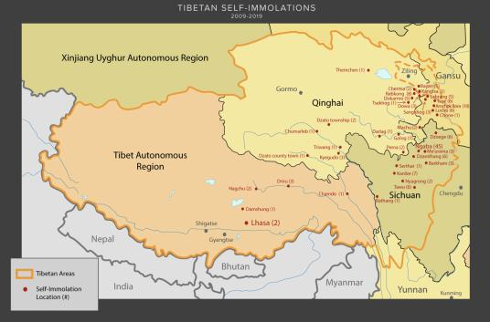
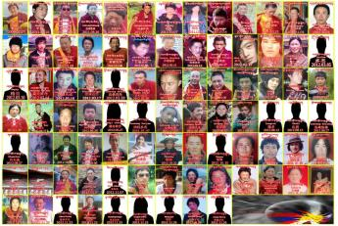
Tibetan Grievances
Total number of Self-immolations: 155 (129 Male and 26 Female),

Slide 23
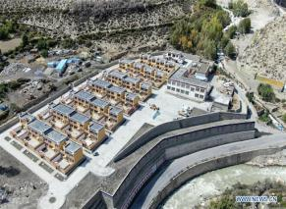
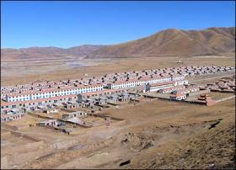
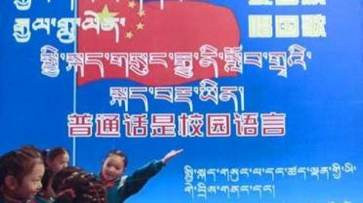
1) Religion: CCP/the State interference in purely religious affairs
2 Language / Education Residential/ Boarding schools
3)Jobs/Economic/ forced resettlement of nomads.
4) Forced Sinicization Loyalty to China diminish Tibetan identity.
Population transferred;
Resettlement of Nomads/
Introduction of common language education

Slide 24
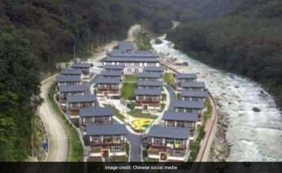
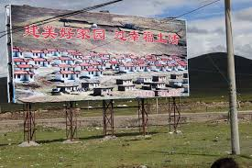
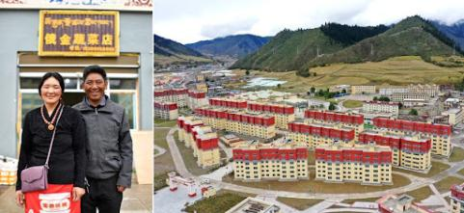
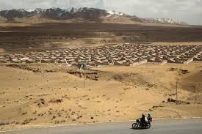
When Xi Jinping came to power in 2013, he set a goal to completely overcome poverty by 2020.

Slide 25
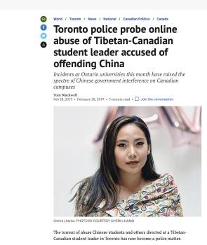
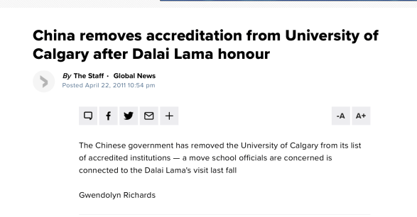
Canada and Tibet
China asserts and tries to influence global opinion.

Slide 26
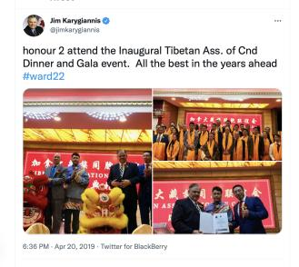
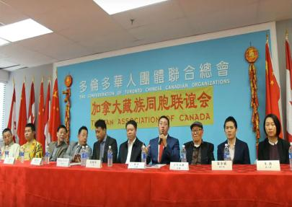
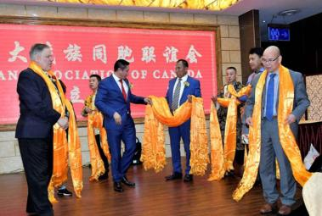
China is funding and setting up groups in Canada disguised as genuine community lead groups.
They lobby MPs, MMP and Businesses

Slide 27
My country or my religion:
 | CCP | Religion
Ideology | Socialism with Chinese characteristics | Buddhism, Christianity, Islam,
Leadership | Party Sec, Central Committee | Religious leaders, e.g. the Dalai Lama,
Organization | The Party | Church/ Religious sects and groups
Membership | CCP membership/ 85 Million | 244 Million Buddhists, 67 Million Christians 21 Million Muslims

