Slide 1
Community Researcher??
Patient Researcher??
Patient Researcher??
Community Researcher??
Community Researcher??
Patient Researcher??
Patient Researcher??
Patient Researcher??

Slide 2
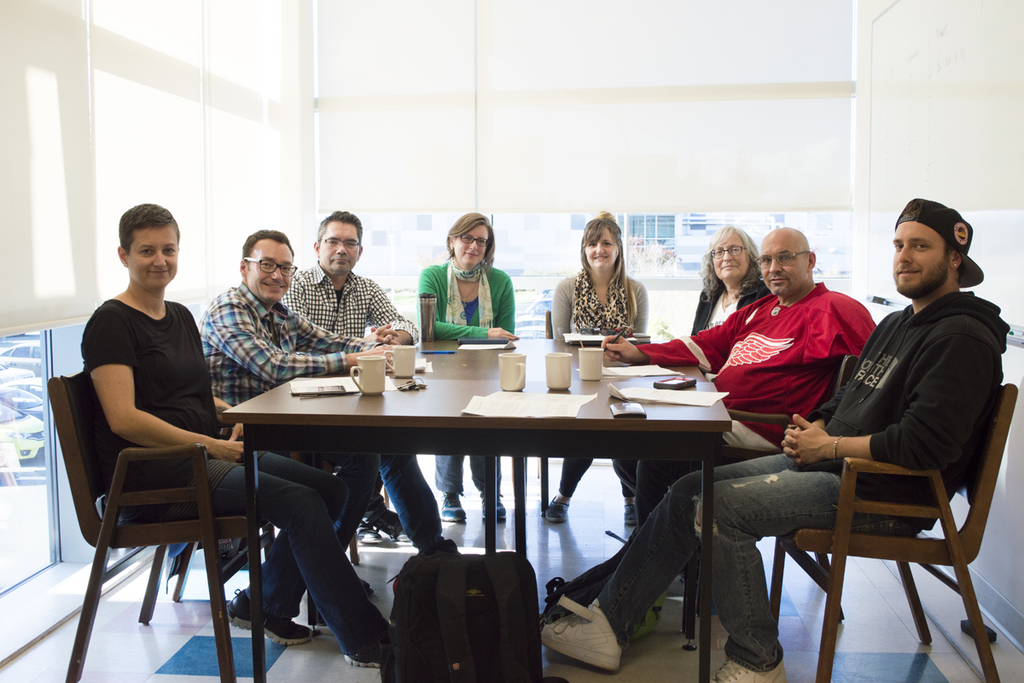
Creating Culturally Safe Primary Care and Reducing Stigma of Substance Use
https://www.uvic.ca/research/centres/cisur/index.php
Notes:
The main purpose of our study is to promote cultural safety around primary care for people who use substances.

Slide 3
Project expectations
Increase awareness:
Hope to increase physician awareness and compassion to reduce stigma
We will be aware that stigma between people who use substances and primary care providers can go both ways
We hope that one day substance use and mental health will be less stigmatized and openly discussed and acknowledged
Increase dignity
In healthcare and other social settings – this in the form of more humane treatment and safe respectful services
We expect to be treated with dignity while learning and sharing our experiences with one another
We hope to build trusting relationships across the groups represented in this project
Contribute in a meaningful way to the community
Given the current opioid epidemic, we expect our team to acknowledge the value in both abstinence and harm reduction models and keep in mind the importance of saving lives
We aim to be part of a forward thinking movement building on the work of Insite and the overdose response units here in Victoria
We hope to impact physicians in positive ways so that primary care will be improved for the whole community and prevent or lessen the impact of harms which could ultimately result in savings to the economy
Notes:
Increase awareness:
Hope to increase physician awareness and compassion to reduce stigma
We will be aware that stigma between people who use substances and primary care providers can go both ways
We hope that one day substance use and mental health will be less stigmatized and openly discussed and acknowledged
Increase dignity
In healthcare and other social settings – this in the form of more humane treatment and safe respectful services
We expect to be treated with dignity while learning and sharing our experiences with one another
We hope to build trusting relationships across the groups represented in this project
Contribute in a meaningful way to the community
Given the current opioid epidemic, we expect our team to acknowledge the value in both abstinence and harm reduction models and keep in mind the importance of saving lives
We aim to be part of a forward thinking movement building on the work of Insite and the overdose response units here in Victoria
We hope to impact physicians in positive ways so that primary care will be improved for the whole community and prevent or lessen the impact of harms which could ultimately result in savings to the economy

Slide 4
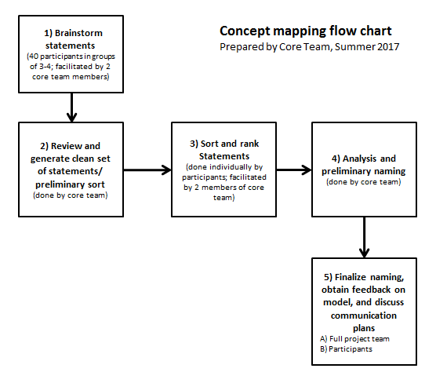
I would feel safe going to the doctor if…

Slide 5
What FlavoUr were Our ‘Patient’ Engagement Research Methods? (PARTICIPATORY, COLLABORATIVE)
CORE RESEARCH TEAM

Slide 6
Ingredients for success
Compassion, empathy and understanding
Teamwork
Personal and shared community benefit
Partnership
Notes:
Conor’s Notes
What were our ingredients for success?
Compassion and Empathy and Understanding- were three of our biggest ingredients that came from all of our lived experience
Teamwork – Uvic researches encouraged us to participate fully in ALL of the process. Everyone had equal opportunity to participate, the fact that all of our participants were excited helped motivate us as the research assistants and researches.
Personal and Shared Community Benefit – We had the opportunity to network with our community that as a whole is burdened by the stigma that can negatively affect the health care experience for substance users and the physicians practicing.
Partnership- Umbrella Society’s partnership with Solid was a new and crucial ingredient in the sense that we both represented different groups with similar issues revolving around substance use: ranging from illicit street level users to middleclass citizens we look at out similarities not our differences. The commonality we all shared in regards to the pains and struggles of substance use and how when we come together as a community with the hope and determination for changes, changes can and will happen.

Slide 7
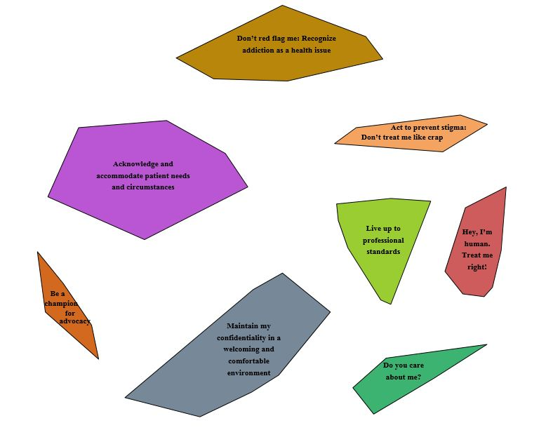
Culturally Safe Primary Care means….. (12 FOCUS GROUPS: 69 PEOPLE)
Notes:
The core team came together to decide the most appropriate number of clusters to take back to the participants who we asked to generate a label for each bluster. As a group, we decided that anything more than 8 clusters was too specific and would prove more difficult to label; while any number less than 8 would lose specificity.
Red= Hey, I’m human. Treat me right!
Light green= Live up to professional standards
Light orange= Act to prevent stigma: Don’t treat me like crap
Dark Green= Do you care about me?
Grey= Maintain my confidentiality in a welcoming and comforting environment
Brown= Don’t red flag me: Recognize addiction as a health issue
Purple= Acknowledge and accommodate patient needs and circumstances
Dark orange= Be a champion for advocacy

