Slide 1
Proximity Effect in EBL
Jian Wu
Feb. 11, 2014
Notes:
Good morning, everyone. My topic is proximity effect in EBL.

Slide 2
Outline
Introduction
Physical and quantitative model of proximity effect
Reduction and correction of proximity effect
Conclusion
Notes:
First I will introduce the concept of proximity effect. Then I will explain its physical and quantitative model. And its reduction and correction method. The last part is conclusion.

Slide 3
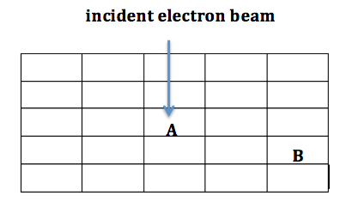
Introduction
Proximity effect:
Electron scattering effect.
Non-uniform exposure.
Causing exposure of areas surrounding the area where the electron beam is incident.
Limiting the resolution in EBL.
Notes:
Proximity effect in EBL is essentially an electron scattering effect. Due to the non-uniform exposure, it can cause additional exposure of areas surrounding the area where the electron beam is incident. Thus it limits the resolution in EBL. This figure simply illustrates what is proximity effect. The electron beam is incident on pixel A. But due to electron scattering, pixel B will also get certain exposure.

Slide 4
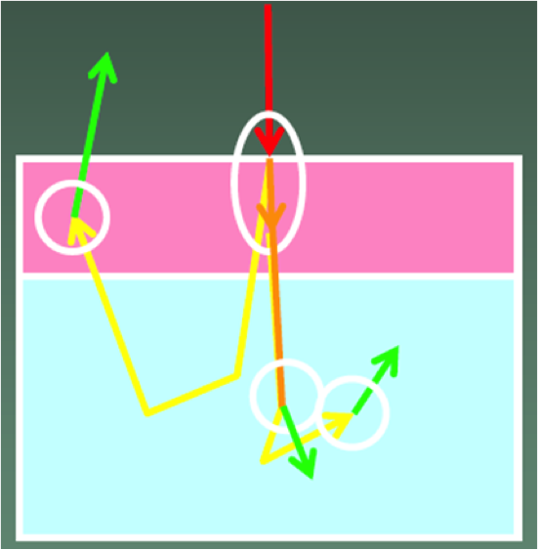
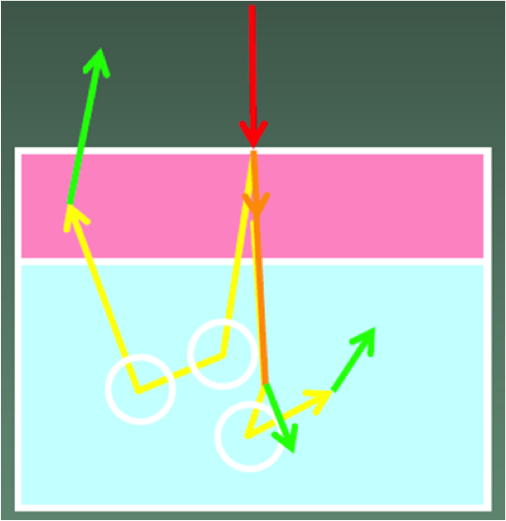
Forward and Backward Scattering
Resist
Resist
Substrate
Substrate
Forward scattering:
Small angle.
Inelastic.
Generating secondary electrons
with low energy.
Backward scattering:
Large angel.
Elastic.
High energy, same range of
primary electrons.
- Large travel length.
Backscattering is mainly responsible for resist exposure far from incidence
(proximity effect), as BSE can generate SE along its path to expose the resist there.
Notes:
There are two kinds of electron scattering. They are forward scattering and backward scattering, respectively. Forward scattering is an inelastic scattering. Its scattering angle is small. It can generate secondary electrons with low energy. Backward scattering is an elastic scattering. It has large scattering angle. The scattered electron has high energy, thus has large travel length. These two figures shows a comparison between forward and backward scattering. Backward scattering happens in the substrate. After large angle scattering in the substrate, electrons can return back to the resist at a significant distance from the incident beam, thereby cause additional resist exposure. So backscattering is mainly responsible for proximity effect.

Slide 5
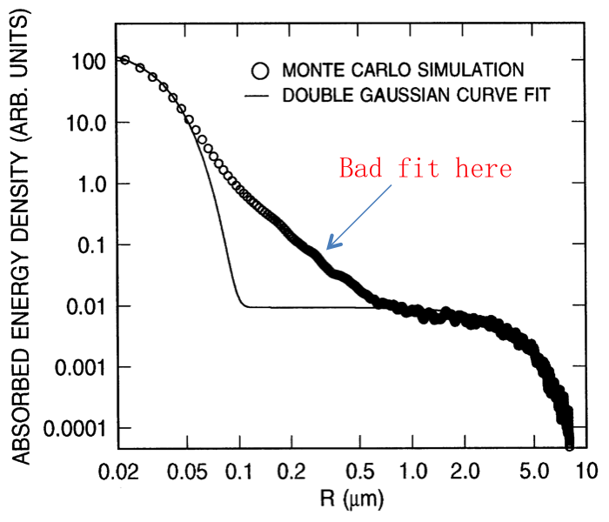
Energy Density Profile
α: range of forward scattering (in μm)
β: range of backscattering (in μm)
η: ratio of backscattering to forward
scattering
forward
scattering
backward scattering
- Energy density profile deposited in resist layer due to a point or pixel exposure.
- Approximated by the sum of two Gaussian distributions.
- Used in proximity effect correction algorithm.
Notes:
A proximity effect correction algorithm requires an accurate knowledge of the energy density profile deposited in the electron resist layer due to a point or pixel exposure (often called point spread function). This profile is often approximated by the sum of two Gaussian distributions
One distribution stands for forward scattering. The other one stands for backward scattering. In general, the energy profile depends upon depth as well as radius. By averaging out the depth dependence, a two dimensional profile can be obtained out of a three dimensional profile. There are several reasons for using this simplification. These include a greatly reduced computation time for the exposure estimation and correction, the fact that it will be difficult to determine the three dimensional profile accurately.

Slide 6
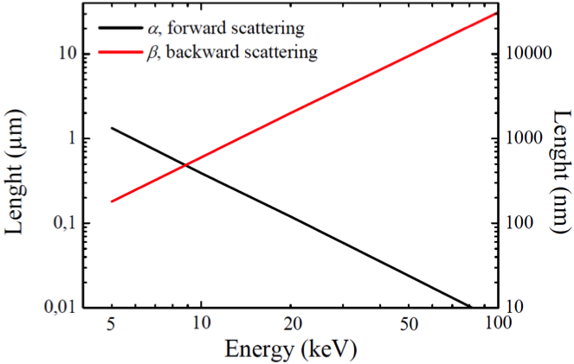
Reducing Proximity Effect
Electron beam energy & resist thickness
d_{f} is the effective beam diameter in nm
R_{t} is the resist thickness in nm
V_{b} is the beam voltage in kV
High electron beam energy
Thin resist thickness
Notes:
There are many process parameters can affect proximity effect, like electron beam energy, resist thickness, exposure time and development time. The relation between the effective beam diameter, the resist thickness and the beam voltage can be given by this empirical formula. In order to get high resolution, high electron energy should be used. The drawback using high beam energies is that the sensitivity is reduced and consequently the dose must be increased. The dose is proportional to the beam voltage, due to the increased transparency of resist layers at high voltage. Care must be taken that no damage is caused by substrate heating.

Slide 7
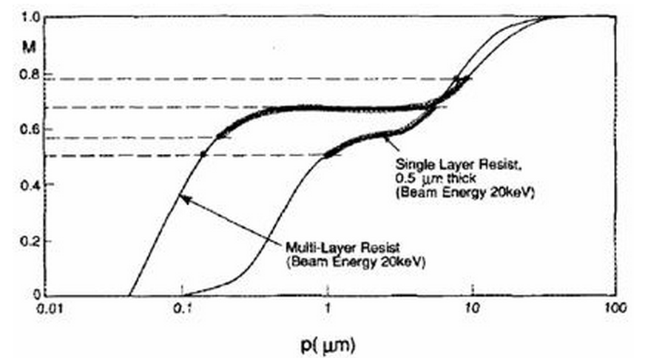
Reducing Proximity Effect
Multilayer resists
The upper layer is used for patterning.
The lower layer functions to reduce
backscattering.
the resolution increases considerably. The disadvantage is the increased process complexity.
Notes:
Multilayer resists can be used to reduce the proximity effect. Typically the upper layer is used for patterning, while the lower layer functions to reduce backscattering. This figure is modulation transfer function (MTF). This function can be obtained by Fourier transforming and normalizing the energy density profile. The resolution increases considerably by using multilayer resists. The disadvantage is the increased process complexity.

Slide 8
Proximity Effect Correction
Dose modification
Not using the same dose for the whole pattern.
Changing the dose in some parts of the pattern.
Shape modification
A single dose is use for the entire pattern.
Reducing structure size for exposure compensation.
Changing the shapes at critical points.
Background exposure correction
Writing a second exposure which is the inverse of the intended image.
Background dose is brought to a constant level.
Notes:
There are essentially three methods of proximity effect correction. Dose modification, shape modification and background exposure correction. Instead of using the same dose for the whole pattern, dose modification uses different doses for different parts of the pattern. So the problem is to determine the required dose for each pixel with a reasonable accuracy. Shape modification. In this method, a single dose is used for the entire pattern. The shapes in the pattern image are modified in a way that the developed image will resemble the intended image as close as possible. Background exposure correction works by writing a second exposure which is the inverse of the intended image. This is done in such a way that the background dose is brought to a constant level. The main advantage of this method is that it is one of the easiest proximity effect correction methods. However, the main problem is that it only provides correction to the backscattering component, where the forward scattering remains uncorrected.

Slide 9
Conclusion
Electron scattering (forward and backward) is responsible for proximity effect.
High electron beam energy should be used to obtain high resolution.
Algorithms can correct proximity effect. But there is a trade-off between speed,
complexity and accuracy.
Notes:
Electron scattering is the most challenging problem in e-beam lithography for producing very high resolution images. The physical concepts behind the electron scattering are explained. Electron scattering (forward and backward) is responsible for proximity effect. High electron beam energy should be used to obtain high resolution. Algorithms can correct proximity effect. But there is a trade-off between speed,
complexity and accuracy.

Slide 10
References
[1] http://nanolithography.gatech.edu/proximity.htm
[2] Chang, T. H. P. (1975). "Proximity effect in electron-beam lithography.”
Journal of Vacuum Science and Technology 12(6): 1271-1275.
[3] Nanofabrication: principles, capabilities and limits, by Zheng Cui
[4] G. Owen, Methods for proximity effect correction in electron lithography,
Journal of Vacuum Science Technology B, 8(6), 1889-1892, 1990

Slide 11
Thank you

