Slide 1
Liquid metal ion sources
Niloofar Sadeghi

Slide 2
What is Liquid Metal Ion Source?
“needle-type” liquid metal ion source (LMIS):
Its principle of operation is based on the formation of a liquid metal cone at the apex of a needle wetted by a film of liquid metal. The cone is maintained by the
combined action of electric field
stress, surface tension and liquid
flow.
Typical needle apex radii
are 1-1Opm.

Slide 3
What is Liquid Metal Ion Source?
“Capillary-type” liquid metal ion source (LMIS):
It employs a capillary tube filled with liquid metal, at the nozzle of which a liquid cone forms. It is from the apex of this cone, whether formed at the apex of a needle
or at the nozzle of a capillary,
that the ions are field-emitted.
Do not normally display the
stability that the needle type does

Slide 4
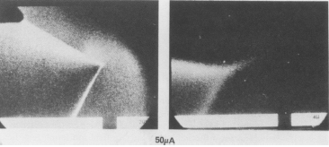
What is Liquid Metal Ion Source?
A Taylor cone is formed under the application of a strong electric field. As the cone's tip get sharper, the electric field becomes stronger, until ions are produced by field evaporation.

Slide 5
Why LMIS?

Slide 6
Operation principle of LMIS

Slide 7
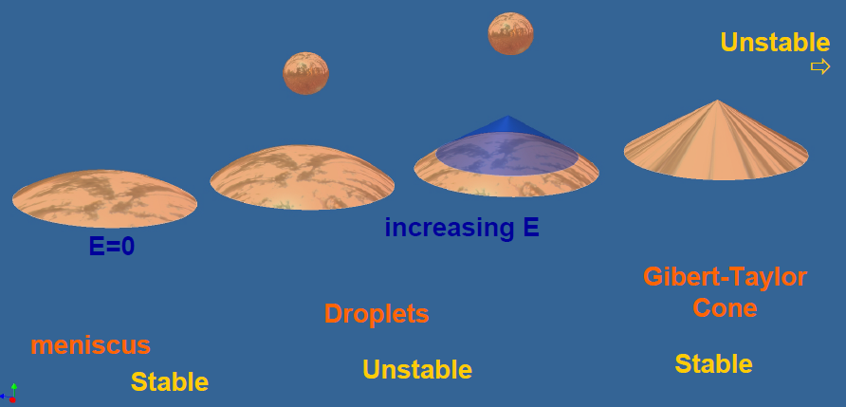
Operation principle of LMIS
Electrostatic energy and surface tension energy

Slide 8
Requirements For The Ideal LMIS
A Low Melting Temperature
Low Volatility at the Melting Temperature
High Relative Bulk Concentration of Ion Species of Interest
Low Surface Free Energy and Good Wetting
Low Solubility of Alloy in Substrate
Low Solubility of Substrate in Alloy
Favourable Mechanical, Electrical , and Vacuum Properties

Slide 9
Comparison of Various Ion Sources

Slide 10
Thank you!

