Slide 1
Effect of Accelerating Voltage on Resolution
CAMTEC Nanofabrication Workshop
Mohammadreza Sanadgol Nezami
sanadgol@uvic.ca

Slide 2
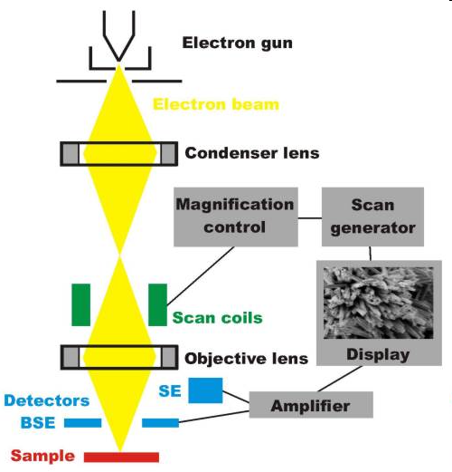
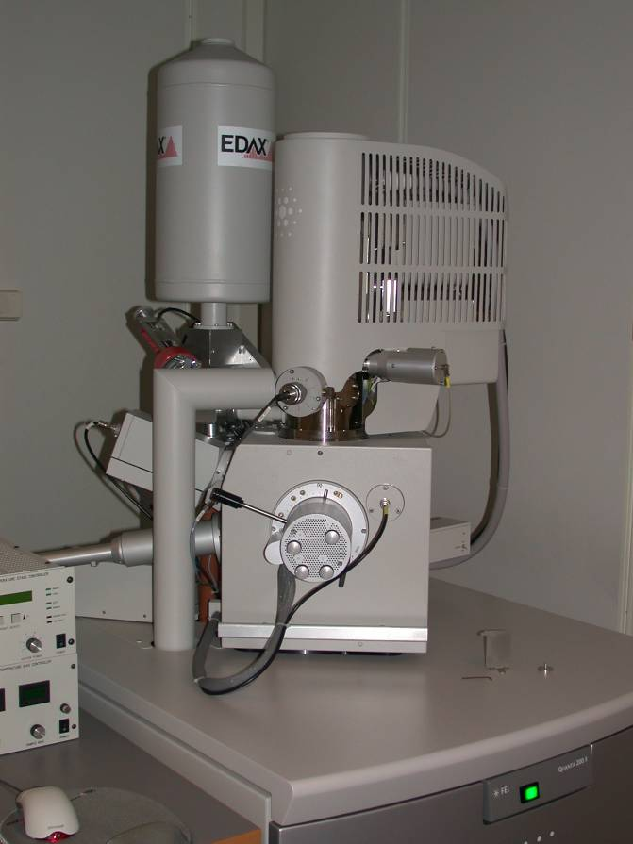
The instrument in brief
http://www.uio.no/studier/emner/matnat/fys/MENA3100/v09/lecture_notes/24february09.ppt

Slide 3
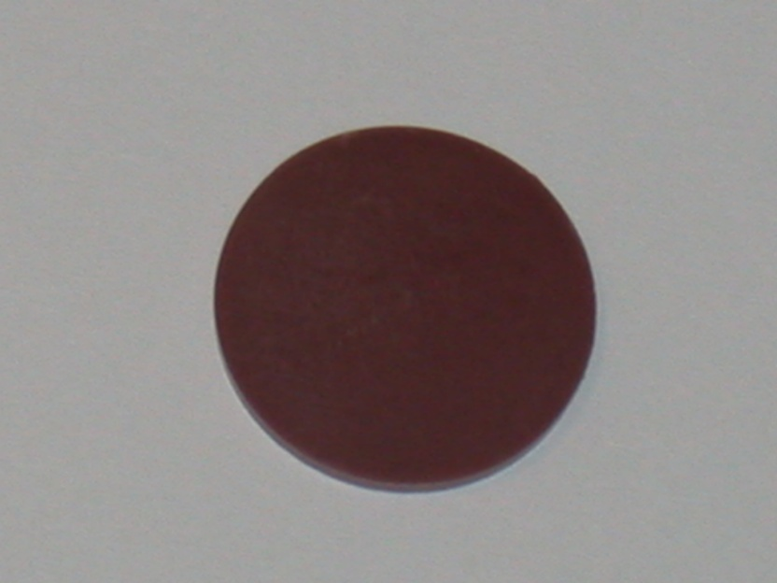
How do we get an image?
Electrons in
Electrons out
or: x-rays out
In brief: we shoot high-energy electrons and analyze the outcoming electrons/x-rays
http://www.uio.no/studier/emner/matnat/fys/MENA3100/v09/lecture_notes/24february09.ppt

Slide 4
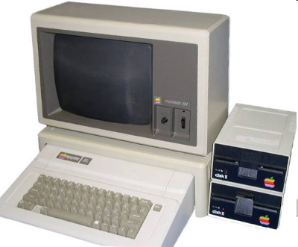
How do we get an image?
Electron gun
156 electrons!
288 electrons!
Detector
Image
http://www.uio.no/studier/emner/matnat/fys/MENA3100/v09/lecture_notes/24february09.ppt

Slide 5
Signals from the sample
Incoming electrons
Secondary electrons
Auger electrons
Backscattered
electrons
Cathodo-
luminescence (light)
X-rays
Sample
http://www.uio.no/studier/emner/matnat/fys/MENA3100/v09/lecture_notes/24february09.ppt

Slide 6
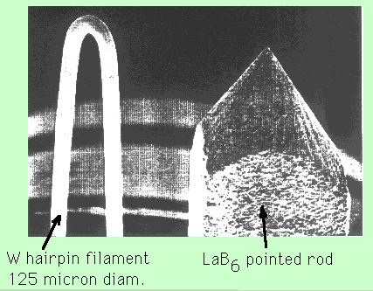
Electron gun
Electron emitter

Slide 7
λ = h/(2m_{electron}qV_{o} + q²Vo²/c²))
Effects of increasing voltage in electron gun:
Resolution increased (λ decreased)
Penetration increases
Specimen charging increases (insulators)
Specimen damage increases
Image contrast decreases

Slide 8
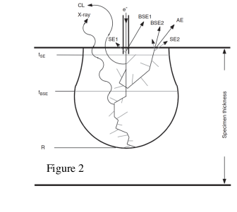
Interaction Volume
The image details and resolution in the SEM are determined not by the size of the electron probe by itself but rather by the size and characteristics of the interaction volume.
The resulting region over which the incident electrons interact with the sample is known as interaction volume.
The energy deposition rate varies rapidly throughout the interaction volume, being greatest near the beam impact point.
The interaction volume has a distinct shape
For low-atomic-number target it has distinct pear shape.
For intermediate and high-atomic number materials the shape is in the form of hemi-sphere.
The interaction volume increases with increasing incident beam energy and
decreases with increasing average atomic number of the specimen.
For secondary electrons the sampling depth is from 10 to 100 nm and diameter equals the diameter of the area emitting backscattered electrons.
BSE are emitted from much larger depths compared to SE.
Ultimately the resolution in the SEM is controlled by the size of the interaction volume.

Slide 9
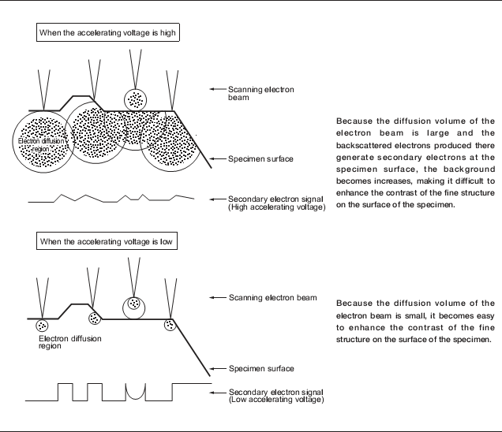
http://www.medicine.mcgill.ca/femr/SEM%20Sample%20Prep%20JEOL.pdf

Slide 10
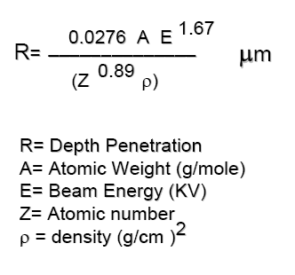
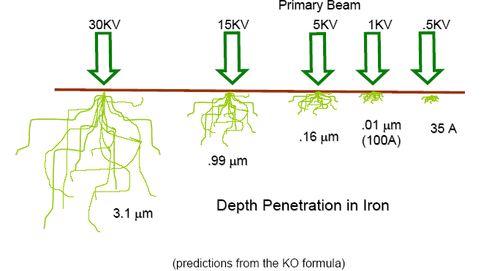
http://www.polymer.hacettepe.edu.tr/webim/msen/undergraduate/NNT602/SEM_TEM.ppt

Slide 11
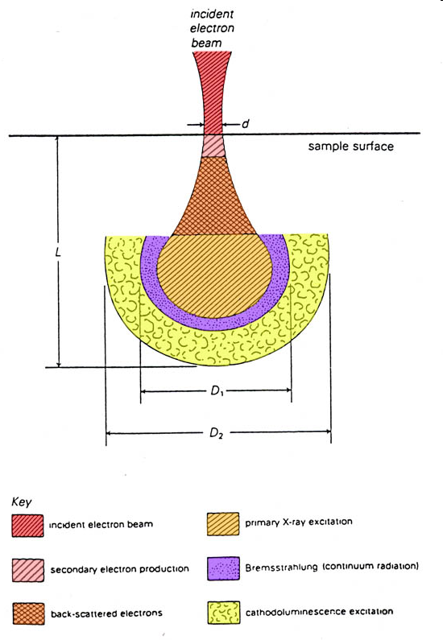
Where does the signals come from?
Diameter of the interaction volume is larger than the electron spot
→ resolution is poorer than the size of the electron spot
Image: Department of Geology and Geophysics, Louisiana State University
http://www.uio.no/studier/emner/matnat/fys/MENA3100/v09/lecture_notes/24february09.ppt0

Slide 12
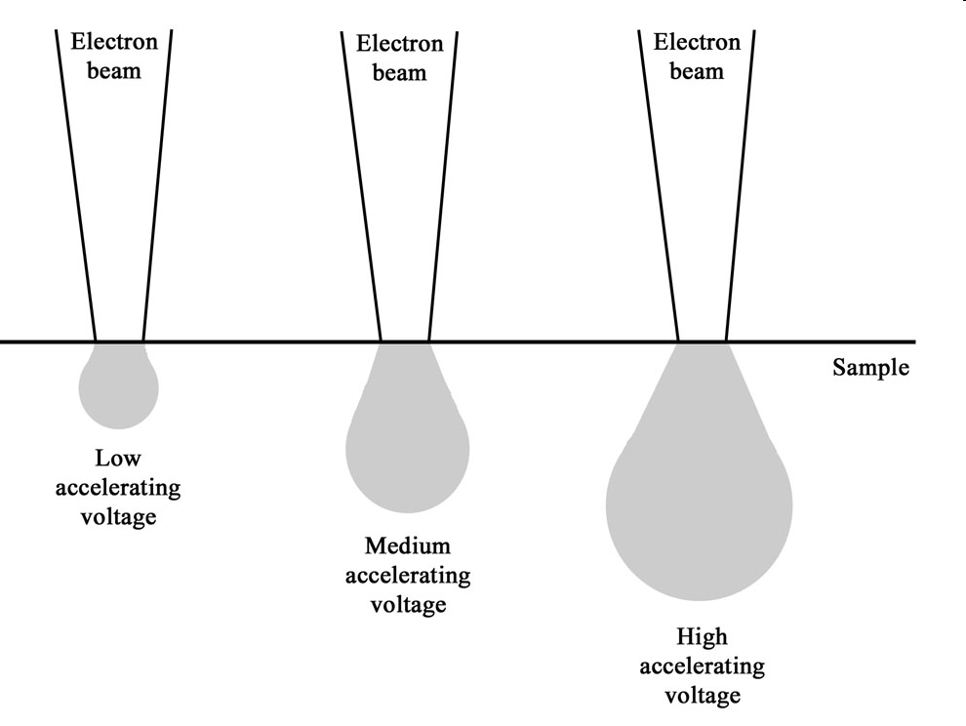
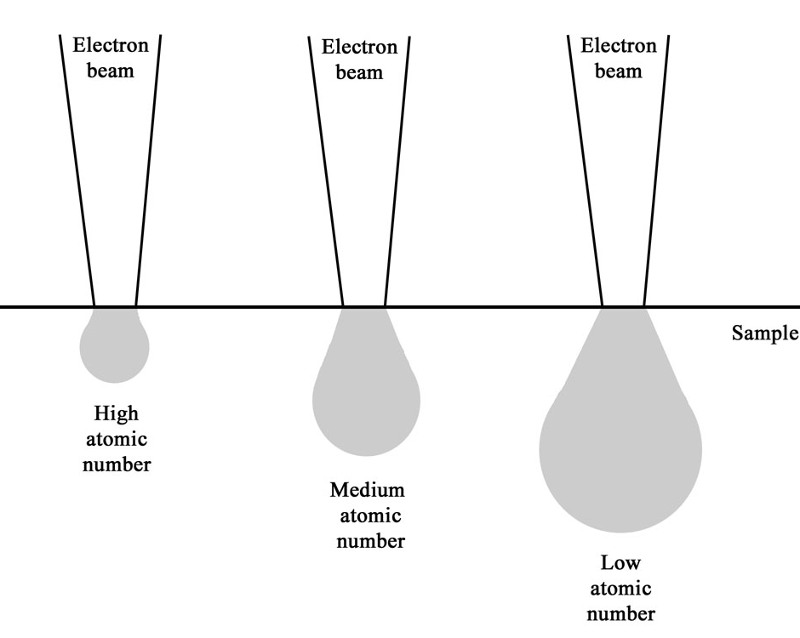
Electron beam-sample interactions
The incident electron beam is scattered in the sample, both elastically and inelastically
This gives rise to various signals that we can detect (more on that on next slide)
Interaction volume increases with increasing acceleration voltage and decreases with increasing atomic number
Images: Smith College Northampton, Massachusetts
http://www.uio.no/studier/emner/matnat/fys/MENA3100/v09/lecture_notes/24february09.ppt0

Slide 13
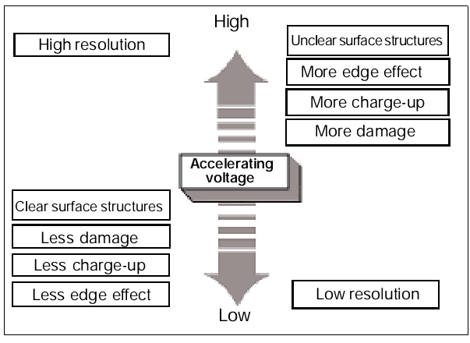
Effects of accelerating voltage

Slide 14
λ = h / (2m_{electron}qV_{o} + q²V_{o}²/c²)^{1/2}
λ = 1.22639 / (V_{o} + 0.97845 · 10⁻⁶V_{o}²)^{1/2}
λ(nm) & V_{o}(volts)
10 kV ——> 0.12 Å
100 kV ——> 0.037 Å

Slide 15
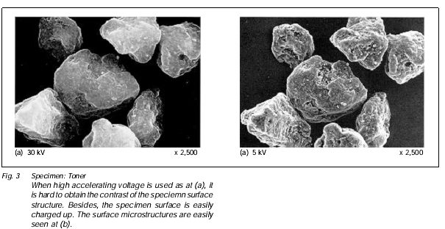
http://www.medicine.mcgill.ca/femr/SEM%20Sample%20Prep%20JEOL.pdf

Slide 16
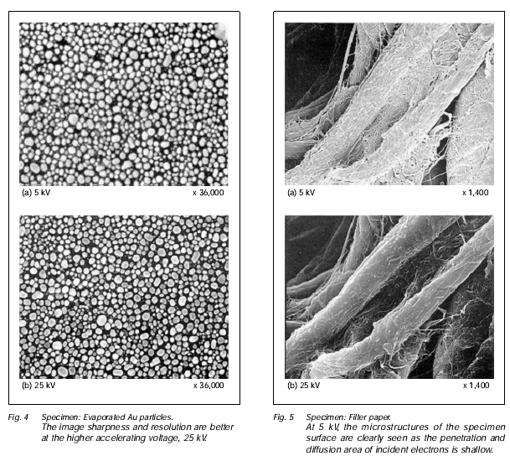

Slide 17
Thank you!

