Slide 1
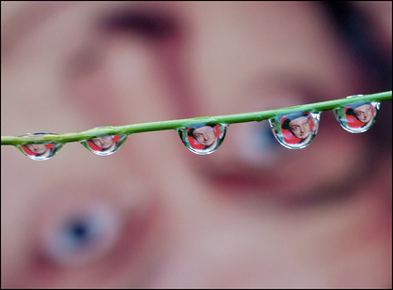

Depth of Focus/Depth of Field
Mana Norouzpour
Feb. 2014
CAMTEC workshop presentation

Slide 2
Outline:
Definitions
Depth of field (DOF)
Depth of focus(DOF’)
2. Depth of field versus depth of focus
3. Effective factors on DOF and DOF’
4. Conclusion

Slide 3
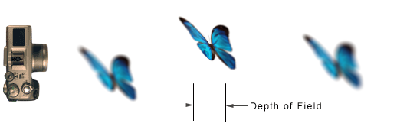
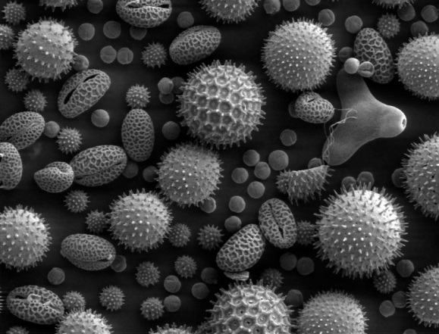
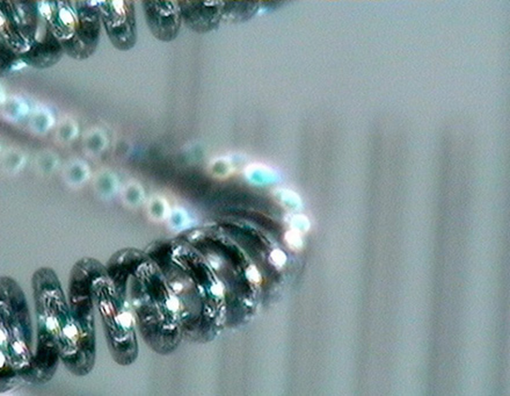
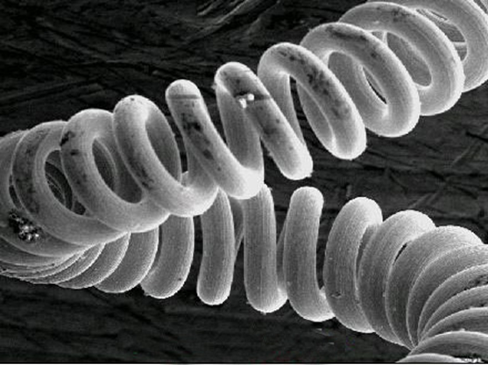
Definitions
Depth of Field (DOF): The distance between the nearest and the farthest objects in an image that appear acceptably sharp.
Depth of Focus (DOF’): The depth of focus is the distance above and below the image plane over which the image appears in focus.

Slide 4
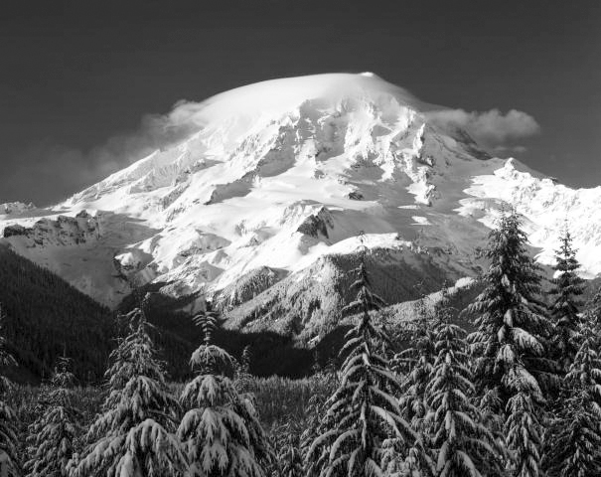

deep depth of field= everything is in focus
shallow depth of field=
subject in focus, all else out of focus

Slide 5
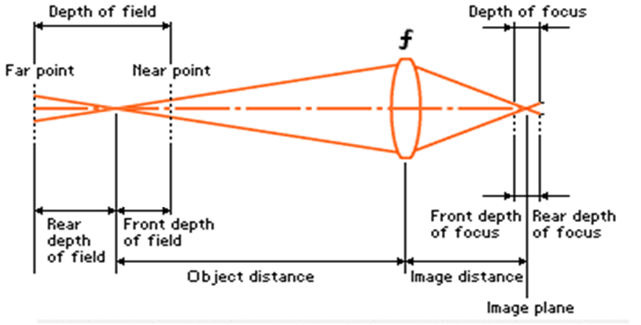
Depth of field versus depth of focus

Slide 6
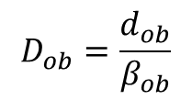
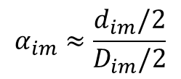
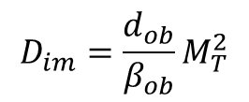
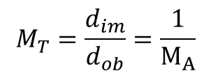
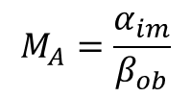
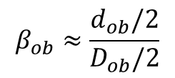
$$α_{im}≈\frac{d_{im}/2}{D_{im}/2}$$
$$β_{ob}≈\frac{d_{ob}/2}{D_{ob}/2}$$
$$M_{A}=\frac{α_{im}}{β_{ob}}$$
$$M_{T}=\frac{d_{im}}{d_{ob}}=\frac{1}{M_{A}}$$
Angular
magnification
Transverse
Magnification
= MAGNIFICATION
$$D_{im}=\frac{d_{ob}}{β_{ob}}M_{T}^{2}$$
DOF’
$$D_{ob}=\frac{d_{ob}}{β_{ob}}$$
DOF

Slide 7
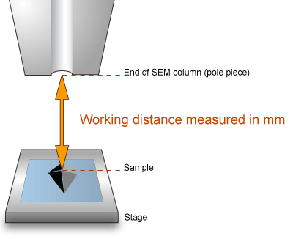
Effective factors on DOF and DOF’
Depth of field and focus will be larger when the aperture size is smaller (has side effects)
Depth of field and focus will be larger when the working distance is larger (has side effects)
Depth of focus will be higher at higher magnification
Depth of field & focus are not affected by the nature
of the sample
largest working distance and smallest aperture size are not best choices to enhance the DOF and DOF’ (both have side effects)

Slide 8
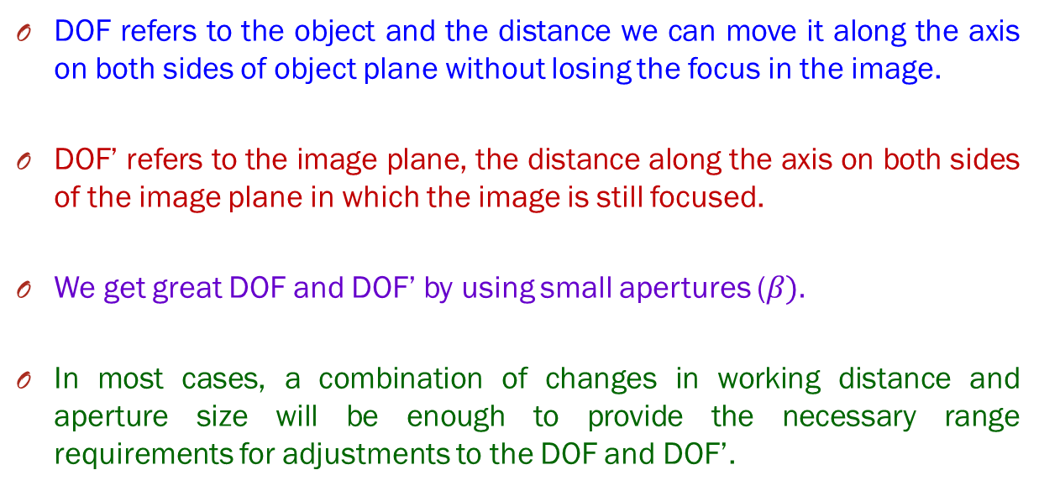
Conclusion
DOF refers to the object and the distance we can move it along the axis on both sides of object plane without losing the focus in the image.
DOF’ refers to the image plane, the distance along the axis on both sides of the image plane in which the image is still focused.
We get great DOF and DOF’ by using small apertures ($β).$
In most cases, a combination of changes in working distance and aperture size will be enough to provide the necessary range requirements for adjustments to the DOF and DOF’.

Slide 9

Thanks for your attention

