Slide 1
Turbo Pumps
Julia Bobak
Nanofab Workshop
February 11, 2014

Slide 2
Outline
Turbo and turbomolecular pumps
Vacuum pump comparisons
History
Design
Operational considerations
Applications

Slide 3
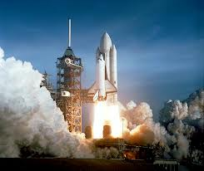
A quick definition to start
Turbo vs. turbomolecular pumps
Turbomolecular pump: high vacuum pump
Turbo pump: propellant pump
The space shuttle’s main turbo pump delivers 150 lb of liquid hydrogen and 896 lb of liquid oxygen to the engine per second.

Slide 4
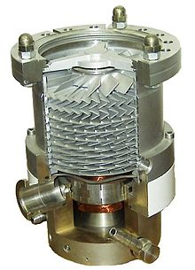
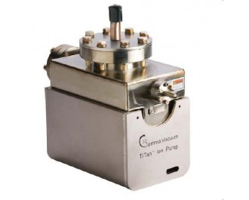
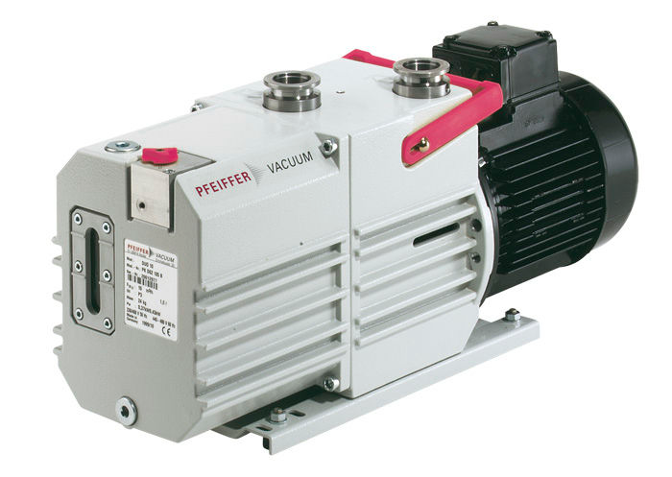
Pump comparison
To achieve ultra high vacuum, we usually rely on a series of three pumps:
Rotary pump ( ~ 10⁻⁴ Torr)
Invented by Charles C. Barnes of New Brunswick!
Turbopump (~ 10⁻³ – 10⁻⁷ Torr)
Ion pump (~ 10⁻⁶ – 10⁻¹¹ Torr)

Slide 5
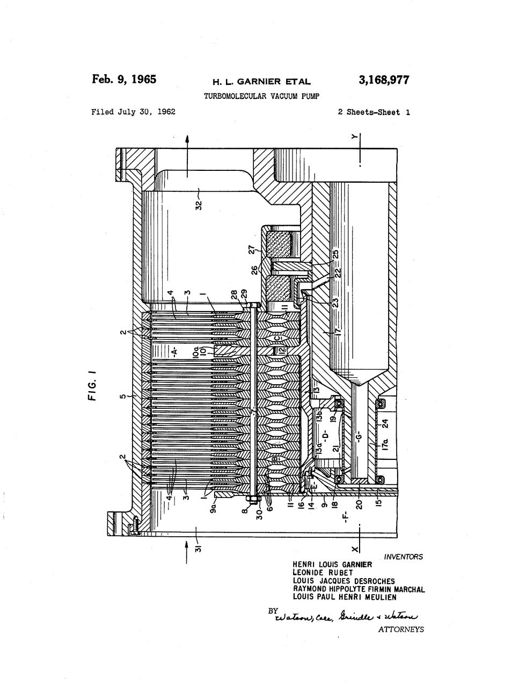
History
First developed and patented at Pfeiffer Vacuum by Dr. W. Becker.
Became commercially available in 1957.
Before that, there were molecular drag pumps, which had a tendency to mechanical seizure.

Slide 6
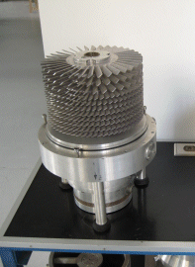
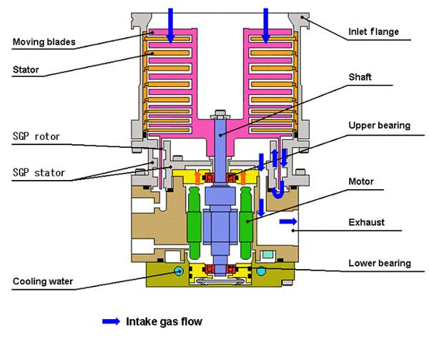
Design
Bearings: can be oil lubricated or, more often now, magnetically levitated.

Slide 7
Operation
The rotor blades spin around at up to 90,000 rpm
When then hit gas molecules in the chamber they impart momentum
The angles of the rotor and stator blades drives the gas molecules towards the exhaust
Inlet
Rotor
Net gas flow
Stator
Outlet

Slide 8
Operating criteria
At atmospheric pressure, the behaviour of gases is described as “viscous flow”.
The gas molecules move in bulk and interact more with each other than with the walls of the container.
Most turbopumps will not work in this case because the momentum imparted by the rotors is insignificant compared with intermolecular interactions.
A roughing pump is used to get the pressure down to ~10⁻³ Torr
In this regime, gas molecules behave approximately independently. This is described as “molecular flow”.
Now the turbopump can impart momentum on each molecule individually.

Slide 9
Limiting factors
A turbopump alone is insufficient to achieve ultra high vacuum
At a certain point the pressure will cease dropping due to…
1. Desorption of materials from seals and bearings, which increases at lower pressures.
2. Leaks through the seals, which are also enhanced at low pressure.
3. Reaching maximum compression ratio.
K = P_{outlet}/P_{intake}
K_{max} = {exp[(v_{B}M^{1/2})/(2k_{B}N_{A}T)1/2]f_{(Φ)}}^{n}
v_{B} = velocity of the blades
M = molar mass of the gas
T = temperature
f_{(Φ)} = function of blade angle
n = number of blades
Notes:
Vacuum Physics and Techniques” by T.A. Delchar

Slide 10
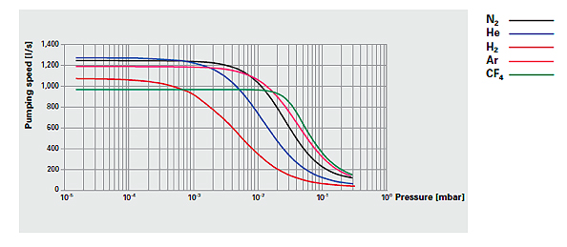
Pumping speed vs. pressure
Different gases pump down at different rates
Compression ratio varies exponentially with molecular weight of gases

Slide 11
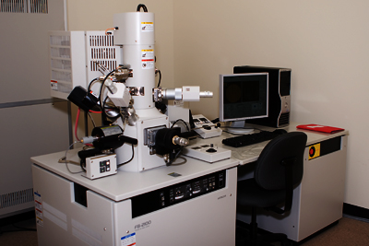
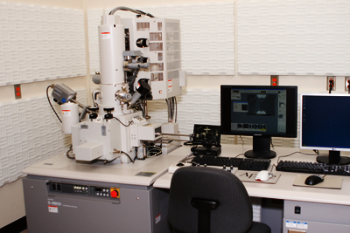
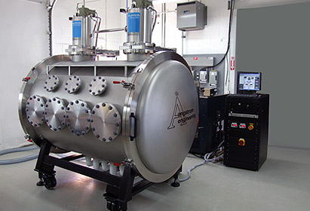
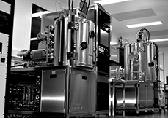
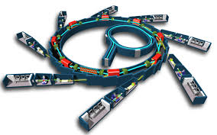
Applications
Focused ion beam system
Scanning electron microscope
Space simulators
Thin film deposition
Synchrotrons

Slide 12
Questions
References:
T.A. Delchar. Vacuum Physics and Techniques, (Chapman & Hall, 1993).
Pfeiffer Vaccum. Working with Turbopumps: Introduction to high and ultra high vacuum production. http://www.pfeiffer-vacuum.com.
Weissler, G.L. & Carlson, W.R., eds. Vacuum Physics and Technology, (Academic Press, 1908).

