Slide 1
Factors affecting the Depth of Field for SEM
Camtec workshop 2014
Aiko Kurimoto

Slide 2
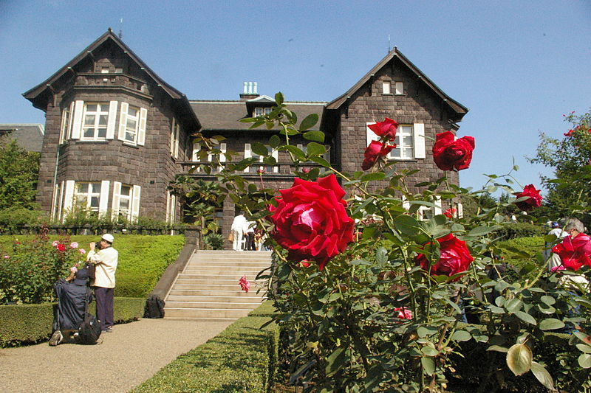
Definition of Depth of Field
Depth of Field (DOF)
Distance between the nearest and farthest objects in a scene that appear acceptably sharp in an image.
Shallow DOF
Deep DOF

Slide 3
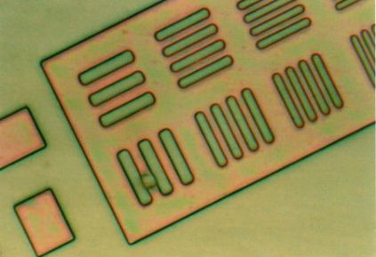
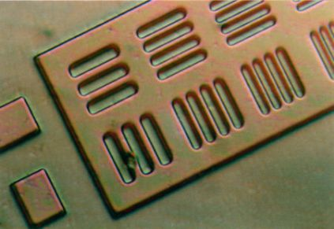
DOF for SEM
Usually great DOF
This makes it possible to examine much rougher, and much higher magnifications, than is possible with optical microscopes.
Shallow DOF
Deep DOF

Slide 4
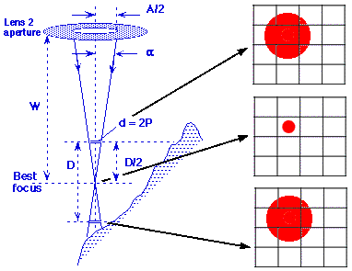
Practical expression of DOF
$DOF≈\frac{0.2}{αM}in mm$
α = the beam divergence
M = Magnification
Since $α=\frac{A/2}{W}$
W = working distance between the lens and the specimen in mm.
A = the aperture diameter.
$DOF≈\frac{4×{10}^{5}W}{AM}in μm$

Slide 5
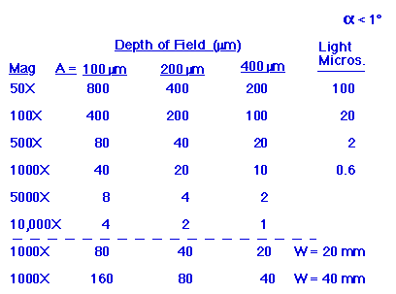
Determination of DOF
$DOF≈\frac{4×{10}^{5}W}{AM}in μm$
W = working distance between the lens and the specimen in mm.
A = the aperture diameter.
M = Magnification
In order to increase DOF,
Increase the distance W
Decrease the size of A
Decrease the magnification M

Slide 6
DECREASE APPERTURE SIZE
An increase DOF
A decrease the probe current and a concomitant decrease in S/N
Possible improvement in the probe size and resolution
Change in astigmatism (needs to be corrected again)

Slide 7
INCREASE WORKING DISTANCE
An increase DOF
Lower attainable limits for low magnification work
An increase probe size and thus less sharp but smoother image in appearance
A possible decrease of signal strength (depending on stage tilt and detector position)
Astigmatism will worsen at long W

Slide 8
CONCLUSION
In order to increase DOF,
Increase the distance W
Decrease the size of A
Decrease the magnification M
However, an increase DOF involves some trade-offs. In order to obtain the best DOF, it is necessary to determine best combinations of the working distance, the aperture size and the magnification.

