Slide 1
Contrast Properties of Electron Beam Resist
Ahmed Al Balushi

Slide 2
Overview
Resist materials
Sensitivity
Contrast
Development curves
Resist contrast
Conclusion
Q&A

Slide 3
Resist Materials
Important properties of resist are:
Sensitivity
Contrast
Linked to resolution capability of resist

Slide 4
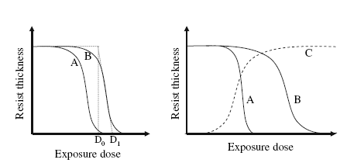
Sensitivity and contrast are derived from a resist development curves
Resist A has higher contrast
Resist A has higher sensitivity

Slide 5
Development Curves
development curves, also called contrast curves, are obtained by exposure and development of a series of large square patterns with different exposure doses
The remaining resist thickness is measured against the exposure dose, which generates the development curves

Slide 6
Resist Contrast
Resist contrast is defined by the slope of a development curve and expressed as:
where
D₁ is the exposure dose at which the resist is fully exposed
D₀ is the exposure dose at which the resist starts to be exposed
The steeper the slope, the higher the resist contrast

Slide 7
Resist Contrast
The steeper the slope is, the higher the resist contrast.
Resist contrast is an inherent property of a resist material. However, development conditions can have some influence on it.

Slide 8
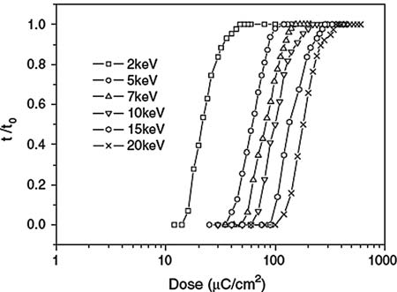
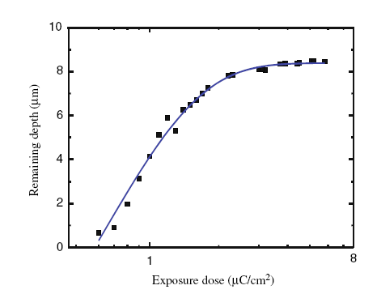
Development curves of HSQ negative-tone resist exposed at different e-beam energies
Contrast curve of SU-8 resist

Slide 9
Resist contrast
By the appearance of contrast curves of these two resists, one can immediately tell that the HSQ resist has higher contrast.
The contrast of negative-tone resist HSQ is 2.8
Another negative-tone resist, SU-8, has a contrast of only 0.92, as measured from contrast curve shown in the figure

Slide 10
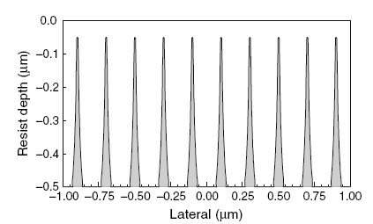
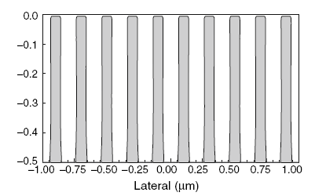
Resist Contrast
Apart from measuring the slope of resist contrast curves, another direct way of judging the resist contrast is to observe the resist profile after development.
High contrast resist

Slide 11
Resist contrast
High contrast is always desirable because:
It enables resist profiles after development to have vertical sidewalls and high aspect ratios
Facilitate pattern transfer
Enable lithography of high density patterns

Slide 12
Thank You Q&A

