Slide 1


TO FISH AS FORMERLY
A STORY OF STRAITS SALISH RESURGENCE
Reef Net (2020) Chris Paul
TEACHER’S GUIDE
Fall 2020

Slide 2
Territory Acknowledgment
The University of Victoria Legacy Art Galleries acknowledges with respect the Lekwungen peoples on whose traditional territory the university stands and the Songhees, Esquimalt, and WSÁNEĆ peoples whose historical relationships with the land continue to this day.
Notes:
Include the territory acknowledgement for your school or one that you have developed here.

Slide 3
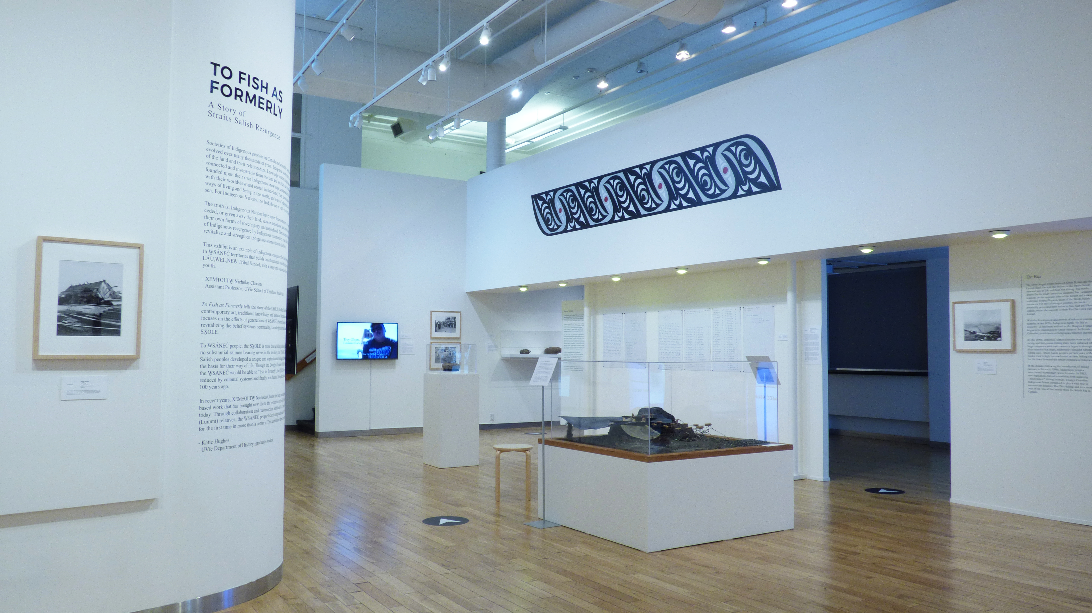
Image 1: To Fish as Formerly Installation view, 2020.
Notes:
Discuss
To Fish as Formerly: A Story of Straits Salish Resurgence shares the story of the
SXOLE (Reef Net Fishery) through contemporary art, traditional knowledge and historical documentation.
The name of the exhibition comes from the Douglas Treaties of 1852,
which stated that the WSÁNEĆ would be able to “fish as formerly”.
However, the SXOLE was systematically reduced by colonial systems for the next
50 years and finally was banned altogether in Canada in the early 19th Century.
The exhibition shares the story of generations of WSÁNEĆ people who are revitalizing
the practices, beliefs, ceremony, and knowledge inherent to the SXOLE.

Slide 4
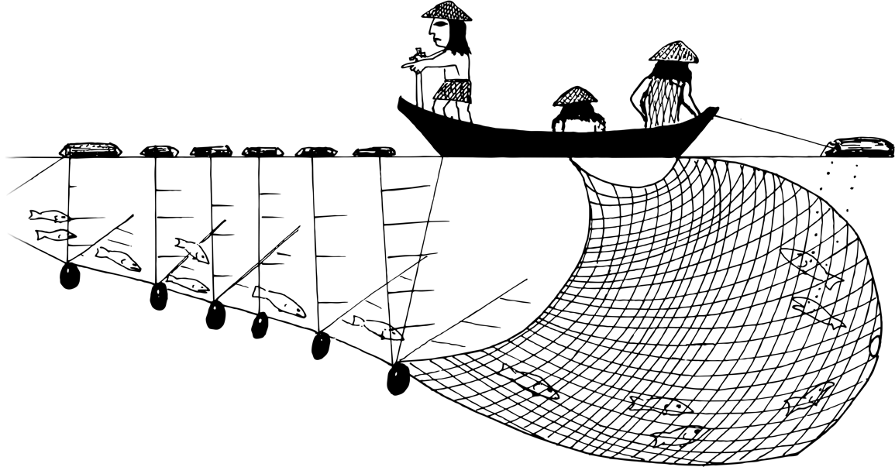
Introduction to the SXOLE – Reef Net
The SXOLE is unique to Straits Salish peoples.
Only a few communities have knowledge of the SXOLE.
The Reef Net ban greatly affected Straits Salish peoples. They have worked hard to keep the knowledge of the SXOLE alive.
Image 2: Reef Net illustration from Reef Net Technology of the Saltwater People, John Elliott, 1994.
Notes:
Discuss
The SXOLE is unique to the Straits Salish peoples and an important part of their cultural identity.
Unlike neighbouring Coast Salish lands, no major salmon-bearing rivers pass through Straits Salish territories.
Instead, Straits Salish peoples developed the sophisticated Reef Net technology that required a deep knowledge of salmon migration routes and ocean currents.
Straits Salish peoples harvested salmon for thousands of years by intercepting them in the Salish Sea before they could return to large salmon spawning regions like the Fraser River.
Only a few Straits Salish communities have the knowledge of the SXOLE. This includes the Lekwungen peoples, Songhees and Xwespsum (Esquimalt), on whose traditional territories the To Fish as Formerly exhibition stands, the Sc’ianew (Beecher Bay), T’souke, Malahat, Semiahmoo, Xwelemi (Lummi), and WSÁNEĆ (Saanich). There are four nations that make up the WSÁNEĆ people: Tsawout, Tsartlip, Puaquachin, and Tseycum.
When the Reef Net Fishery bans were enacted in the early 19th century, only 50 years after fishing rights were guaranteed in the Douglas Treaties,
Straits Salish peoples were cut off from their homelands, waters, and resources.
This act compounded the loss of language, culture, and identity that many nations were already experiencing.
Since then, generations of Straits Salish people have worked to keep the knowledge of the SXOLE alive and to return to Reef Netting once again.
For the Straits Salish people, revitalizing the Reef Net is about so much more than fishing.
The SXOLE forms the basis for the worldview of Straits Salish peoples like the WSÁNEĆ and Xwelemi.
We acknowledge that there are many other Straits Salish histories of the Reef Net Fishery that have yet to be told.
The exhibition and this guide draw primarily from WSÁNEĆ perspectives.

Slide 5
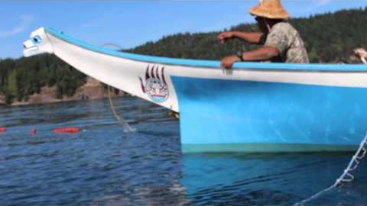
Notes:
Step 1: Introduction to the Video
(5 minutes and 35 seconds)
The following video is about how Nick Claxton works with his community to revitalize the knowledge of the SXOLE.
Dr. Nick XEMŦOLTW Claxton is WSÁNEĆ and Chief of the Tsawout First Nation. He was named ȻWENÁLYEN, or Reef Net Captain through ceremony and led the first fishing of the SXOLE in Canadian waters since it was banned over 100 years ago.
When students watch the video, ask them to pay special attention to how the community works together and how everyone has a role to play.
https://www.youtube.com/watch?v=vTQk1IR9ibc

Slide 6
Respond
What are some of the ways the WSÁNEĆ people are bringing back the SXOLE?
Cultural revitalization is the process through which people regain a sense of identity through connecting with their culture. How do you see cultural revitalization happening in the video?
Why are the WSÁNEĆ people called the Saltwater People?
In the video, we see people of all ages coming together to revitalize the SXOLE. Why is it important for Nick to include all members of the community?
Notes:
Discuss these questions as a class or in small groups.

Slide 7
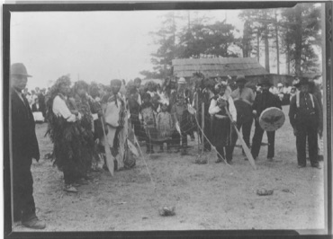
Lesson 1: Revitalization and Community
Image 3: Xwelemi Men with a Ceremonial Reef Net Model, Net Weights, Paddles and Drums at Village Point, Lummi Island, L.R. Corbertt, 1915.
Notes:
This photograph shows Xwelemi people with a ceremonial Reef Net model, net weights, paddles and drums at Lummi Island in 1915.
Ceremony is an important component of the SXOLE. Notice how Xwelemi community members of all ages are taking part in the ceremony.
Discuss
One aspect of cultural revitalization is learning together as a community, where everyone can share their knowledge and learn from each other.
The Xwelemi, who live in what is now Washington State across the Strait of Georgia, have helped the WSÁNEĆ relearn the teachings of the Reef Net. This has been an important part of the Reef Net revitalization process for the WSÁNEĆ peoples.
Ask students to think of an activity they participate in that connects them to their family or friends.
It might be a game or sport they play, an event they attend with family, or a special meal they make with a parent.

Slide 8
Community Activity
Who participates in your activity?
What have you learned by taking part in your activity?
What makes this activity special for you and your community?
Did you learn anything new about your partner today?
Notes:
Create and Share
Ask students to think of an activity they participate in that connects them to their family or friends.
It might be a game or sport they play, an event they attend with family, or a special meal they make with a parent.
Have students draw a picture of their activity that includes the lessons it teaches.
Then, ask each student to show their drawings to a partner and to share their teachings.
Prompt students to reflect on the importance of their chosen activity to their identity as individuals and as part of a community.

Slide 9
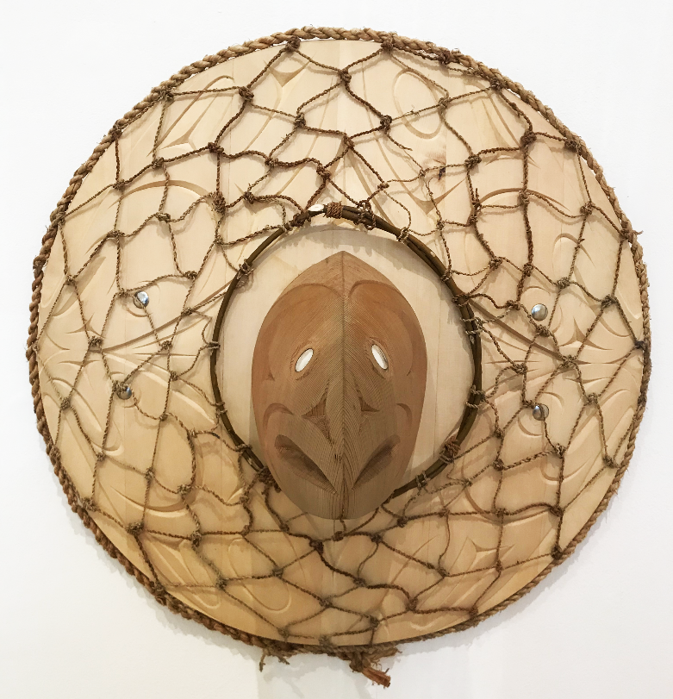
Lesson 2: Conservation and Connection to the Land through Art
Image 4: SHELIS – Life, Temoseng aka Chasz Elliott, 2020.
Notes:
Discuss
Conservation is built into WSÁNEĆ culture.
Salmon are provided the same respect that WSÁNEĆ people provide to each other, and are a symbol of abundance and prosperity.
When the Straits Salish people designed the Reef Net, they had the wellbeing of the salmon in mind so they built a hole in the net, called a SHELIS, that allows some salmon to escape capture.
These salmon can keep swimming up to their home rivers and spawn, so salmon keep returning to Straits Salish territory year after year.
They also took care of the water where they caught the salmon each year.
Each family’s SWÁLET, or Reef Net Fishing site, was cared for and passed down through generations.
These practices demonstrate how the values of conservation and respect are incorporated into the practice of Reef Net Fishing so the people could continue to catch fish every year and the salmon could continue to thrive.
Chasz Elliott, also known as Temoseng, is an emerging WSÁNEĆ and Lekwungen artist from Tsartlip. He is inspired by the SHELIS and included this in his artwork called SHELIS – Life.

Slide 10
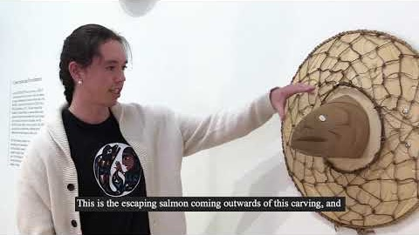
Notes:
Watch
Before watching the video, ask students to pay attention to when Chasz talks about conservation and the importance of the SHELIS.
https://www.youtube.com/watch?v=simwd0GBc5I&feature=youtu.be

Slide 11
Respond
What did Chasz learn while creating his artwork?
What did Chasz say is the most important part of the SXOLE?
What are some of the materials that Chasz’s artwork is made from? Why does Chasz say these materials are important?
What does SHELIS mean? Why did the WSÁNEĆ people build a SHELIS in their Reef Nets?
Notes:
Discuss these questions as a class or in small groups.

Slide 12
Lesson 3: Honouring the Salmon
Circle
Crescent
Trigon
Oval
Extended Crescent
Image 5: Coast Salish Design Elements
Notes:
Discuss
The trigon, crescent, circle, oval, and the extended crescent are shapes that are used in traditional and contemporary Salish art.
Salish artists use positive and negative space to create images and tell stories through their art.
Historically, Coast Salish design elements were carved into wood and can be found on traditional tools like spindle whorls and canoe paddles.
Today, artists often incorporate these design elements into prints and paintings.

Slide 13

How many salmon do you see?
What Coast Salish design elements do you see?
What else do you see?
How many circles do you see? Ovals? Trigons?
Image 6: Dylan Thomas, Net Work, 2018.
Notes:
Salish artists today use the Coast Salish design elements.
In his artwork, Dylan Thomas uses traditional Coast Salish design elements to create a row of salmon.
Salmon were one of the main food sources for people who live on the coast, and Dylan’s design honours the salmon as a symbol of abundance and prosperity. Capturing salmon with the SXOLE involves a great amount of cooperation between fishers, families, and different nations.
In Net Work, Dylan shows the necessity of cooperation by representing the salmon as interlinked.
Ask students to answer the questions about the Coast Salish design elements visible in Net Work.

Slide 14
Create a Salmon
Notes:
Tell students that they are going to honour the salmon by creating their own salmon using the Coast Salish design elements.
There are two options for making a salmon. More information about these options can be found on page 11 of the Reef Net Teacher’s Guide document.
Students may reference Dylan Thomas’s work, but should create an original piece.

Slide 15
Respond
What was your favourite part of using the circle, oval, crescent, and trigon shapes?
Did this activity make you think differently about the salmon?
Did you encounter any challenges when using the design elements?
How did you like working with the Coast Salish design elements to create a salmon?
Notes:
Prompt students to reflect on their experience working with Coast Salish design elements to create a salmon with the following questions.

Slide 16
To Fish as Formerly is open until November 21st at the Legacy Art Galleries Downtown

Slide 17
Media References
Cecil, Holly. To Fish as Formerly installation view. 2020. University of Victoria Legacy Art Galleries, Victoria, B.C.
Elliott, John. Reef Net illustration. 1994. Saanich Indian School Board, Brentwood Bay, B.C.
Amy Becker and Sarah Marie Wiebe. “To Fish As Formerly: WSÁNEĆ Nation Brings Reef Net Fishing Back After 100 Years.” YouTube, 11 Oct. 2014, https://youtu.be/vTQk1IR9ibc.
Corbertt, L.R. Xwelemi Men with a Ceremonial Reef Net Model, Net Weights, Paddles and Drums at Village Point, Lummi Island. 1915. Center for Pacific Northwest Studies, Western Libraries Heritage Resources, Western Washington University, WA.
Cecil, Holly. SHELIS – Life installation view. 2020. University of Victoria Legacy Art Galleries, Victoria, B.C.
University of Victoria Legacy Art Galleries. “To Fish as Formerly | Artist Interview – Temoseng aka Chasz Elliott.” YouTube, 11 Sept. 2020, https://youtu.be/simwd0GBc5I.
Thomas, Dylan. Net Work. 2018.

