Slide 1
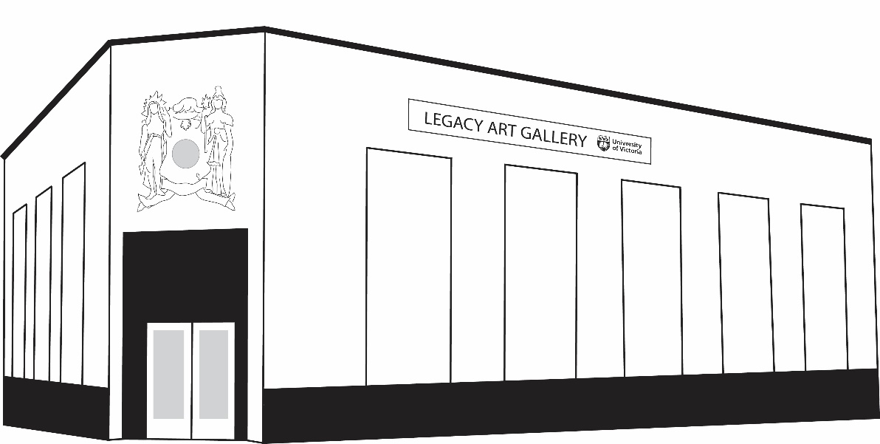
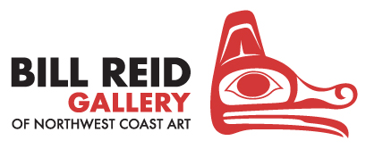

UVic Legacy Art Galleries
Teachers Guide for Body Language: Reawakening Cultural Tattooing of the Northwest

Slide 2
UVic Legacy Art Galleries
Teachers Guide for Body Language: Reawakening Cultural Tattooing of the Northwest
3
5
6
7
10
11
12
16
17
Learning Objectives
Territory Acknowledgement
About the Exhibition
Meet the Curator
Indigenous Tattooing Traditions
Cultural Erasure in Canada
Cultural Reawakening
Self Reflection Activity
Additional Resources
CONTENTS

Slide 3
This guide was created to support teacher and student engagement with Body Language: Reawakening the Cultural Tattooing of the Northwest.
  Learning Objectives
  Learn about historical and cultural tattooing from an Indigenous perspective
  Recognize and understand the impacts of colonialism on Indigenous communities in British Columbia
  Reflect on the relationship between identity, belonging, and wellbeing
LEARNING OBJECTIVES
Notes:
EDUCATOR NOTE
The presentation and class activities will take approximately 90 minutes.
Look for EDUCATOR NOTES on slides to provide you with artist quotes and background information to share with your class
Look for DISCUSSION QUESTIONS on slides to prompt classroom discussion. Will include time estimate.

Slide 4
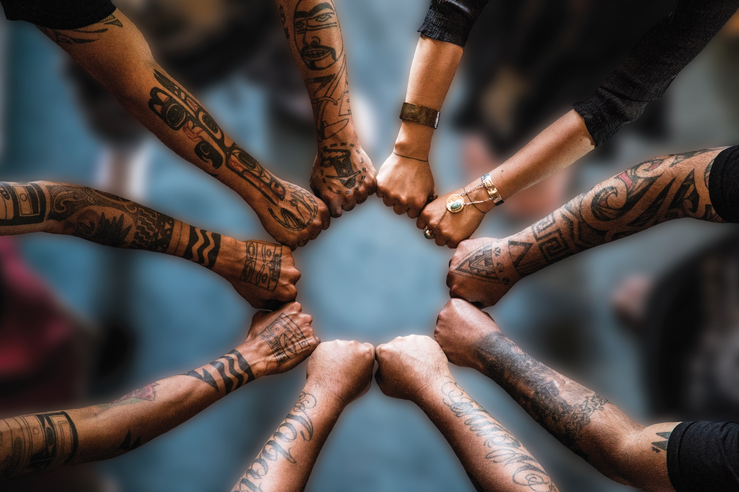
Body Language:
Reawakening Cultural
Tattooing of the Northwest
Notes:
EDUCATOR NOTE
Learn about historical and cultural tattooing from an Indigenous perspective
Recognize and understand the impacts of colonialism on Indigenous communities in British Columbia
Reflect on the relationship between identity, belonging, and wellbeing
Read the following introduction to your students: We are going to look at some of the photos in the Body Language exhibition at Legacy Art Gallery and discuss some of the ideas that the artists in this exhibition want to communicate through their work. We will also watch a short film called This Ink Runs Deep by a young Cree-Métis filmmaker, named Asia Youngman, where we will hear Indigenous artists talk about reawakening their cultural traditions.

Slide 5
The University of Victoria Legacy Art Galleries acknowledges and respects the Lekwungen peoples on whose traditional territory the university stands and the Songhees, Esquimalt, and WSÁNEĆ peoples whose historical relationships with the land continue to this day.
To start the lesson, please create your own territory acknowledgement based on where your school is located.
TERRITORY
ACKNOWLEDGEMENT
Notes:
EDUCATOR NOTE
Read the University of Victoria’s territory acknowledgement from the slide.
If your school does not have a territory acknowledgement, you can follow this guide to develop one for your class: https://www.amnesty.ca/blog/activism-skills-land-and-territory-acknowledgement/

Slide 6
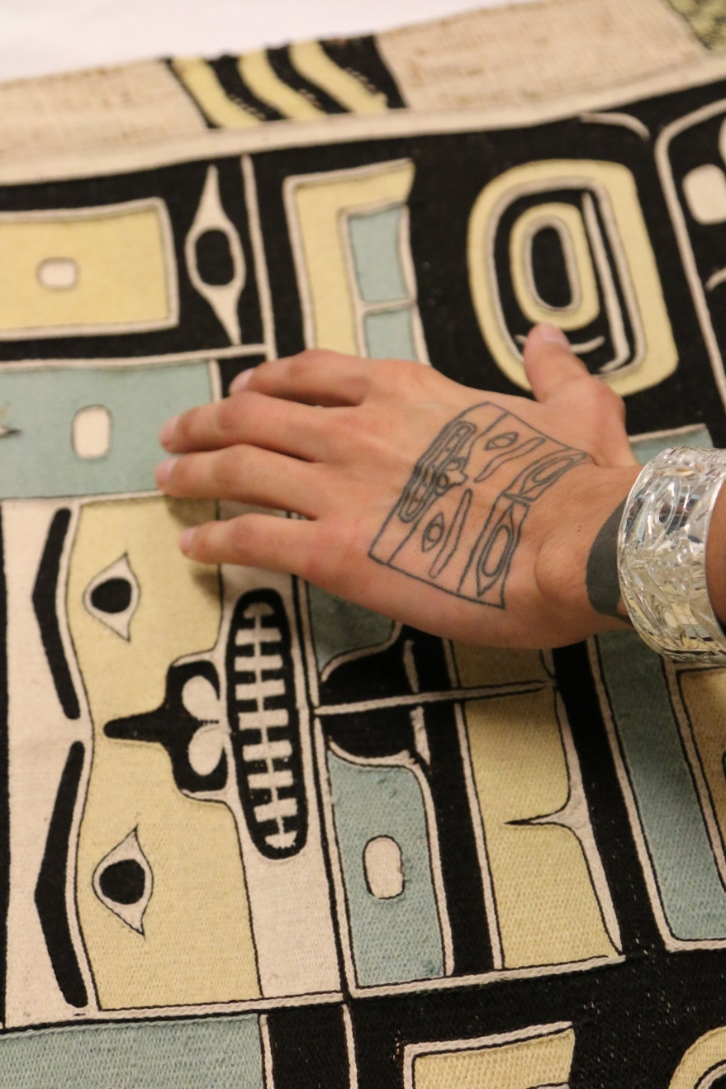
Body Language traces the history and meaning of traditional Indigenous tattooing and piercing practices and explores their contemporary revival through the work of 5 artists who have been at the forefront of this cultural reawakening.
ABOUT THE
EXHIBITION
Chilkat All Over by Dion Kaszas, 2017.
Notes:
EDUCATOR NOTE
Read the text on the slide to your students.
Discuss the term Cultural reawakening: the the act of reclaiming or recovering cultural traditions and practices that were threatened by colonization.
Ask students what they notice about the image on the slide.
Provide students with more information about the image: This photograph was taken at the Burke Museum of Natural History and Culture in Seattle. It shows a tattooed hand hovering over a Chilkat woven shirt in the museum’s collection. Notice the similarities between the design of the tattoo and the design on the shirt.

Slide 7
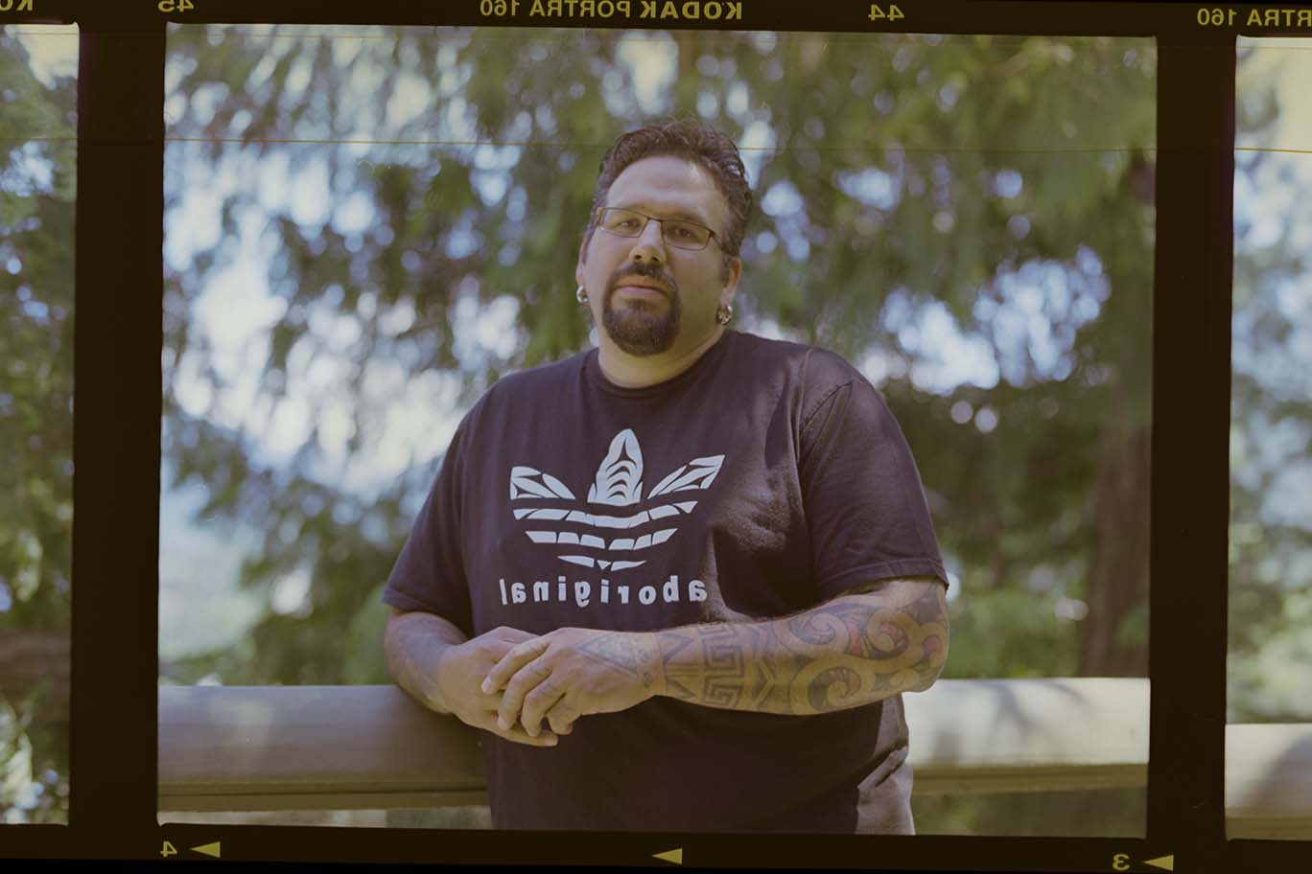
ABOUT THE CURATOR
ABOUT THE
CURATOR
Dion Kaszas is a Hungarian, Metis and Nlaka’pamux artist. He is the co-founder of the Earthline Tattoo Collective and has mentored many Indigenous tattoo artists who are reconnecting with their tattoo traditions.
Photo credit: Aaron Leon, 2015.
Notes:
EDUCATOR NOTE
Read the text on the slide to your students
With your students practice pronouncing Nlaka’pamux: “Ing-Khla-Kap-Muh”.

Slide 8
Dion says:
“Our tattooing traditions transcend mere decoration to provide healing, protection, and a profound sense of cultural knowledge and belonging.
The revival of our tattooing traditions affirms our identity, sends messages of empowerment, and stitches together our history with our contemporary existence. Our tattoos are a permanent reminder that we belong to something bigger than ourselves.”
Notes:
DISCUSSION QUESTIONS
Why is it important for Indigenous artists to revive their tattooing traditions?
How do you think tattooing provides healing and protection?

Slide 9
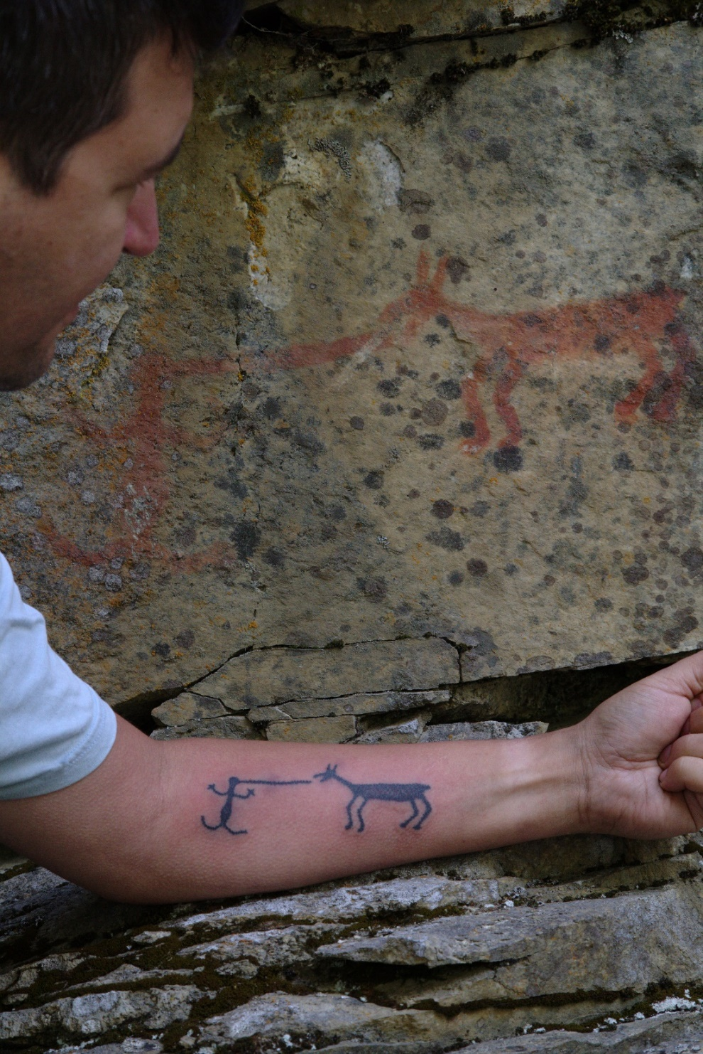
Dion says:
It was challenging to grow up outside of my ancestral community because I didn’t have connection to the land. I didn’t have connection to those cultural teachings.
For many years I felt off balance. The work of Nlaka’pamux tattooing has helped me to feel whole and make me feel stronger and firmer in my own identity as an Indigenous person and as an Nlaka’pamux person.
ABOUT THE
CURATOR
ABOUT THE CURATOR
Colouring Sky: Tattooing Land (Larry K. Kaszas)
by Aaron Leon, 2015.
.
Notes:
EDUCATOR NOTE
Read Dion’s words from the slide .
Define the traditional territory of the Nlaka’pamux: The traditional territory of the Nlaka’pamux is in the southern interior of British Columbia and reaches south to the North Cascades in Washington State.
Explain the context of the photo: The pictograph in the photo is located in the Stein River Valley. It is associated with an Nlaka’pamux ancestral story that teaches kindness and generosity.
DISCUSSION QUESTIONS (5 minutes)
What do you think were some of the challenges Dion might have faced growing up outside of his ancestral community?

Slide 10
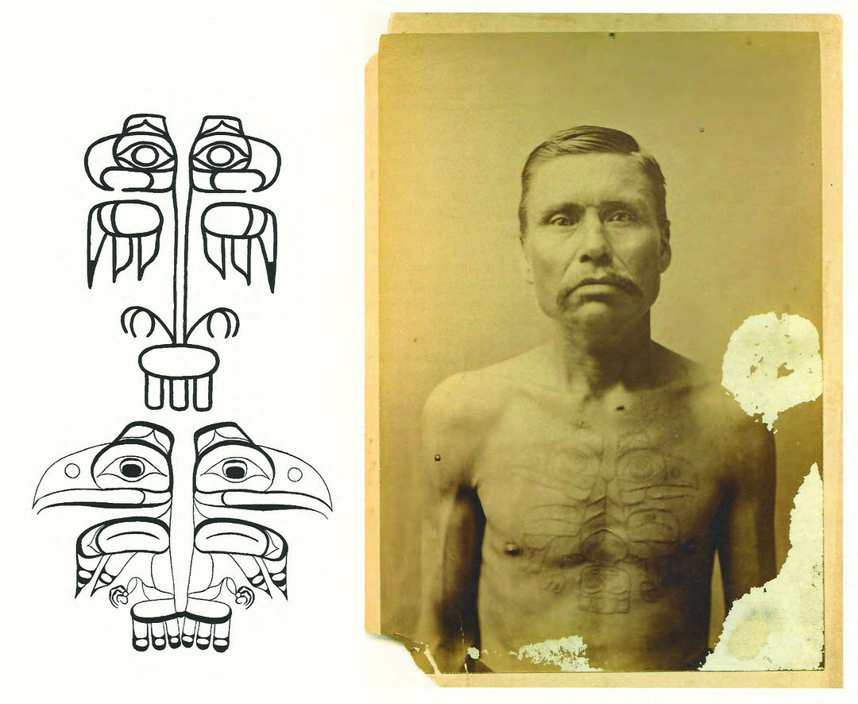
Tattooing was practiced in Indigenous communities before contact with European settlers. Each community has their own practices of skin-stitching, hand-poking, and scarification.
For example, Nisga’a and Haida crest tattoos told family histories and affirmed the identity of the wearer within their clan, their village, and their nation.
INDIGENOUS TATTOOING
TRADITIONS
Haida man with split raven chest tattoo, c.1890.
Photo credit: Franz Boas Photo Collection (PPCB63. Fldr.1, image 29A)
Notes:
EDUCATOR NOTE
Read the text on the slide and provide students with the information about Northwest tattooing traditions below:
Skin-stitching would have traditionally been done with deep bone needles and sinew used to thread the ink through the skin
Hand-poke tattoos were made with different tools, including porcupine quills

Slide 11
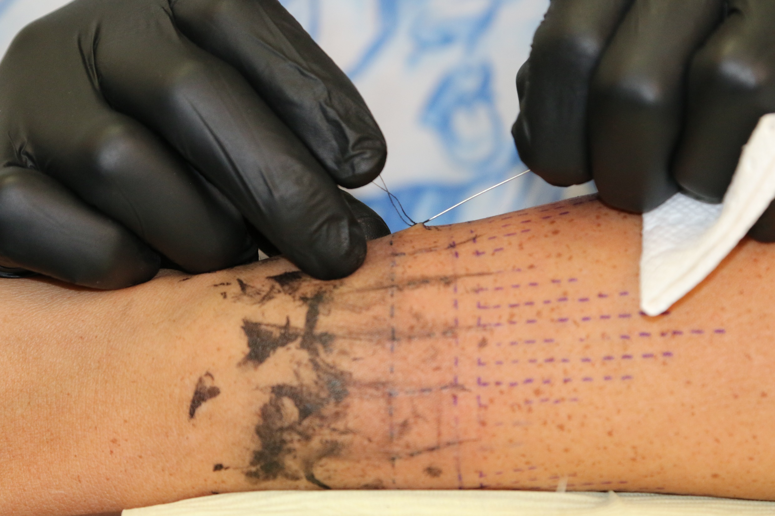
INDIGENOUS TATTOOING
TRADITIONS
)
Notes:
EDUCATOR NOTE
Read the text on the slide and provide students with the information about Northwest tattooing traditions below:
Skin-stitching would have traditionally been done with deep bone needles and sinew used to thread the ink through the skin
Hand-poke tattoos were made with different tools, including porcupine quills

Slide 12
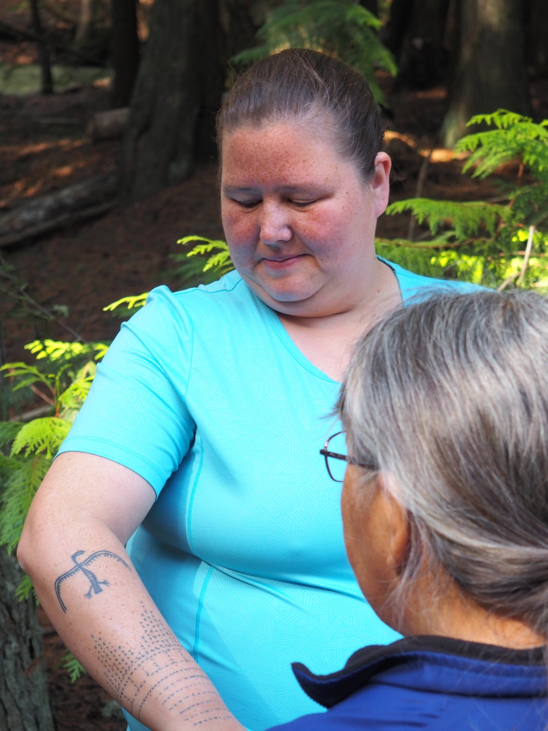
INDIGENOUS TATTOOING
TRADITIONS
)
Notes:
EDUCATOR NOTE
Read the text on the slide and provide students with the information about Northwest tattooing traditions below:
Skin-stitching would have traditionally been done with deep bone needles and sinew used to thread the ink through the skin
Hand-poke tattoos were made with different tools, including porcupine quills

Slide 13
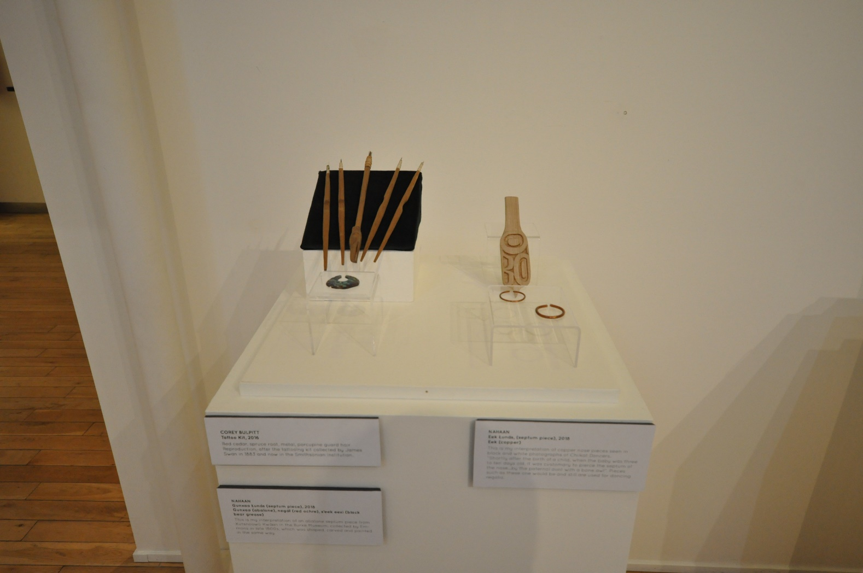
INDIGENOUS TATTOOING
TRADITIONS
)
Notes:
EDUCATOR NOTE
Read the text on the slide and provide students with the information about Northwest tattooing traditions below:
Skin-stitching would have traditionally been done with deep bone needles and sinew used to thread the ink through the skin
Hand-poke tattoos were made with different tools, including porcupine quills

Slide 14
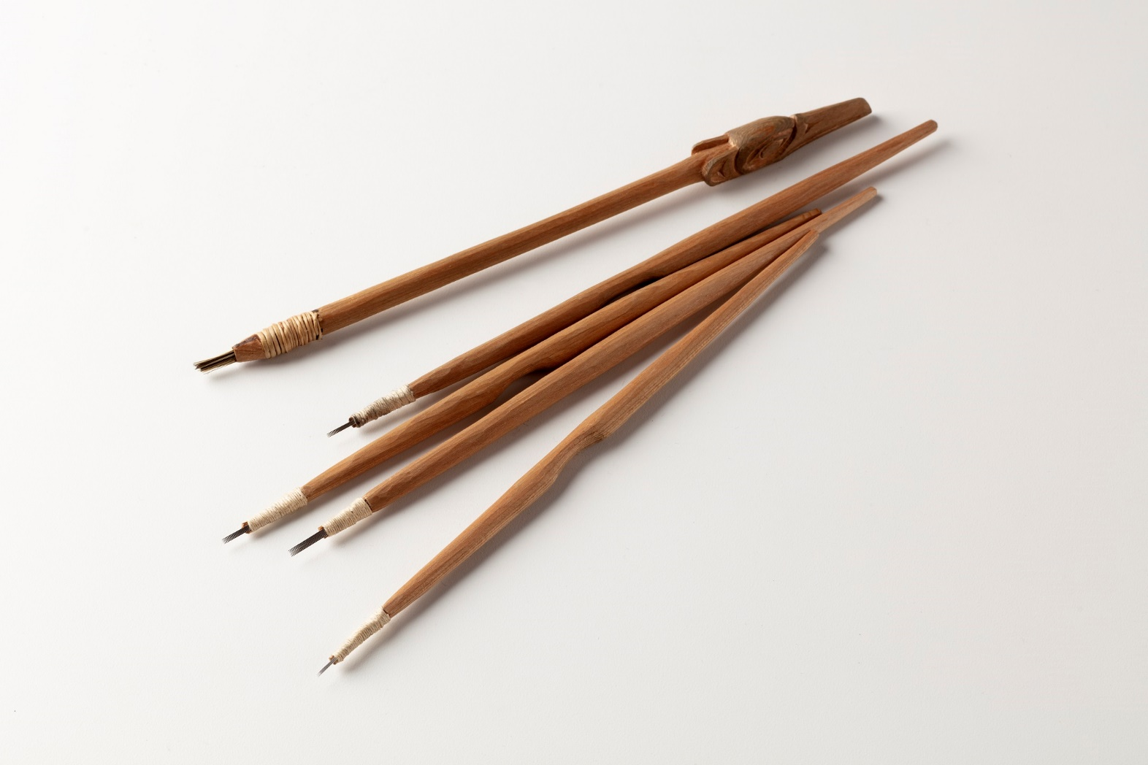
INDIGENOUS TATTOOING
TRADITIONS
)
Notes:
EDUCATOR NOTE
Read the text on the slide and provide students with the information about Northwest tattooing traditions below:
Skin-stitching would have traditionally been done with deep bone needles and sinew used to thread the ink through the skin
Hand-poke tattoos were made with different tools, including porcupine quills

Slide 15
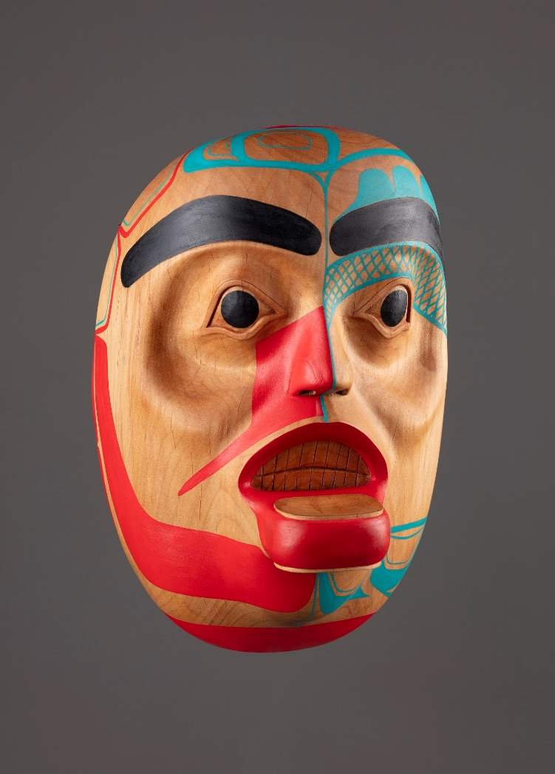
INDIGENOUS TATTOOING
TRADITIONS
Notes:
EDUCATOR NOTE
Jiila Kuns, Corey Bulpitt (2003)
The powerful Creek Woman is a supernatural being and ancestress of most of the Eagle clans on Haida Gwaii
She was the first being to ever be tattooed, with a design of a laughing geese on her shoulders (first tattoo)

Slide 16
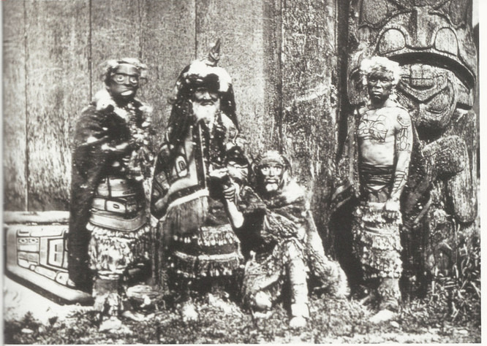
Beginning with the Indian Act of 1876, the Canadian government enacted policies that removed Indigenous people from their lands, their livelihoods, their languages, and their families.
The potlatch ban, which lasted from 1884 to 1951, criminalized inter-clan trade, feast, and dance celebrations in the Northwest. Many Indigenous nations practiced tattooing as part of their potlatch ceremonies.
CULTURAL ERASURE IN CANADA
Outlawing cultural practices like the potlatch created a sense of shame in celebrating Indigenous identity.
Masked Haida Men with Chief Xa’na with Crest Tattoos, 1881.
Photo credit: Edward Dossetter, Royal British Columbia Museum.
Notes:
EDUCATOR NOTE
Read the text on the slide.
To learn more about potlatch ceremonies and the potlatch ban, visit the U’Mista Cultural Society’s website (link in Resources, slide 17).
DISCUSSION QUESTION (10 minutes)
What are some of the other traditions and cultural practices that were erased when potlaches were outlawed?
Can you think of any other policies or events that prevented Indigenous people from practicing their culture?

Slide 17
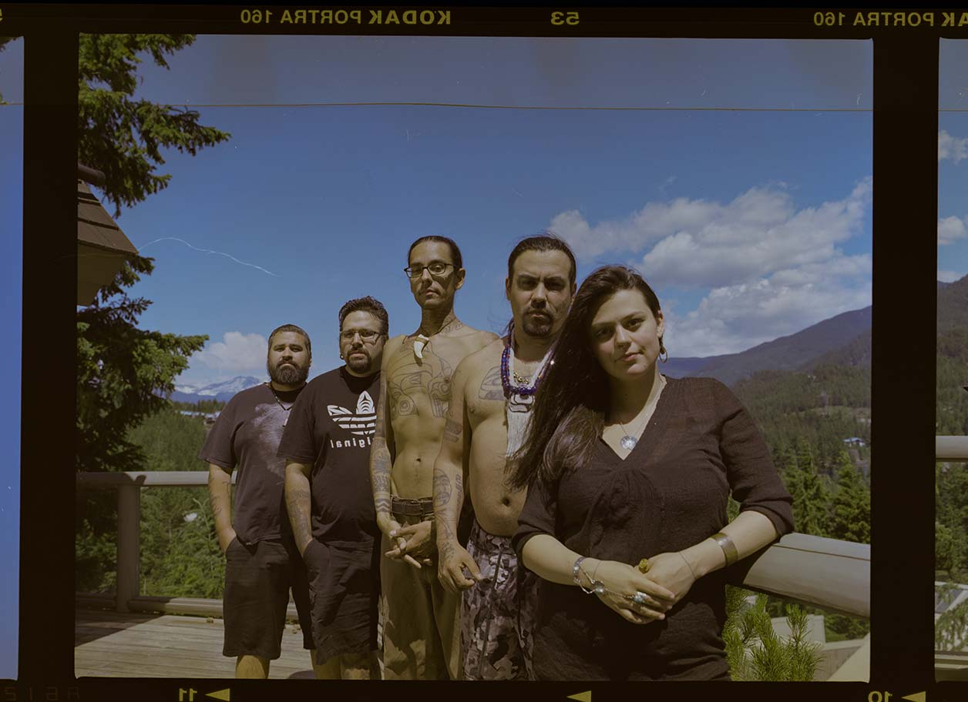
In recent years, Indigenous tattoo artists have been researching the traditional designs and methods of their ancestors in order to reawaken these sacred practices.
CULTURAL REAWAKENING
CULTURAL REAWAKENING
Body Language exhibition artists, L-R: Dean Hunt, Dion Kazsas, Nahaan, Corey Bulpitt, Nakkita Trimble. Photo credit: Aaron Leon, 2015.
Notes:
EDUCATOR NOTE
Read the text on the slide.
Introduce the artists from the Body Language exhibition: Dean Hunt (Heiltsuk), Dion Kaszas (Nlaka’pamux), Nahaan (Tlingit), Corey Bulpitt (Haida), and Nakkita Trimble (Nisga’a).
Tell students that although Dion was the curator, all 5 artists worked closely together to create the Body Language exhibition.

Slide 18
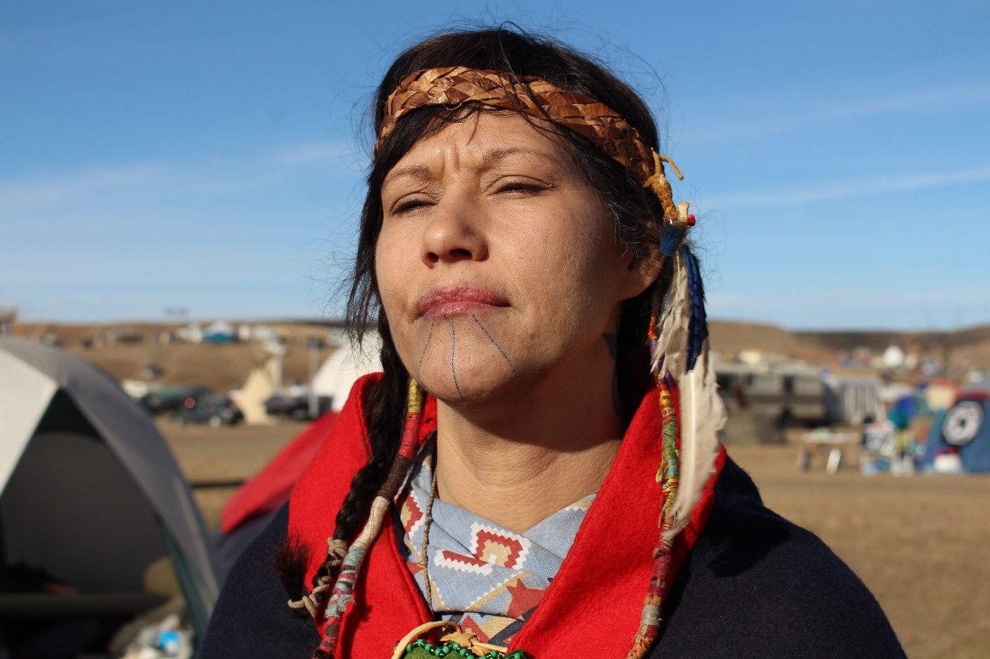
CULTURAL REAWAKENING
Nahaan says:
Tattoos are permanent regalia. Upon our bodies, we wear our history, the deeds to our lands, our access to the skies, and seas, our relatives. With our tattoos we Indigenize every space we are in.
Photo credit: Qatuwas, 2016.
Notes:
EDUCATOR NOTE
Read Nahaan’s words on the slide.
This is a photo of Nahaan’s friend proudly showing her skin-stitch tattoo she received while defending Indigenous water rights at Standing Rock. Nahaan says: “She wanted to receive this tattoo while we both were in the energy of resistance defending water, protecting the sacred, fighting oil corporations and genocide for the future generations.”
DISCUSSION QUESTION (10 minutes)
Why is it important for Nahaan to Indigenize every space he is in?
How have you seen spaces being Indigenized?

Slide 19
CULTURAL REAWAKENING
Notes:
EDUCATOR NOTE
Read Nahaan’s words on the slide.
This is a photo of Nahaan’s friend proudly showing her skin-stitch tattoo she received while defending Indigenous water rights at Standing Rock. Nahaan says: “She wanted to receive this tattoo while we both were in the energy of resistance defending water, protecting the sacred, fighting oil corporations and genocide for the future generations.”
DISCUSSION QUESTION (10 minutes)
Why is it important for Nahaan to Indigenize every space he is in?
How have you seen spaces being Indigenized?

Slide 20
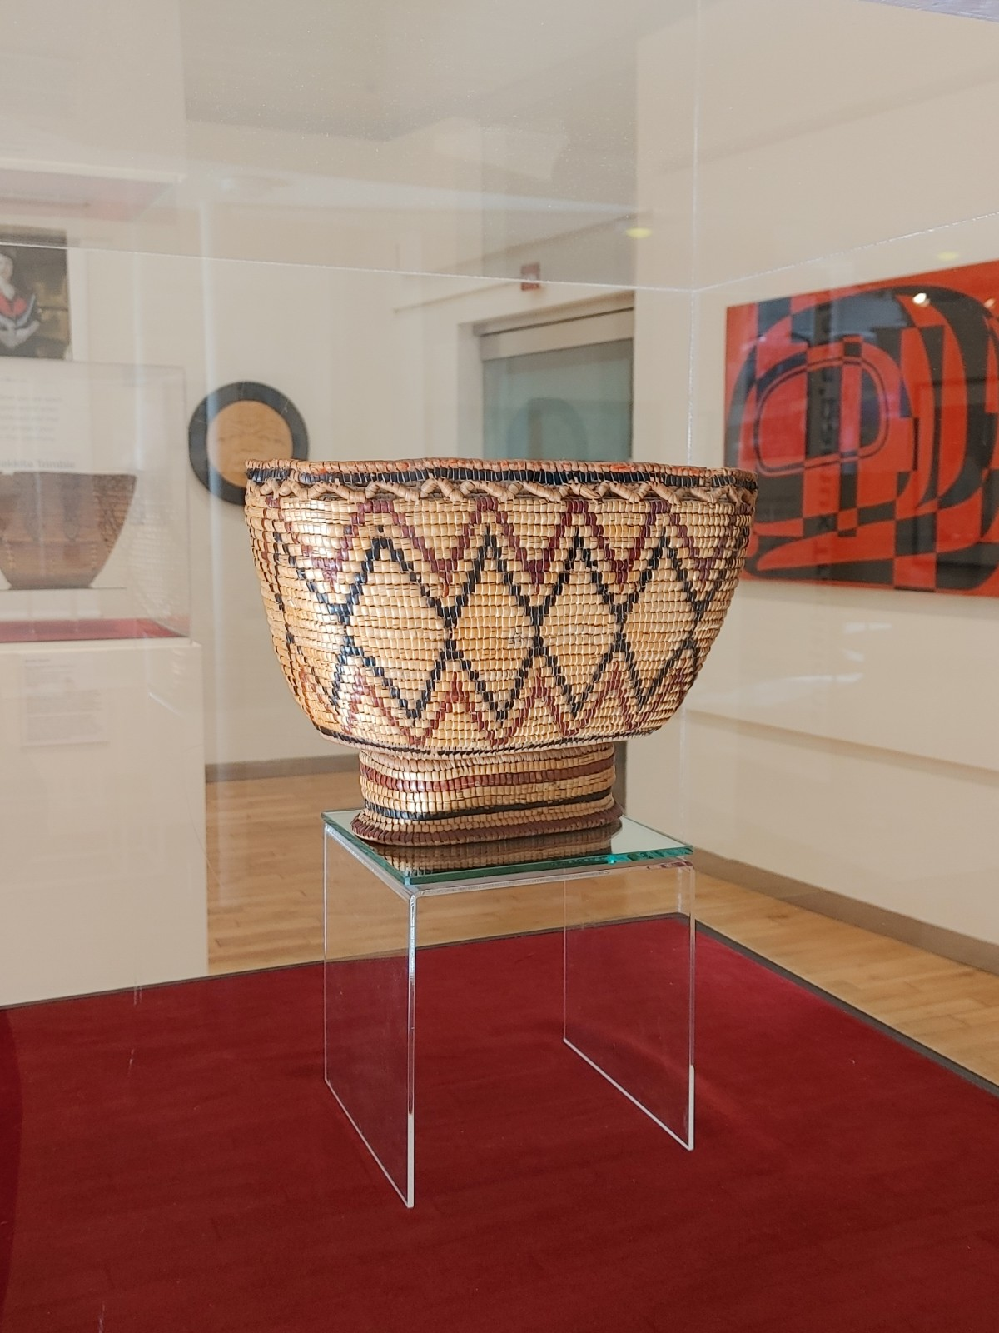

CULTURAL REAWAKENING
Notes:
EDUCATOR NOTE
Read Nahaan’s words on the slide.
This is a photo of Nahaan’s friend proudly showing her skin-stitch tattoo she received while defending Indigenous water rights at Standing Rock. Nahaan says: “She wanted to receive this tattoo while we both were in the energy of resistance defending water, protecting the sacred, fighting oil corporations and genocide for the future generations.”
DISCUSSION QUESTION (10 minutes)
Why is it important for Nahaan to Indigenize every space he is in?
How have you seen spaces being Indigenized?

Slide 21
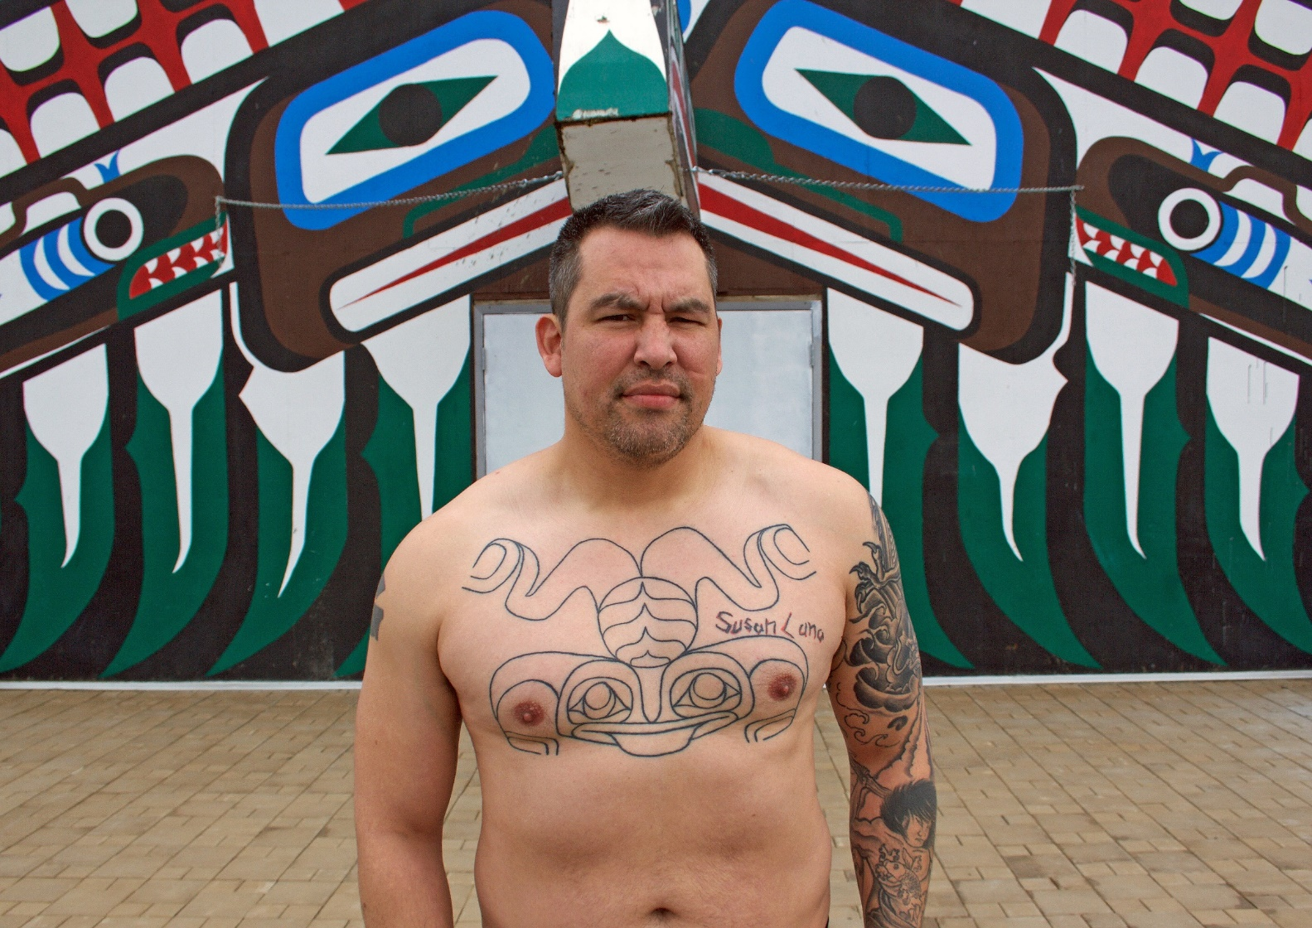
CULTURAL REAWAKENING
Nakkita says:
When you connect to your identity, you feel connected to your community, family, culture, and self.
Image credit: Nakkita Trimble
Notes:
EDUCATOR NOTE
Read Nakkita’s words on the slide.
Nisga’a artist Nakkita Trimble is reclaiming traditional crest tattoos, called Ts’iksna’aks (pronounced, “Tiss-knocks”) in her community. Her goal is to tattoo 80 young people with their traditional clan crests.
Describe the photo for your students: In this picture, Noah Guno shows off the first large handpoked crest tattoo Nakkita completed in her community. She says: “Each time I pricked into the skin I was pricking protection and the spirit of the House Crest into each opening.”
DISCUSSION QUESTIONS (5 minutes)
What kind of impacts do you think Nakkita’s crest tattoo project will have on future generations?

Slide 22
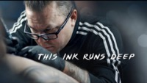
CULTURAL REAWAKENING
This Ink Runs Deep is about more than just tattooing. It's a celebration of the growing pride that is happening across Turtle Island as we revive different aspects of our culture and reconnect to our ancestral teachings.
- Asia Youngman, Cree-Métis filmmaker
Notes:
EDUCATOR NOTE
Read the text on the slide to prepare your students to watch the film.
This Ink Runs Deep (2019) is a short documentary film by Cree-Métis filmmaker, Asia Youngman. The film follows four Indigenous tattoo artists reviving ancestral traditions.
Asia says: “While growing up, I struggled with acknowledging my own identity as a Cree-Métis woman. It wasn't until I was in my early twenties when I started to learn more about my culture and became more grounded in my identity. I understood what it was like to have a fractured identity and feel that disconnect, especially as a youth. With that in mind, it was essential that this film also emphasized the importance of sharing these teachings with the next generation.”
Click the image to play, or follow the link below.
Link to watch This Ink Runs Deep (15 minutes, 54 seconds)
https://www.youtube.com/watch?v=W2Mm_p1469I

Slide 23
The artists in This Ink Runs Deep (2019) talk about the desire to be a part of something collective. What are some other ways you feel a part of something bigger than yourself?
Haida tattoo artist Gregory Williams talks about how people choose to get tattooed as part of a personal healing process or to mark milestones in their life. How have you marked milestones on your life journey? What new things could you do to mark milestones for yourself or others?
SELF
REFLECTION
Notes:
EDUCATOR NOTE
After watching the film, ask students to record their reflections using these prompts or use the prompts to facilitate a class discussion (20-30 minutes).

Slide 24
WATCH
Skindigenous TV show
READ
This Ink Runs Deep: How Indigenous artists 'stitch themselves back together' with ancestral tattooing on CBC Arts
EXPLORE
• Indigenous Tattooing Database by Dion Kaszas
U’Mista Cultural Society Potlatch Collection Virtual Tour
RESOURCES
Notes:
EDUCATOR NOTE
More ways to learn about the revival of Indigenous tattooing and other traditions.
Dion, Nahaan, and Nakkita from Body Language are all featured in episodes of APTN’s Skindigenous, which is available to stream for free with a CBC Gem account: https://gem.cbc.ca/media/skindigenous/s01
Season 1, Episode 4: British Columbia
Follows Dion Kaszas (Hungarian-Métis-Nlaka'pamux), curator of Body Language, as he explores petroglyphs, works with traditional materials, and tattoos elders in his community.
Season 1, Episode 8: Seattle
Featuring Nahaan (Tlingit), who is a cultural tattoo practitioner, inter-tribal dance leader, and activist.
Season 1, Episode 11: Prince Rupert
Follows Nakkita Trimble (Nisga’a) in her work to research Ts’iksna’aks (house crest tattoos) and reclaim this tradition in her home territory.

