Slide 1





Generative AI in [this course]
Read and then delete
This is a selection of slides that we encourage you to adopt/adapt for your course. Suggestions are on the "stickeys" and related resources are in the slide notes.
Please make a copy of this slide deck and edit your personal copy!
This slide deck (Version 1 – Nov 26, 2024) adapts and builds upon the following resources: How to Incorporate Generative AI by the Centre for Teaching and Learning at Durham College is licensed under CC BY-NC-SA 4.0 and “Talking to Students about Generative AI” by Jen Easter and Paula Demacio is licensed under CC BY-NC-SA 4.0.

Slide 2


Let’s learn together!
Read and then delete
GenAI tools are new for all of us, teachers and students alike! And, GenAI tools are not only here to stay, they are rapidly evolving. Approaching this as an opportunity to learn along with your students sets the stage for a meaningful, ongoing learning experience for everyone.
GenAI tools - what are they and how do they work?
What do you need to think about before deciding to use GenAI tools?
What do you need to know about using GenAI tools in this course?
Image: Jacob Lund via Canva

Slide 3

Read and then delete
Facilitate a discussion around this topic.
Suggested questions:
What do you know about GenAI tools?
How do they work? Where do they get their information?
What types do you know about?
Have you used them before? In what ways?
*Don’t assume all of your students know about these tools
What do you know about GenAI tools?
Image: kanchanachitkhamma via Canva

Slide 4

What is GenAI?
Generative AI (GenAI or GAI) is a type of artificial intelligence that uses machine learning algorithms to produce, copy or rework content.
This content output can be:
Read and then delete
Consider sharing the "Introduction to AI for Teachers and Students" video with your students (10 minutes). For more details see the slide notes.
  text
  imagery
  audio
  code
  other formats
Image: Andy Barbour via Pexels
Notes:
Definition: What is Gen AI?
“Generative AI (GenAI) is an artificial intelligence (AI) technology that automatically generates content in response to prompts written in natural-language conversational interfaces. Rather than simply curating existing webpages, by drawing on existing content, GenAI actually produces new content. The content can appear in formats that comprise all symbolic representations of human thinking: texts written in natural language, images (including photographs, digital paintings and cartoons), videos, music and software code. GenAI is trained using data collected from webpages, social media conversations and other online media. It generates its content by statistically analysing the distributions of words, pixels or other elements in the data that it has ingested and identifying and repeating common patterns (for example, which words typically follow which other words)” (p. 8 in Guidance for generative AI in education and research by UNESCO - licensed under CC BY-SA 3.0).
Video: Practical AI for Instructors and Students Part 1: Introduction to AI for Teachers and Students
Creators: Wharton School - Ethan Mollick and Lilach Mollick
Link: https://youtu.be/t9gmyvf7JYo
Description: “In this introduction, Wharton Interactive's Faculty Director Ethan Mollick and Director of Pedagogy Lilach Mollick provide an overview of how large language models (LLMs) work and explain how this latest generation of models has impacted how we work and how we learn. They also discuss the different types of large language models referenced in their five-part crash course: OpenAI’s ChatGPT4, Microsoft’s Bing in Creative Mode, and Google’s Bard.”

Slide 5

Read and then delete
Facilitate a discussion around this topic. Consider using a Microsoft Form to collect and share ideas (How to Guide from Microsoft).
Possible questions:
What are some limitations of GenAI tools?
What concerns are there surrounding GenAI?
Limitations of Gen AI
Image: bongkarn thanyakij via Pexels

Slide 6
  Worsening digital poverty
  Outpacing regulations
  Use of content without consent
  Violations of intellectual property rights
  Privacy concerns
  Unexplainable modules used to generate outputs (blackbox)
  AI-generated content polluting the internet
  Lack of understanding of the real world (stochastic parrots)
  Reducing the diversity of opinions and further marginalizing already marginalized voices
  Generating deeper deepfakes
Controversies and ethical risks
UNESCO, 2023
Notes:
Report: Guidance for generative AI in education and research
Creators: UNESCO - licensed under CC BY-SA 3.0
Link: https://unesdoc.unesco.org/in/documentViewer.xhtml?v=2.1.196&id=p::usmarcdef_0000386693&file=/in/rest/annotationSVC/DownloadWatermarkedAttachment/attach_import_eac0f406-0548-426d-b1f9-8158c22906bc%3F_%3D386693eng.pdf&locale=en&multi=true&ark=/ark:/48223/pf0000386693/PDF/386693eng.pdf
Description: "Having previously discussed what GenAI is and how it works, this section examines controversies and ethical risks raised by all GenAI systems and considers some of the implications for education." (p.14)

Slide 7


Read and then delete
Facilitate a discussion around this topic. Give students a few minutes to research examples of AI use in your disciple and have students share ("Share examples of AI use in your field" activity from OSU).
GenAI in your field
Notes:
Article: How using genAI to fuse creativigy and technology could reshape the way we work
Creator: World Economic Forum – Kathleen O'Reilly
Link: https://www.weforum.org/agenda/2024/01/how-genai-can-help-modern-industries-navigate-digital-transformation/
Takeaways: “GenAI could transform as much as 40% of people's working hours in certain jobs performed across modern industries like telecommunications and media. Some companies are already using genAI tools to support their employees, while also improving their businesses. Supporting genAI use through process redesign, skill investment and cultural change could boost productivity and innovation even more, while also empowering employees to redefine how they work” (para. 1).
Report: Future of Jobs Report (2023)
Creator: World Economic Forum
Link: https://www3.weforum.org/docs/WEF_Future_of_Jobs_2023.pdf?_gl=1*19ubrm7*_up*MQ..&gclid=CjwKCAjwjaWoBhAmEiwAXz8DBQ7_9vypwVThhXUyS8_xzwBnHiPBP6dXnXtZMrrXI4-fFtgkusqMGhoCTuEQAvD_BwE
Description: “The annual Future of Jobs Report explores how jobs and skills will evolve. The report is based on unique survey data that details the expectations of a cross-section of the world’s largest employers related to how socio-economic and technology trends will shape the workplace of the future.”

Slide 8

The importance of originality & process
Read and then delete
Lead a discussion on the importance of originality and the learning process. Try the "authorship activity" from the University of Waterloo. For more details see the slide notes.
Image: Milkos via Getty Images
Notes:
Resource: Conversations with Students about Generative Artificial Intelligence Tools
Creator: University of Waterloo – Centre for Teaching Excellence
Link: https://uwaterloo.ca/centre-for-teaching-excellence/catalogs/tip-sheets/conversations-students-about-generative-artificial
Description: Waterloo suggests "share with your students statements regarding academic integrity from publishers such as Elsevier. Discuss what authorship is, what insight and analysis mean, and what “original work” means in your discipline’s context. Ask your students to explain what it feels like to learn as a result of their own efforts versus taking shortcuts."

Slide 9


Academic Integrity
The decision to allow or permit the use of GenAI in courses will fall on your individual instructors.
Read and then delete
Think about these five strategies shared by Eaton (2022) when talking to your students about academic integrity: be straight forward, use humour, be (a little) vulnerable, show compassion, show them where help is available.
Individual Instructors
Un-cited or unauthorized use of GenAI in course work may constitute a violation of the university’s Academic Integrity policy. For example:
  Submitting the work of GenAI in whole or part as original work is academic dishonesty
  Giving inadequate attribution to GenAI is academic dishonesty
  Using GenAI to edit work without an instructor’s explicit written authorization is academic dishonesty
Syllabus
Acknowledgement
If GenAI tools are permitted, you can expect it to be clearly stated in the course syllabus/outline
If you choose to use GenAI tools and the instructor permits it in your class, you must acknowledge how you used the tool and cite appropriately.
Notes:
Resource: The use of Generative AI (GenAI) tools such as ChatGPT in the classroom
Creators: University of Victoria - LTSI
Link: https://onlineacademiccommunity.uvic.ca/LearnAnywhere/2024/01/11/genai-in-classroom/
Description: "You may be curious as to whether you can use ChatGPT or other Generative Artificial Intelligence (GenAI) tools in the classroom and to what extent. There are some strengths and weaknesses in GenAI tools. Below are some FAQs regarding usage of GenAI at UVic."

Slide 10
Read and then delete
Although there is always space for exploration and experimentation, incorporation of GenAI into teaching and learning should be purposeful and in alignment with fundamental learning objectives and/or skills for job readiness. As with all course expectations, clear communication is key.
Using GenAI in this course

Slide 11



Using GenAI in your courses
Read and then delete
Pick one option! Communicate your course policy to students - draw on UVic’s example syllabus statements. Explain why you have made the decision.
  The use of Generative AI is permitted in specific components of this course
  The use Generative AI is permitted in this course
  The use of Generative AI is not permitted in this course
Notes:
Resource: Artificial Intelligence Evaluation and Assessment in Post Secondary
Creator: University of Victoria - LTSI
Link: https://teachanywhere.uvic.ca/academic-integrity/ai-evaluation/
Description: Resources include syllabus statements for instructors to use and adapt in their courses for transparent direction to students.

Slide 12
Assignment
Guidance
  The use Generative AI is permitted in this course
  Details will be included
Read and then delete
For each assignment in your course, let students know that you will share the appropriate GenAI assignment guidelines.
  The use of Generative AI is permitted in specific components of this course
  Details will be included
  The use of Generative AI is not permitted in this course
  Details will be included

Slide 13




Using GenAI in this course
Faculty responsibilities
Read and then delete
It’s very important for students to understand what your faculty responsibilities will be. This slide is meant to be communicated to students.
Provide transparent communication on each assignment about if/how/why you can use GenAI
Provide alternatives to address concerns and/or access issues (you will not be mandated to use AI)
Assessing
learning

Slide 14

Using GenAI in this course
Student responsibilities
Understand UVic's Academic Integrity Policy
Document and acknowledge use
You are responsible for the entire form and content of your academic work.
Consider relevance, accuracy, bias, usefulness, currency, etc.
Read and then delete
It’s very important for students to understand what their responsibilities will be. This slide is meant to be communicated to students.
Know the policy for this course and each assignment
Cite Appropriately
How to cite text generated with A.I.
Demonstrate learning

Slide 15
Help Resources
If you are struggling with your schoolwork, there are many sources of help:
Centre for Academic Communication academic integrity and academic skills (academic writing, time management, and more!)
UVic Libraries can help with research and citations
Centre for Accessible Learning supports students with disabilities and chronic health conditions achieve their academic goals
Student Wellness supports students' mental, physical and spiritual health
Ombudsperson provides independent, impartial, and confidential resources for students
When in doubt, ask!
You should seek guidance from your instructor if you have any questions or concerns about the use of AI tools in an assignment. If you have questions about academic integrity book an appointment the CAC.
Remember!
GenAI permissions will be different for each class. Be sure you understand the situation for each of your courses!!

Slide 16
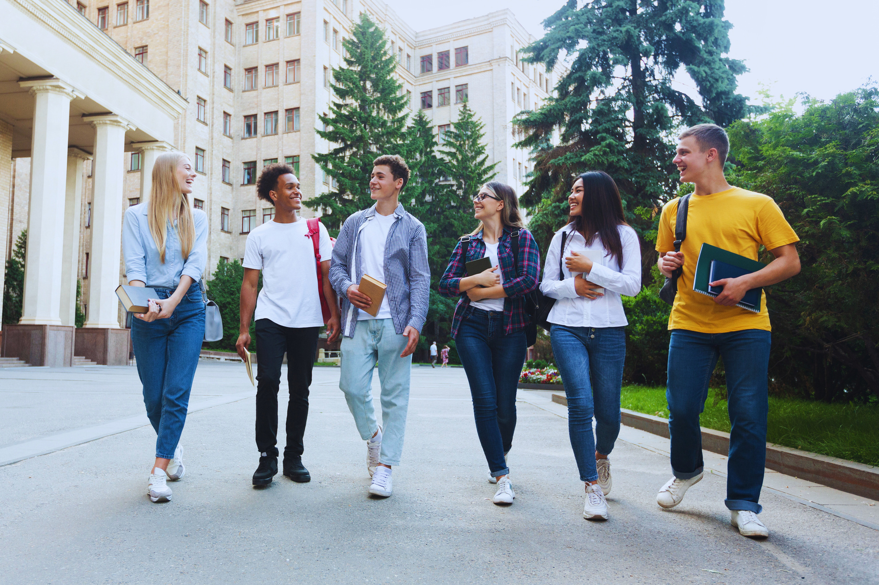
Read and then delete
Ensure your students that this is just the beginning of an ongoing conversation as you all learn about the potential and limitations of AI in your course. Be sure to ask for feedback and input along the way!
Continue the
conversation
Image: Milkos via Getty Images

