Slide 1
Outbound Exchange Info Session
Tuesday January 21, 2025
FRA Room 158
12:30 pm to 1:20 pm
Notes:
Territorial Acknowledgement
Connections of law, sense of place, and learning law in another place

Slide 2
Partner Institutions
University of Limerick, Limerick, Ireland (4)
University of Utrecht, Netherlands (4)
Vrije University, Amsterdam, Netherlands (3)
National University of Singapore, Singapore (4)
University of Hong Kong, Hong Kong (4)
University of Sydney, Australia (2)
Victoria University of Wellington, New Zealand (4)
Kyushu University, Fukuoka, Japan (2)
Chulalongkorn University, Bangkok (2)
Bocconi University, Milan, Italy (2)
University College Cork, Cork, Ireland (2)
NEW- Jigme Singye Wangchuck in Bhutan (2)
Notes:
Depends on University guidelines/restrictions on international student travel, and partner institutions’ ability to accept international exchange students.
UVic has exchange agreements with many schools/universities around the world. However, these are the only law schools that UVic Law has active exchange agreements with.
Students can attend other schools on a letter of permission but they will have to pay tuition of those schools which is almost always MUCH more expensive.

Slide 3
Advantages of Going on Exchange
Learn about different legal systems
Expand your knowledge of other countries
Streamlined application process
Pay UVic tuition
Eligible for law bursaries and Canada student loans while on exchange*
Travel
Notes:
Students must take minimum of 4.5 units/term to qualify for CSL and bursaries.
Learn/experience different legal systems and courses we do not offer here
Because you are still considered a UVic student, can apply for bursaries and student loans. Talk to Financial Aid Officer.
Re bursaries: (a) Travel expenses are not allowable expense for bursaries since an exchange program is not a required degree component. (b) Allowed same living expenses as students living in Victoria. (c) Exchange admin fee of $150 is claimable as an allowable expense for bursary fund.

Slide 4
Drawbacks to Going on Exchange
Graduation and articling may be delayed
Limits choice of UVic law courses; Law Centre
Adjusting to cultural differences while attending classes
Term dates may affect student loans
Not available to visiting, transfer & BCL/JD students due to UVic Law residency requirements
JD/JID students must ensure exchange term does not conflict with their program requirements
Non-refundable admin fee of $150 upon acceptance of an offer for an exchange term
Notes:
Law students must attend UVic for 2 years to earn a UVic Law degree. This prohibits transfer, visiting (LOP), & JD/BCL students from going on exchange.
Can do co-op.
Likely can do as part of JD/JID, still to be confirmed, but not until after 2nd year of program and on certain conditions (Indigenous content? Does not conflict with field school or other required courses – need to consult with JID committee)

Slide 5
Selection Criteria
UVic Law
Selection by Subcommittee of the International Committee
Minimum 4.5 GPA - * some hosts may have higher GPA requirements- for HKU, students must have a minimum B+ average
3L/4L students have preference over 2L students
3L/4L students on exchange in their last term must have completed all mandatory courses
Academic performance relative to other applicants
Reasons for wishing to participate in exchange
Host University
Nominations sent to host institutions who have final say in accepting/declining an application

Slide 6
Academic Information
Registered in LAW 352 at UVic
Block credit of 7.5 units is typical
Pass/Fail; Grades do not contribute to GPA and course prizes
Can only take law courses at host university
All program required courses must be completed at UVic
Associate Dean & Registrar’s Office must approve all course registrations during an exchange term
Cannot register for courses at UVic during exchange term

Slide 7
Monday, March 3rd at 9:00 am
Application Deadline
Application forms available online at www.uvic.ca/law/jd/exchangeterms/outgoingexchange/index.php

Slide 8
University of Limerick (Limerick, Ireland)
Cutting edge legal research through its Centre for Criminal Justice, International Commercial and Economic Law Group, and Research Cluster for Understanding Emotions in Society
Wide range of modules covering European Union law, international commercial law, human rights in criminal justice, etc.
Terms run September to December and January to May

Slide 9
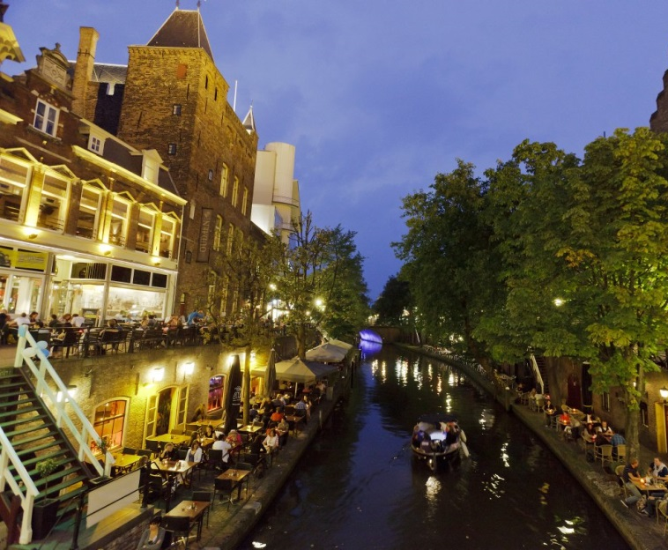
University of Utrecht (Utrecht, Netherlands)
One of the oldest and largest universities in Europe
Courses in international law, human rights, and European law
Terms run September to February and February to June **early departure in December is an option for the fall term

Slide 10
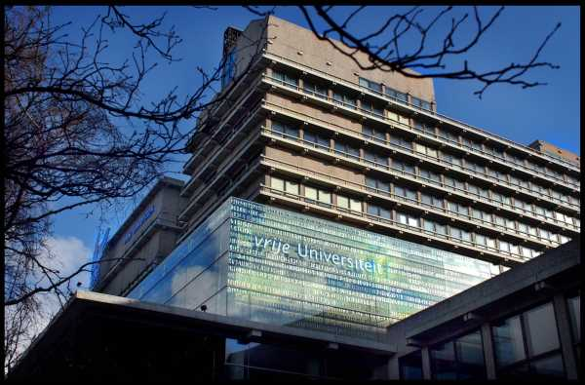
Vrije University (Amsterdam, Netherlands)
Four interdisciplinary university themes: Human Health and Life Sciences, Science for Sustainably, Connected World, and Governance for Society
May take a mix of undergraduate and master’s courses in international law, crime and justice, and human rights
Terms run September to February and February to June**early departure in December is available it the fall term

Slide 11
National University of Singapore
Students and faculty from more than a hundred countries
Electives in Asian legal studies, corporate law, world trade law, IP and technology law, international and comparative law, etc. **students need a B+ average
Terms run August to December and February to June

Slide 12
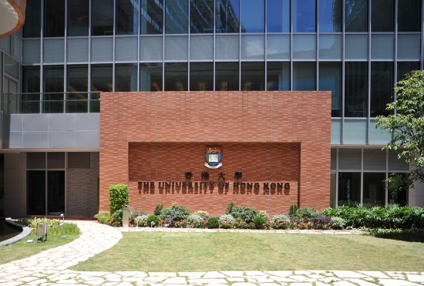
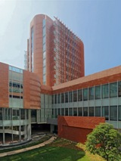
University of Hong Kong
Offers excellent courses on Hong Kong’s unique legal and constitutional system
Wide range of electives in human rights, corporate and financial law, information technology and IP law, international law, and arbitration
Terms run September to December and January to May-*students need B+ average
Cheng Yu Tung Tower
Centennial Campus

Slide 13
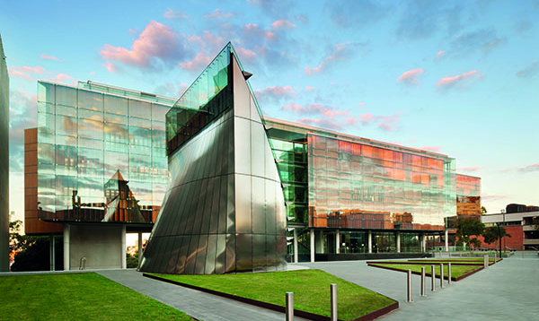
University Of Sydney (Australia)
Offer courses in international and transnational law, comparative law, and environmental law
Terms run July/Early August to November and February to June
Sydney Law School

Slide 14
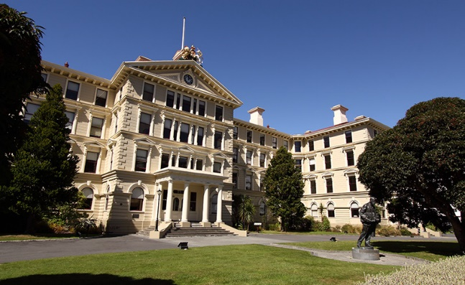
Victoria University of Wellington (New Zealand)
Located in the city centre close to the Parliament House and Supreme Court
Courses in public law, commercial law, legal theory, and comparative law, Indigenous & Aboriginal Law courses
Semesters run July to November and February to June
Government Building housing the VUW Faculty of Law
NZ Parliament Buildings Executive Wing

Slide 15
Chulalongkorn University, Bangkok, Thailand
Has a new Bachelor of Laws Experiential Learning in Business and Tech Law, taught in English- 1 year in progress
Chance of staying in the International dormitory on Campus
LL.M. in Business Law, taught in English
We can send two students in the Fall term- August to December
For 2025-26, students will choose courses from their LBEL program
https://www.chula.ac.th/en/academics/exchange-student/

Slide 16
Kyushu University (Japan)
Courses in English and Japanese
Semesters run October to March and April to September
https://www.law.kyushu-u.ac.jp/international/exchange-programs/inbound
Accommodation on campus is available for international exchange students
For 2025 26, we can send 2 students in the fall term. The placement will run over two academic terms- Fall and Spring. To stay on track for graduation, students will need to take summer courses.

Slide 17
Bocconi University (Italy)
Courses taught in Italian and English
Semesters run September to December and February to May
Examples of courses taught in English
**Spring term attendees- transcripts not released until Mid-July
The process for completing all the steps to secure a spot at Bocconi can be lengthy. You will need ample time to work through the process- it is a good idea to meet with Fran once you have been offered a spot.

Slide 18
University College Cork (Ireland)
Centre for Criminal Justice and Human Rights; Centre for Law and the Environment
Semesters run September to December and January to May
See https://www.ucc.ie/en/law/
Courses on EU and International Law
Feedback from UVic students who have been to Cork on exchange talked positively about the support offered to the international students attending UCC by the university.
This Photo by Unknown Author is licensed under CC BY-SA-NC

Slide 19
JSW in Bhutan
Jigme Singye Wangchuck School of Law was created in 2015.
Their Mission Statement:
Provide globally recognized legal education infused with Gross National Happiness values, and produce impactful research, promoting a fair, just, and harmonious society.
Accommodation and food provided for all exchange students

Slide 20
Visit the Outgoing Exchange Webpage www.uvic.ca/law/jd/exchangeterms/outgoingexchange/
Notes:
Application form is online
Webpage will be updated as we receive 2024-25 factsheets from partners

Slide 21
Study Abroad Funding

Slide 22
Student International Activities Fund (SIAF)
Basic value $500
Asia* Undergraduate Supplement $1,000
Asia* Graduate Supplement $5,000
*includes Australia, New Zealand, Hawaii
Next deadline: March 19, 2025.
How to apply:
Complete and submit the online application form.

Slide 23
One World International Scholarship
Value $2,000-5,000
Three competitions are held each year. The deadlines for applications are 4:30 PM on the third Wednesday in March, July and November
How to apply:
Submit completed pdf application (incl. transcript and reference forms) to world@uvic.ca.
Notes:
Kiran

Slide 24
For other funding opportunities, please contact:
Office of Global Engagement
JCC B202
world@uvic.ca

