Slide 1
Outbound Exchange Info Session
Tuesday January 17, 2023
FRA Room 157
12:30 pm to 1:20 pm
Notes:
Territorial Acknowledgement
Connections of law, sense of place, and learning law in another place

Slide 2
Study Abroad Funding

Slide 3
Student International Activities Fund (SIAF)
Basic value $500
Asia* Undergraduate Supplement $1,000
Asia* Graduate Supplement $5,000
*includes Australia, New Zealand, Hawaii
Next deadline March 15th, 2023.
How to apply
Complete and submit the online application form.

Slide 4
One World International Scholarship
Value $2,000-5,000
Next deadline March 15th, 2023 (same as SIAF)
How to apply
Submit completed pdf application (incl. transcript and reference forms) to world@uvic.ca.
Notes:
Kiran

Slide 5
International Mobility Access Grant (IMAG)
IMAG aims to reduce barriers for Indigenous students, students with a disability and low-income students to access and participate in UVic’s international outbound mobility programs and strengthen their global skills.
Value: up to $10,000
Next deadline: February 15th, 2023.
How to apply
Submit completed pdf application to the Office of Global Engagement by email or in person.

Slide 6
Questions?
Heike Edam & Maggie Gramlich
Office of Global Engagement
JCC B202
world@uvic.ca

Slide 7
Partner Institutions
University of Limerick, Limerick, Ireland (4)
University of Utrecht, Netherlands (4)
Vrije University, Amsterdam, Netherlands (3)
National University of Singapore, Singapore (4)
University of Hong Kong, Hong Kong (4)
University of Sydney, Australia (4)
Victoria University of Wellington, New Zealand (4)
New!
Bocconi University, Milan, Italy (2)
University College Cork, Cork, Ireland (2)

Slide 8
Advantages of Going on Exchange
Learn about different legal systems
Expand your knowledge of other countries
Streamlined application process
Pay UVic tuition
Eligible for law bursaries and Canada student loans while on exchange*
Travel

Slide 9
Drawbacks to Going on Exchange
Graduation and articling may be delayed
Limits choice of UVic law courses; Law Centre
Adjusting to cultural differences while attending classes
Term dates may affect student loans
Not available to visiting, transfer & BCL/JD students due to UVic residency requirements
JD/JID students must ensure exchange term does not conflict with their program requirements
Non-refundable admin fee of $150.00 upon acceptance of an offer for an exchange term

Slide 10
Selection Criteria
UVic Law
Selection by Subcommittee of the International Committee
Minimum 4.5 GPA
3L/4L students have preference over 2L students
3L/4L students on exchange in their last term must have completed all mandatory courses
Academic performance relative to other applicants
Reasons for wishing to participate in exchange
Host University
Nominations sent to host institutions who have final say in accepting/declining an application

Slide 11
Academic Information
Registered in LAW 352 at UVic
Block credit of 7.5 units is typical
Pass/Fail; Grades do not contribute to GPA and course prizes
Can only take law courses at host university
All program required courses must be completed at UVic
Associate Dean & Registrar’s Office must approve all course registrations during an exchange term
Cannot register for courses at UVic during exchange term
Pass/Fail; Grades do not contribute to GPA and course prizes

Slide 12
Application Deadline
Wednesday, March 1st at 4:00pm
Submit the following by email to Fran Blake at lawcaa@uvic.ca:
Completed application form
Law school transcript from Online Tools
Current CV/resume
Application forms available online at www.uvic.ca/law/jd/exchangeterms/outgoingexchange/index.php

Slide 13
University of Limerick (Limerick, Ireland)
Cutting edge legal research through its Centre for Criminal Justice, International Commercial and Economic Law Group, and Research Cluster for Understanding Emotions in Society
Wide range of modules covering European Union law, international commercial law, human rights in criminal justice, etc.
Terms run September to December and January to May

Slide 14
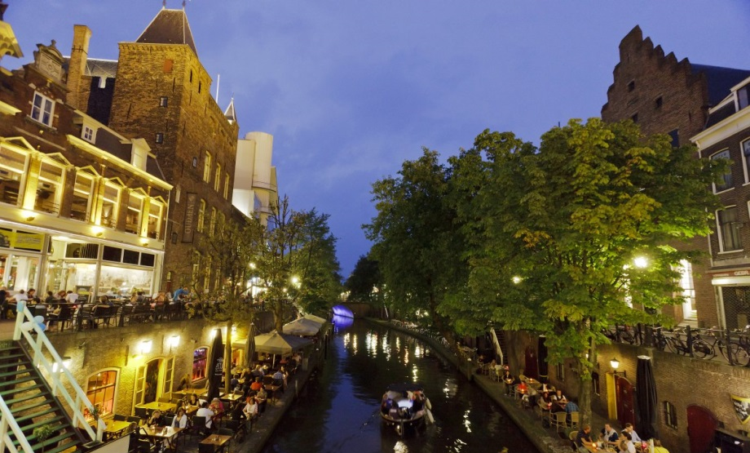
University of Utrecht (Utrecht, Netherlands)
One of the oldest and largest universities in Europe
Courses in international law, human rights, and European law
Terms run September to February and February to June

Slide 15
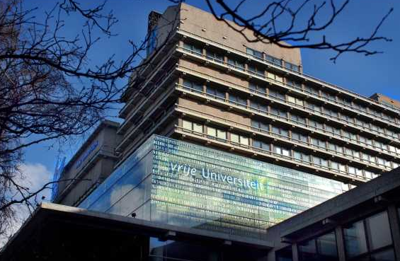
Vrije University (Amsterdam, Netherlands)
Four interdisciplinary university themes: Human Health and Life Sciences, Science for Sustainably, Connected World, and Governance for Society
May take a mix of undergraduate and master’s courses in international law, crime and justice, and human rights
Terms run September to February and February to June

Slide 16
National University of Singapore
Students and faculty from more than a hundred countries
Electives in Asian legal studies, corporate law, world trade law, IP and technology law, international and comparative law, etc.
Terms run August to December and February to June

Slide 17
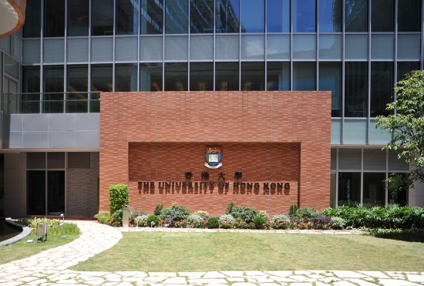
University of Hong Kong
Offers excellent courses on Hong Kong’s unique legal and constitutional system
Wide range of electives in human rights, corporate and financial law, information technology and IP law, international law, and arbitration
Terms run September to December and January to May
Cheng Yu Tung Tower
Centennial Campus

Slide 18
University Of Sydney (Australia)
Offer courses in international and transnational law, comparative law, and environmental law
Terms run July to November and February to June
Sydney Law School

Slide 19
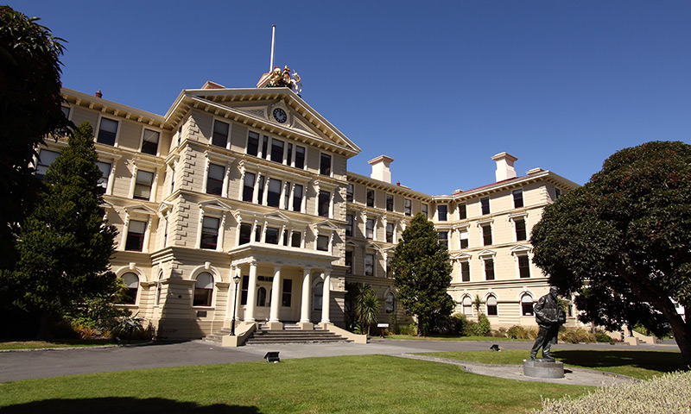
Victoria University of Wellington (New Zealand)
Located in the city centre close to the Parliament House and Supreme Court
Courses in public law, commercial law, legal theory, and comparative law
Semesters run July to November and February to June
Government Building housing the VUW Faculty of Law
NZ Parliament Buildings Executive Wing

Slide 20
Bocconi University (Italy)
Courses taught in Italian and English
Semesters run September to December and February to May
Examples of courses taught in English

Slide 21
University College Cork (Ireland)
Centre for Criminal Justice and Human Rights; Centre for Law and the Environment
Semesters run September to December and January to May
See https://www.ucc.ie/en/law/

Slide 22
Visit the Outgoing Exchange Webpage www.uvic.ca/law/jd/exchangeterms/outgoingexchange/

