Slide 1
Outbound Exchange Info Session
Tuesday, March 1, 2022
FRA Room 157
12:30 pm to 1:20 pm
Notes:
Territorial Acknowledgement
Connections of law, sense of place, and learning law in another place

Slide 2
Partner Institutions
University of Limerick, Limerick, Ireland (4)
University of Utrecht, Netherlands (4)
Vrije University, Amsterdam, Netherlands (3)
National University of Singapore, Singapore (4)
University of Hong Kong, Hong Kong (4)
University of Sydney, Australia (4)
Victoria University of Wellington, New Zealand (4)
New!
Kyushu University, Fukuoka, Japan (2)
Bocconi University, Milan, Italy (2)
University College Cork, Cork, Ireland (2)
Notes:
Depends on University guidelines/restrictions on international student travel, and partner institutions’ ability to accept international exchange students.
UVic has exchange agreements with many schools/universities around the world. However, these are the only law schools that UVic Law has active exchange agreements with.
Students can set up their own exchanges with attend other schools on a letter of permission but they will have to pay tuition of those schools which is almost always MUCH more expensive.

Slide 3
Advantages of Going on Exchange
Learn about different legal systems
Expand your knowledge of other countries
Streamlined application process
Pay UVic tuition
Eligible for law bursaries and Canada student loans while on exchange*
Travel
Notes:
Students must take minimum of 4.5 units/term to qualify for CSL and bursaries.
Learn/experience different legal systems and courses we do not offer here
Because you are still considered a UVic student, can apply for bursaries and student loans. Talk to Financial Aid Officer.
Re bursaries: (a) Travel expenses are not allowable expense for bursaries since an exchange program is not a required degree component. (b) Allowed same living expenses as students living in Victoria. (c) Exchange admin fee of $150 is claimable as an allowable expense for bursary fund.

Slide 4
Drawbacks to Going on Exchange
Graduation and articling may be delayed
Limits choice of UVic law courses; Law Centre
Adjusting to cultural differences while attending classes
Term dates may affect student loans
Not available to visiting, transfer & BCL/JD students due to UVic residency requirements
JD/JID students must ensure exchange term does not conflict with their program requirements
Non-refundable admin fee of $150.00 upon acceptance of an offer for an exchange term
Notes:
Law students must attend UVic for 2 years to earn a UVic Law degree. This prohibits transfer, visiting (LOP), & JD/BCL students from going on exchange.
Can do co-op.
Likely can do as part of JD/JID, still to be confirmed, but not until after 2nd year of program and on certain conditions (Indigenous content? Does not conflict with field school or other required courses – need to consult with JID committee)

Slide 5
Selection Criteria
UVic Law
Selection by Subcommittee of the International Committee
Minimum 4.5 GPA
3L/4L students have preference over 2L students
3L/4L students on exchange in their last term must have completed all mandatory courses
Academic performance relative to other applicants
Reasons for wishing to participate in exchange
Host University
Nominations sent to host institutions who have final say in accepting/declining an application
Notes:
Offers are conditional:
1st years:
December marks reviewed = 4.5 GPA
April marks are essential
2nd year:
1st year grades reviewed = 4.5 GPA
2nd year grades are essential
If GPA slips below 4.5, the exchange offer will be revoked.
315 required only if student commenced first year Law 2012-2018

Slide 6
Academic Information
Registered in LAW 352 at UVic
Block credit of 7.5 units is typical
Pass/Fail; Grades do not contribute to GPA and course prizes
Can only take law courses at host university
All program required courses must be completed at UVic
Associate Dean & Registrar’s Office must approve all course registrations during an exchange term
Cannot register for courses at UVic during exchange term
Pass/Fail; Grades do not contribute to GPA and course prizes

Slide 7
Application Deadline
Tuesday, March 8th at 4:00pm
Submit the following by email to Fran Blake at lawcaa@uvic.ca:
Completed application form
Law school transcript from MyPage
Current CV/resume
Application forms available online at www.uvic.ca/law/jd/exchangeterms/outgoingexchange/index.php

Slide 8
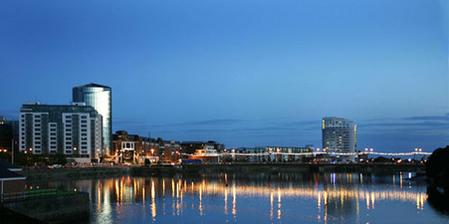
University of Limerick (Limerick, Ireland)
Cutting edge legal research through its Centre for Criminal Justice, International Commercial and Economic Law Group, and Research Cluster for Understanding Emotions in Society
Wide range of modules covering European Union law, international commercial law, human rights in criminal justice, etc.
Terms run September to December and January to May
Notes:
30 ECTS = 7.5 units at UVic Law; can do more (easier) undergrad-level courses or fewer (harder) post-grad courses to meet 30 ECTS
International Commercial and Economic Law Group (ICEL) provides some financial support to exchange students
Need card to travel outside Ireland, can be a long process with long wait periods. Once you have it, can travel freely. !! To do: contact Limerick re issue. [Not sure what this is about.]

Slide 9
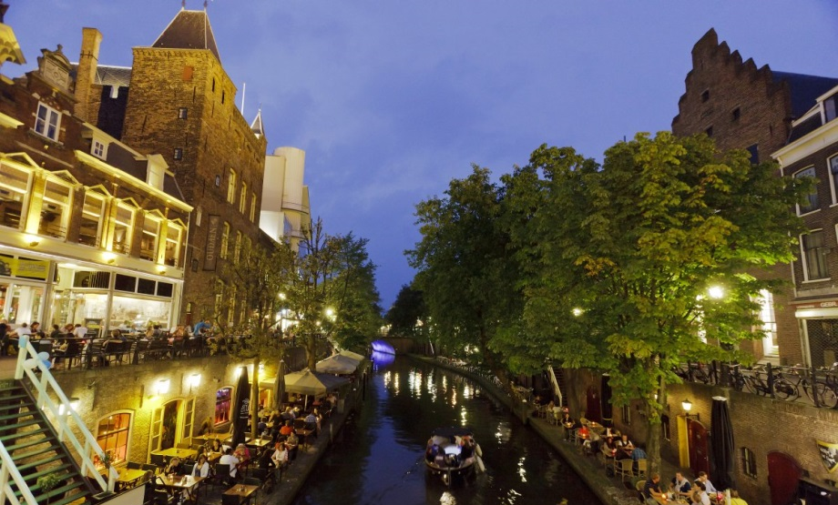
University of Utrecht (Utrecht, Netherlands)
One of the oldest and largest universities in Europe
Courses in international law, human rights, and European law
Terms run September to February and February to June
Notes:
Utrecht is the fourth largest city in Netherlands. It is located on the banks of the River Rhine.
Lots of international students, uni town, lots of bike lanes. 2 week welcome period and weekend trips organized during time there.
UU offers condensed courses. Students may take 3 courses = 22.5 ECTS = 4.5 UVic units. 4 courses = 30 ECTS=7.5 UVic units.
If take Sept-Nov classes and then 1-month intensive Ethics course, can finish during fall term to return to UVic for January. Ethics course is substantially different than UVic Law’s ethics course.
Pick courses, don’t know the schedule, get approval, and then choose time slots of the courses you picked/had approved.
Can do masters-level courses which are very interesting and not too difficult.
Housing difficult to arrange. Uni does not have any housing, they will send info re a private company (NAME?) for students to apply to online. Also brokers who will search for you.
Student speakers: Emily Pitre, Sydney Hamilton, Morven Burch, Fall 2018

Slide 10
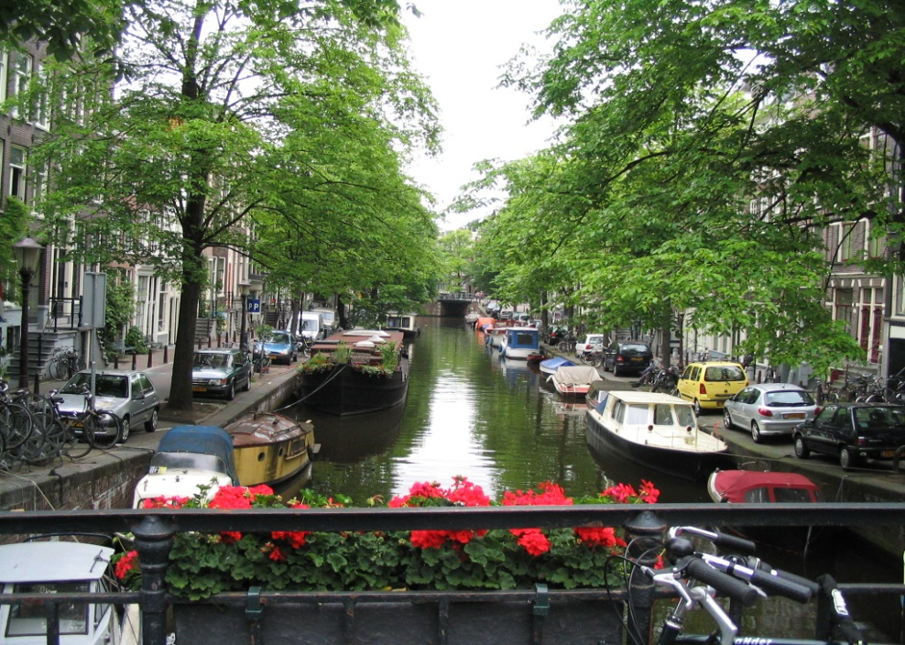
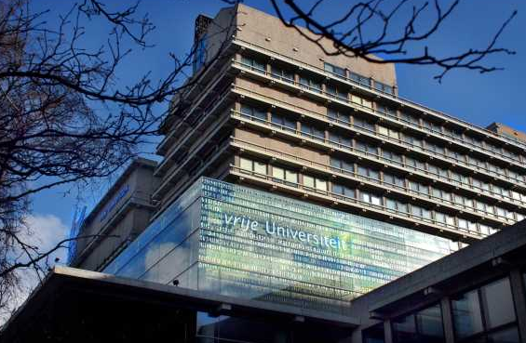
Vrije University (Amsterdam, Netherlands)
Four interdisciplinary university themes: Human Health and Life Sciences, Science for Sustainably, Connected World, and Governance for Society
May take a mix of undergraduate and master’s courses in international law, crime and justice, and human rights
Terms run September to February and February to June
Notes:
(5 courses) 30 ECTS = 7.5 units

Slide 11
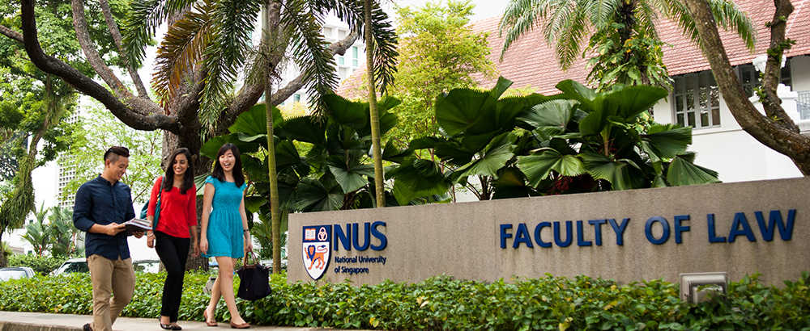
National University of Singapore
Students and faculty from more than a hundred countries
Electives in Asian legal studies, corporate law, world trade law, IP and technology law, international and comparative law, etc.
Terms run August to December and February to June
Notes:
MC=modular credits
Minimum of 20 MC’s at NUS = 7.5 UVic units
While at NUS, you may register in any combination of 4, 5 or 8 MC term-long courses to get to the number of MC’s you need. As part of the number of MC’s you need, you may register in one intensive 4 MC course should any intensive courses be offered in your exchange term at NUS.

Slide 12
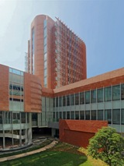
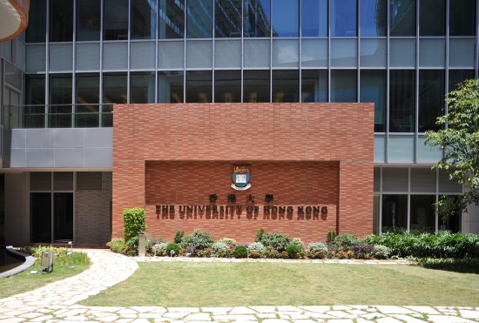
University of Hong Kong
Offers excellent courses on Hong Kong’s unique legal and constitutional system
Wide range of electives in human rights, corporate and financial law, information technology and IP law, international law, and arbitration
Terms run September to December and January to May
Cheng Yu Tung Tower
Centennial Campus
Notes:
Can take intensive courses, change each year.
30 HKU credits = 7.5 UVic units
Masters courses are not as difficult as UVic JD course
Visa application is extensive! And occurs during UVic exam period. Start early.
Lots of CNDs in HK, students and lawyers.
Many opportunities for cheap travel by air and high-speed trains
Housing can be difficult to arrange. Is some residence on and off campus. www.Hongkongrooms.com? Confirm with Spencer.
Student Speakers: Jordan Kay, Daniel Babcock, and Spencer Toffoli, Fall 2018

Slide 13
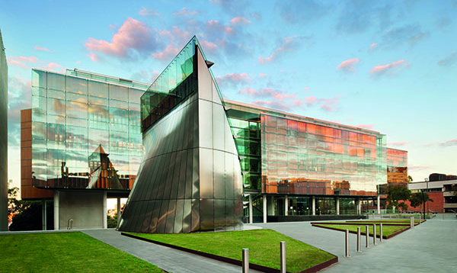
University Of Sydney (Australia)
Offer courses in international and transnational law, comparative law, and environmental law
Terms run July to November and February to June
Sydney Law School
Notes:
3 options/combinations of courses to equal 24 Sydney units = 7.5 UVic units
Can take undergraduate and graduate-level courses

Slide 14
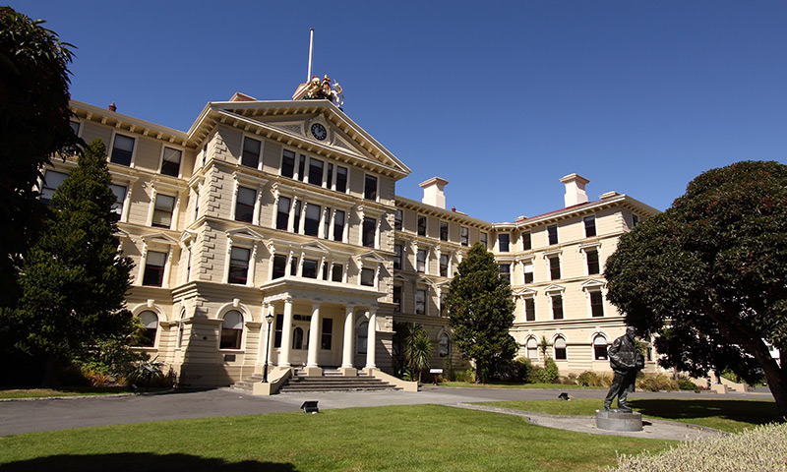
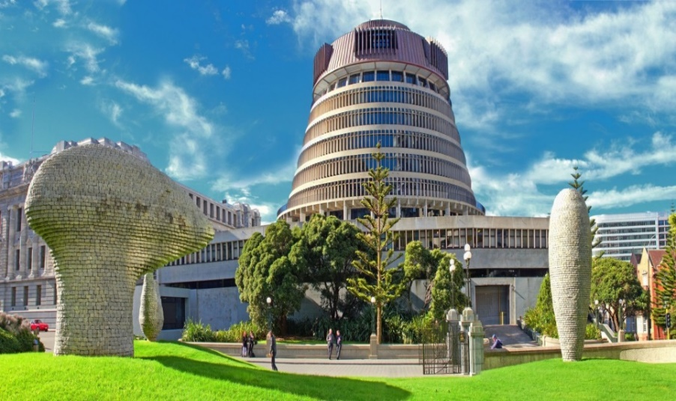
Victoria University of Wellington (New Zealand)
Located in the city centre close to the Parliament House and Supreme Court
Courses in public law, commercial law, legal theory, and comparative law
Semesters run July to November and February to June
Government Building housing the VUW Faculty of Law
NZ Parliament Buildings Executive Wing
Notes:
4 courses=60 points = 7.6 UVic units
May delay convocation to November; degree completion letters available.
Common law
Indigenous legal issues
Can take graduate-level courses

Slide 15
Kyushu University (Japan)
Courses in English and Japanese
Semesters run October to March and April to September
https://www.law.kyushu-u.ac.jp/international/exchange-programs/inbound

Slide 16
Bocconi University (Italy)
Courses taught in Italian and English
Semesters run September to December and February to May
Examples of courses taught in English
Notes:
4 courses=60 points = 7.6 UVic units
May delay convocation to November; degree completion letters available.
Common law
Indigenous legal issues
Can take graduate-level courses

Slide 17
University College Cork (Ireland)
Centre for Criminal Justice and Human Rights; Centre for Law and the Environment
Semesters run September to December and January to May
See https://www.ucc.ie/en/law/

Slide 18
Visit the Outgoing Exchange Webpage www.uvic.ca/law/jd/exchangeterms/outgoingexchange/
Notes:
Application form is online
Webpage will be updated as we receive 2021-22 factsheets from partners

