Slide 1
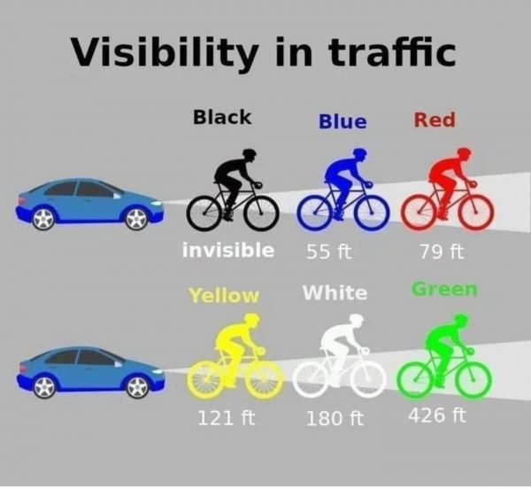
Safety Moment – Cycling
Riding, driving, & walking is working
  No distractions!
Always defensive
  Assume everyone else is distracted!
Safety gear (helmet, gloves, pads)
  High visibility!
Envision why we work & ride safe
  Getting home to our loved ones!

Slide 2
Evaluating feasible pathways for FortisBC to decarbonize the BC energy sector using analytic tools and the lenses of Industrial Ecology
Chiradeep Majumdar
26-May-2022
Notes:
Good afternoon, and welcome to my presentation. The topic for my summer project is “Evaluating feasible pathways for FortisBC to decarbonize the BC energy sector using analytic tools and the lenses of Industrial Ecology”

Slide 3
Research Question
What combination of implementations (policy, economic, technological, etc.) can achieve feasible carbon reductions by 2030 while minimizing risk?
Notes:
Well, what does that mean? As a research question, we must ask what combination of implementations – whether policy, economic, technological, etc. – can achieve feasible carbon reductions by 2030 while minimizing risk.

Slide 4
Methodology
Industrial Symbiosis (Literature)
Designing the material/energy flow between industries & technologies from the perspective of systems engineering to increase synergy
Sector coupling: Gas, Heat, Electricity, Transport (GHET)
  (Shirizadeh, 2020)
  (Robinius, Otto, Heuser, et al., 2017)
Decision Model (Literature)
Defining success
Examples: CO₂ budget, risk mitigation, LCOE, etc.
  (Simon et al., 2022)
Industrial Symbiosis
Decision Model
Objective
Evaluating Decarbonization Pathways
Policy Analysis
Are they realistic?
  CleanBC Roadmap to 2030
  Canada’s 2030 Emissions Reduction Plan
What is reasonable?
Scenario Setup & Evaluation (Modelling – Literature / Policy)
Scenario definition
OSeMOSYS
Analysis
  Sensitivity (Park et al., 2013)
  Trade-off (De La Peña et al., 2022)
Policy Analysis
Scenario Setup & Evaluation
Notes:
- The question needs to be framed as an objective, which is *click* Evaluating Decarbonization Pathways.
- In order to answer this question, we will follow the system we learned in CIVE 510 & 512 – which is to first set up the problem space using a lens of Industrial Ecology. For this topic, the lens I picked was Industrial Symbiosis *click*.
- Industrial symbiosis can be quite a diverse term, but for this project, the one selected is “Designing the material & energy flow between industries & technologies from the perspective of systems engineering to increase synergy.”
- As an energy engineer, that means sector coupling *click*, where the gas, heat, electricity, & transport sectors form an energy mosaic. The papers listed do exactly that for France & Germany respectively. This will be emulated for BC but at a much smaller scale and only for the Heat & Transport sectors.
- So, after our problem has been framed, we need to develop a *click* decision model that *click* *click* defines success. *click* What combination of carbon budget, risk mitigation, LCOE, etc. can be put together in an equation of sorts to either maximize or minimize such that we are able to evaluate a certain design for sector coupling? The papers identified discuss these. I will be iterating a decision model in CIVE 580 – Integrated Assessment Models for Energy Transition – using a different data set, and then referring back to that model for this project.
- In parallel with building a decision model, I will work with my IESVIC group to *click* set up sector coupling scenarios & evaluate them. Because of the time constraint, the scenario accuracy will be limited, and analysis will be completed in OSeMOSYS – a linear programming energy modelling tool. As part of our analysis, we will assess the sensitivity of different factors, as well as trade-offs. Again, because of the time constraint – the sensitivity & trade-off analysis is limited to identifying only the factors that have broad-stroke effects on scenarios.
- Finally, the results will show us *click* whether the policy that we have written today (namely CleanBC Roadmap to 2030 & Canada’s 2030 Emissions Reduction Plan) are realistic – and whether they need to be toned down to achieve timely results.

Slide 5
Team Members
Lead Advisor: Andrew Rowe
IESVIC Team Lead: Jacob Monroe
Industrial Symbiosis: Chris Kennedy
Decision Model: Madeleine McPherson
Scenario Setup & Evaluation: Jacob, Tamara, Colton, Cristiano
Policy Analysis: Andrew, Madeleine, Chris, Jacob
Notes:
For this to be successful, I will rely on support from various team members.
For helping define the industrial symbiosis problem space, I will rely on Chris to review my work. For setting up my decision model, I will work with my Andrew, Madeleine, & Jake.
For scenario setup & evaluation, I will work with my IESVIC team that includes Jake, Tamara, Colton, & Cristiano.
And finally for policy analysis, I will work with Andrew, Madeleine, Jake, and Chris.

Slide 6
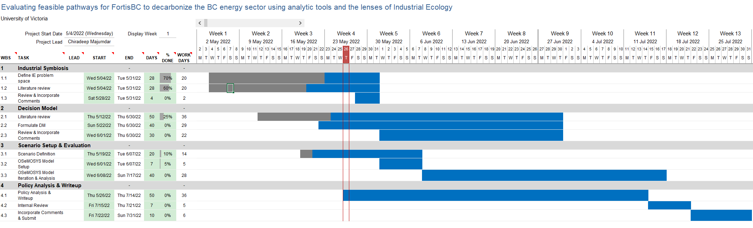
Schedule
Notes:
- My schedule has 4 phases
- Setting up the problem space is scheduled for completion by the end of May, and the decision model is aimed to be created by second week of June. Scenario setup & evaluation will be completed by the second week of July, and the policy analysis & evaluation (including write-up) will be completed by the 3rd week of July – giving approximately 10 days to review & incorporate comments for final submittal.

Slide 7
Questions
Evaluating feasible pathways for FortisBC to decarbonize the BC energy sector using analytic tools and the lenses of Industrial Ecology
Notes:
- Thank you, and I will open the floor for questions now.

