Slide 1
Navigating the new normal – A roadmap for decision-making and communication
June 25, 2020
School of Public Administration
University of Victoria

Slide 2
Overview
Environmental Overview
Defining the Problem
Developing a roadmap
Assess
Plan
Review
The importance of communications
Questions?
Notes:
Nikki

Slide 3
Environmental Overview
Challenge with this crisis – it is a slow-moving crisis with unknown boundaries
Significant uncertainty
Timing of the crisis and recovery
What impact it will have on economy, on community, on organization
Minimal historical precedent to draw on for predictions
We are moving into a phase of transition – from the initial crisis towards recovery
This Photo by Unknown Author is licensed under CC BY-NC-ND
Notes:
Nikki

Slide 4
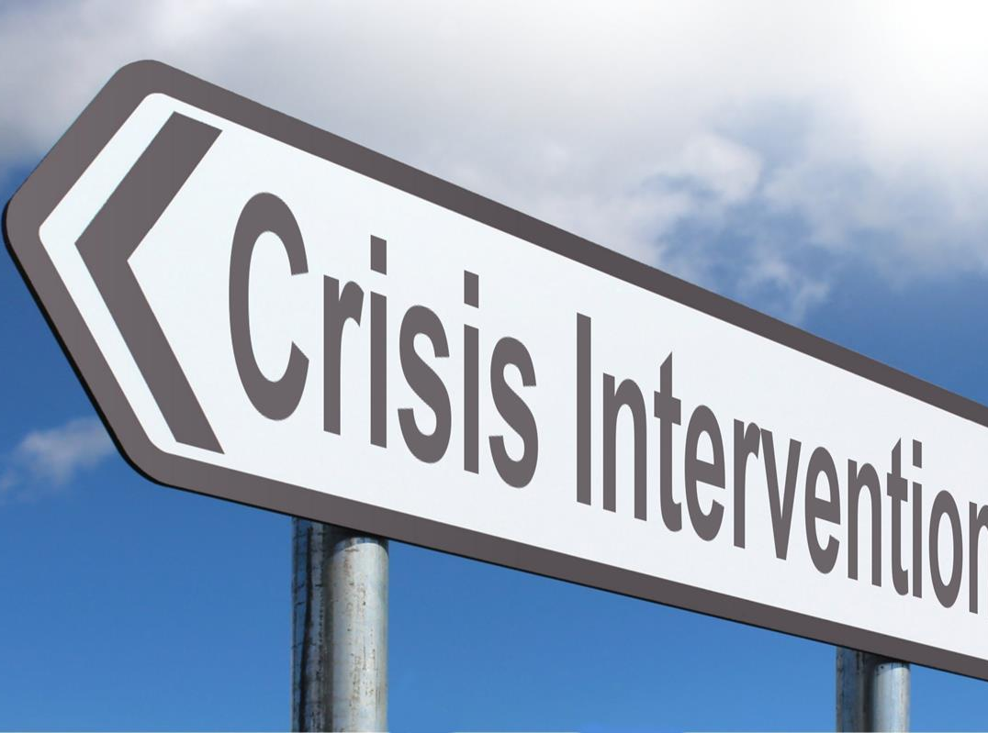
Crisis
Focus:
social distancing and flattening the curve
significant government support including wage subsidies, rent subsidies and targeted support for NGO sector and PSE
Additional support to individuals and households reduced the burden on organizations as well
new tools and ways of working together during this time
unprecedented levels of cooperation amongst governments, within communities
And great stories of caring and compassion
This Photo by Unknown Author is licensed under CC BY-SA
Notes:
Nikki

Slide 5
Defining the Problem
What we heard
Organizations need tools to navigate the new normal
Need a roadmap to guide their decision-making over the next 6 months – 2 years
Ability to be agile and adaptive recognizing that there is nothing certain in the new normal
Continue risk of resurgence (until vaccine)
Notes:
Nikki

Slide 6
Strategic Plan versus Road map
Strategic Planning – normally start with the big objectives – major goals and then build a plan to get us there
Roadmap – intended to address the immediate situation. Focuses on short term to get through crisis and into recovery
This Photo by Unknown Author is licensed under CC BY-SA
Notes:
Nikki
Strategic Plan – This does not mean that your strategy plan no longer fits – in fact, those organizations with solid strategy plan will likely weather this crisis more effectively but it will need some adaptation to current situation – hence the roadmap
Road Map - To create a place of ‘stability’ in this place of change and unknown
This is about creating a roadmap that is good enough for your organization right now – Not striving for perfection and need to be able to adapt and change as new information/issues come online
Make the point that they coexist. Need to balance action and planning. Act for employees for near term and plan for the future (look at Bridgespan webinar) survival now and sustainability later

Slide 7
Developing a Roadmap
Key elements for building a roadmap:
Assess impact – how has COVID impacted the organization – where are we now?
Define goals – where do we want to be?
Strategies – what can I do now, how can I do it, what are the key tasks
Review – measurable objectives - is my plan working, how do I need to adapt?
Dynamic Planning Process
Critical to have a clear communication plan throughout the process
Timeline for roadmap 6 months to 2 years
This Photo by Unknown Author is licensed under CC BY-SA
Notes:
Jen

Slide 8
Assess
How have things changed for:
My employees?
My clients?
My partners?
My funders?
What does this mean for the organization?
How does it affect the delivery of core programs or projects
How does it relate to organization’s core principles
Has it changed my organization’s culture?
What key decisions do I need to address right now?
Priorities
Internal
Getting people back to work
Have the needs of my clients/students changed?
External
Current health and safety guidelines
Economic impact - how does it affect my funding?
Notes:
Jen

Slide 9
Dynamic Planning Process
overall_0_132313425406187664 columns_1_131932671858153565 33_1_132313425350784274
1
Assess
What has changed
How does that affect my organization
What are the external factors to consider (example 2nd wave, further economic loss)
1
2
Define goals
Where do we want to be? What are our non-negotiables?
Translate into measurable objectives
Reflect the impact on your organization over next 6 to 12 months
Continuous Review and Adaptation,
2
4
3
Strategies
Develop a set of actions that would allow you to effectively manage against each objective
What can I do now, how can I do it, what are the key tasks
3
4
Review
Is my plan working - do I need to adapt?
What external factors have changed that require me to adapt my plan?
Adapted from https://www.bridgespan.org/forms/download/nonprofit-scenario-planning-tool-download
Notes:
Jen
The intent is to have a framework to manage the dynamic environment, how to make key decisions, how to adapt as needed
Information changing quickly – need constant feedback loops
Plans and actions are dynamic, adaptive and flexible based on new information, changing needs, impacts and unintended consequences
Managing risk – urgency and importance

Slide 10
Review
Changing environment, no precedent means building in ongoing review is critical
Need to be agile and adapt the roadmap to respond
Create feedback loops and other information sources to feed the review and adaptation process
Include learning from others – find out what others are doing and how that can be used in my organization
This Photo by Unknown Author is licensed under CC BY-SA
Notes:
Jen

Slide 11
Communicate
Need to make special effort to create opportunities for dialogue, engagement and communication
To address the anxiety and fear of the unknown/rapid change
To build trust and confidence during this period of instability
Roadmap offers framework to help communicate where we are going
Connect roadmap back to basic principles of the organization (critical to building trust)
This Photo by Unknown Author is licensed under CC BY-SA
Notes:
Nikki
Good communication underpins the whole process of building a roadmap
Roadmap offers a framework that you can use to share with others – how and why you have made these key decisions. How you are managing in the dynamic environment. Creates trust and confidence during this period of instability

Slide 12
Questions
Nikki Macdonald, PhD
nikkimac@uvic.ca
Jennifer Hall, PhD (c)
jjhall0405@gmail.com

