Slide 1
Performance and Development Cycle
Human Resources
Fall 2017

Slide 2
Background
Performance planning and review processes exist for CUPE 951, Professional Employees Association, Exempt Support and Management Excluded employee groups
This project updated the forms and resources to simplify and incorporate Edge elements, but the process follows the same steps
Student Affairs initiated the updating process and piloted the new forms and tools with CUPE 951, PEA and ME roles.

Slide 3
Employee Outcomes
Engagement
Performance
Self-awareness
Self-confidence
Trust
Resiliency
Appreciation
Recognition
Clear expectations
Goals
Clear understanding of roles/responsibility
Commitment
Constructive feedback
Notes:
The PDC program recognizes two components of employee outcomes. Both components are important and must be balanced to realize employee performance goals.
Engagement
Employee engagement is critical to performance and development and is the first step to achieving performance outcomes
Engagement outcomes include: self-awareness, self-confidence, trust, resiliency, appreciation and recognition
These outcomes are the first component of effective performance and development and must be in place to achieve performance outcomes
Performance
Will not be effective without engagement
Performance outcomes include: clear expectations, goals, understanding of roles and responsibilities, commitment to the process and constructive feedback

Slide 4
Supervisor Outcomes
Relationship
Results
Engagement
Clear, open communication
Strengthened teams
High retention
Strengthened relationships
Trust and understanding
Resiliency
Notes:
Supervisor outcomes also fall into two main categories
Relationships
Relationships with employees are integral to positive performance outcomes. Strong relationships make performance conversations easier and more meaningful. The good news is that regular performance conversations strengthen relationships, so it is a positively re-enforcing cycle.
Improved relationships lead to more trust and mutual understanding between employees and supervisors, and better results
Results
Focusing on results will be less effective without strong relationships. When supervisor have trust and credibility, employees will feel more confident and committed to performance and development.
Performance outcomes include: employee and supervisor engagement, shared commitment, strengthened teams, higher employee retention,
Clear, open lines of communication

Slide 5
Principles:
Regular
Scheduled, organized, efficient
Cyclical, ongoing conversations
Respectful
Developmental, constructive, learning-focused
Reciprocal, meaningful, 2-way conversations
Rewarding
Clear development path, specific performance goals
Better connection to role, and UVic
Easy and transparent process
Relationship-driven
Increased trust, recognition and appreciation
Notes:
Regular:
This means that it will be scheduled, organized and efficient. NOT a one time conversation.
Cyclical, with ongoing conversations
Easy and transparent. All forms and tools are available for everyone to see and use
Respectful:
The process also needs to be developmental, constructive and learning-focused
Include reciprocal, meaningful, 2-way conversations
And be driven be the relationship between employee and supervisor
Rewarding:
With a clear path for employee development and specific performance goals
Resulting in a better connection for each employee with their role, the division, and the university
Leading to increased trust, recognition, and appreciation, both for employees and supervisors

Slide 6
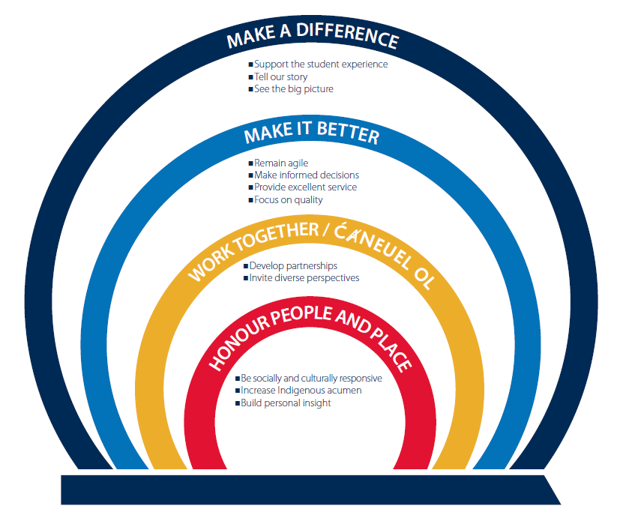
UVic Competency Model
Notes:
Updating the UVic competency model provides an opportunity to re-look at how we do our performance conversations. The new model relies on conversations between employees and supervisors, and the Performance Development Cycle is a great place to have those conversations and discuss development opportunities that relate to both the duties of the job and to being an employee of the University
The competencies are also an excellent source of ideas for goal setting outside of the day to day duties of the job.

Slide 7
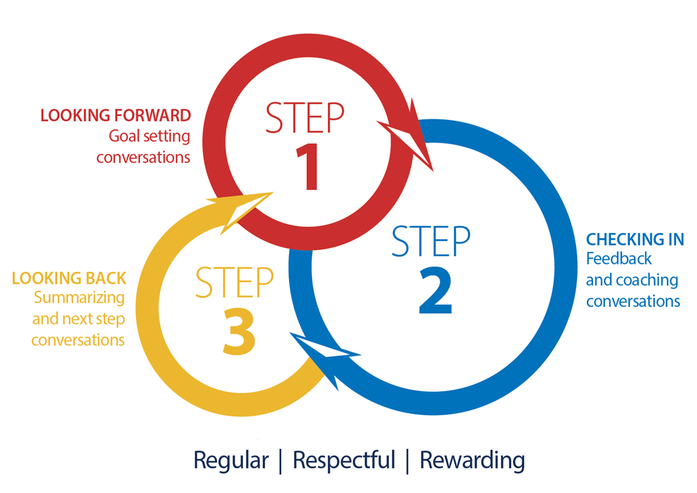
What is PDC?
The Performance and Development Cycle provides a structure for setting goals, providing ongoing feedback and coaching, and identifying ways to support employee’s learning and development objectives.
Notes:
The steps of the PDC are:
Step 1: Looking forward – Goal setting conversations
Step 2: Check in – Feedback and coaching conversations
Step 3: Looking back – Summarizing and next step conversations

Slide 8
What are we not talking about?
PDC is not intended to replace any of the following processes:
Investigations of misconduct or disciplinary issues
Performance improvement/management processes or letters of expectation
Accommodation for illness or disability
Attendance management
Probation and Trial periods
Notes:
It is important to note that when we are talking about the Performance and Development Cycle, we are not talking about:
Investigations of misconduct or disciplinary issues
Performance Improvement processes or Letters of Expectation
Accommodations for illness or disability
Attendance management
Probation and Trial periods
These processes exist separately and, if we need to engage in any of them, we may need to pause the PDC while we access other resources and tools as appropriate.
NOTE: should any of these situations arise during the normal PDC process please connect with your HR Consultant without delay. Early identification of issues and actions is very important and your HRC can help determine the appropriate next steps. For employees on a probation or trial period, the process and purpose for documenting performance is different. The responsibilities of the supervisor and employee are different, and focus of the conversations is related to the employees ability to perform the job duties as defined. Please use the probation/trial forms available on the HR website in these situations.

Slide 9
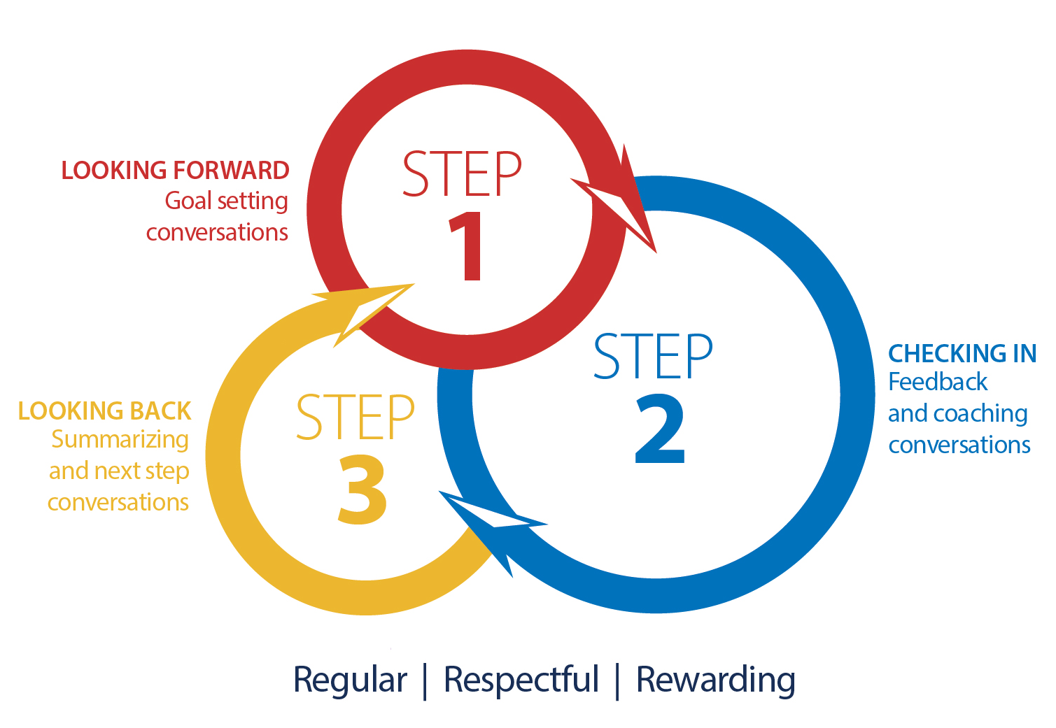
PDC Overview
Notes:
SEE PDC OVERVIEW HANDOUT – LOOK AT ROLES OF EMPLOYEE AND SUPERVISOR
Coaching, feedback and recognition incorporated throughout
Cyclical and ongoing process
Departments can rotate based on schedules and calendars
Aligned with university, division, department and individual goals, vision and values
Shifting the focus from forms to conversations
Short, easy to use forms at each stage
Training tools and resources offered at each stage for both employees and supervisors

Slide 10
Forms for each step
All forms are available at uvic.ca/pdc and are 1 page long.

Slide 11
Step 1: Looking forward – Goal setting conversations
Notes:
Step 1 - Follow along with the new forms
At the beginning of each performance cycle, establish clear expectations about employee performance and behaviour by:
Setting meaningful goals that help the employee to stretch, grow and achieve success
Identifying a learning plan and the support necessary to achieve it
It may be helpful to discuss both of your preferences around giving/receiving feedback at this stage, as it is easier to talk about feedback styles BEFORE you need to have a performance conversation.
Don’t let the job description get in the way of performance conversations. For example, the job description could be out of date, but the important thing for the PDC is that you both supervisor and employee are on the same page and agree on job responsibilities and performance expectations.

Slide 12
Step 2: Check in – Feedback and coaching conversations
Notes:
Step 2 – follow along with the new forms
Establish regular coaching check-ins, where you support employee development by asking three coaching questions:
“What went well?” to recognize and celebrate successes
“What was tricky, or could have been better?” to provide both strengths based and constructive feedback to enhance performance.
“What could you do differently and how else can I help you?” Agree on any changes, course corrections, or additions to learning and development plans.
The most important thing about this step is that you record meeting dates, and any changes or progress, whether you use the new forms or not.

Slide 13
Step 3: Looking back – Summarizing and next step conversations
Notes:
Step 3 – follow along with the new forms
At the end of the Performance Cycle, look back over the past PDC to document accomplishments, identify areas for further development, and transition to the next performance and development cycle.
Note: Refer to departmental records management processes for where copies of the Step 1, 2, 3 forms should reside All three forms and other notes can be stapled together and placed in the employee file
Note: It doesn’t matter who completes the form, what matters is that employee and supervisors discuss the summary and ideally agree. If there are challenges or agreement can’t be reached, supervisors would complete the form, and employee have an opportunity to add their own comments. Employee signature means they have READ AND UNDERSTOOD the supervisor’s comments. Employee signature does not necessarily mean they AGREE with it.

Slide 14
Resources and Supports
New forms have links to helpful one-page resource guides built into each step:
PDC Overview
PDC Getting started
Competency resource index
Effective Feedback
Coaching Questions
Setting Key Goals
Difficult and Productive conversations
8 Pitfalls to Avoid for Supervisors

Slide 15
Resources and Supports
Training sessions available through the Learning Calendar and by invitation for intact teams :
30 minute overview
2 hour orientation to the process and forms
½ day training including goal setting and feedback skills

Slide 16
Resources and Supports
Sessions available through the Employee Learning Calendar include:
Setting Good Goals
Effective Employee Feedback
Difficult Conversations

Slide 17
Questions?
Contact your Human Resources Consultant

