Slide 1


SSHRC CGRS-D
Learn about the scholarship

Slide 2
Accessibility Statement
For a copy of these slides and a transcript of this recording please visit the Faculty of Graduate Studies (FGS) Canada Graduate Research Scholarship – Doctoral website. Content is available in Microsoft Powerpoint, Microsoft Word, and other formats upon request.
If you experience accessibility barriers with this presentation please contact Kathy McCarthy, Scholarship Officer kathymcc@uvic.ca.

Slide 3
What you will learn
What is the SSHRC CGRS-D?
Am I eligible?
How do I apply?
When is the deadline?
What are my next steps?

Slide 4
What is the SSHRC CGRS-D?
Research Councils (the “Tri-Agencies”)
Social Sciences and Humanities Research Council (SSHRC)
Natural Sciences and Engineering Research Council (NSERC)
Canadian Institutes of Health Research (CIHR)
Canada Graduate Research Scholarship – Doctoral
$40,000 per year for 3 years

Slide 5
Am I eligible?
Domestic and international students
Doctoral program includes a significant research component
No more than 36 months of study in doctoral program as of December 31 of the year of application

Slide 6
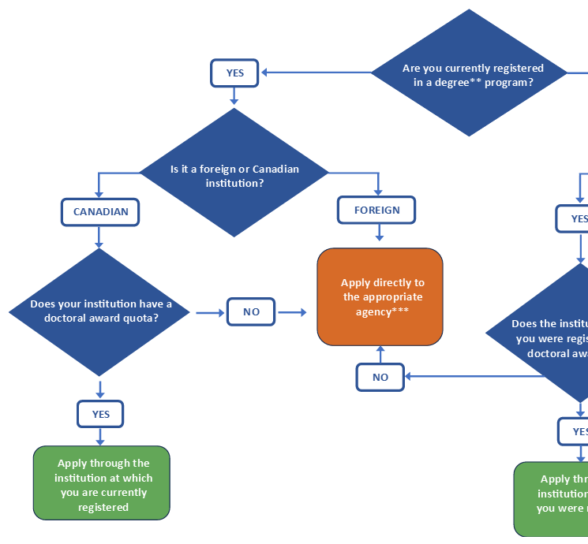
How do I apply?
Select the appropriate research council
Where should I submit my application?
Apply via the SSHRC On-line System
Follow the SSHRC Applicant instructions

Slide 7
When is the deadline?
Activity | Timeline
SSHRC portal opens for applications | Summer 2026
FGS holds application workshops | August 2026
UVic application deadline | 12pm/Noon (PT), September 22nd
Top-scoring applications go to national competition | November 2026
SSHRC announces results | Late-April 2027
Successful applicants begin receiving scholarship payments | May 2027, Sept 2027, or January 2028

Slide 8
What are my next steps?
Consult with your academic supervisor and begin drafting your Outline of Proposed Research and Research Contributions and Statements. Set a schedule that allows time for feedback from a UVic SSHRC coach.
Contact your referees. Provide them with your draft application, CV, and the SSHRC instructions for referees.
Review the selection criteria: learn how your application will be evaluated.
Plan to attend one of the FGS application information sessions.

Slide 9
Contacts and resources
UVic
Kathy McCarthy, Scholarship Officer kathymcc@uvic.ca
FGS CGRS-D website
SSHRC coaches
Workshop dates
UVic deadline
SSHRC
CGRS-D program website
Application instructions
Referee instructions
Helpdesk for accessibility and technical support

