Slide 1


CGRS-M
Application advice & support
Play the audio for each slide:

Slide 2

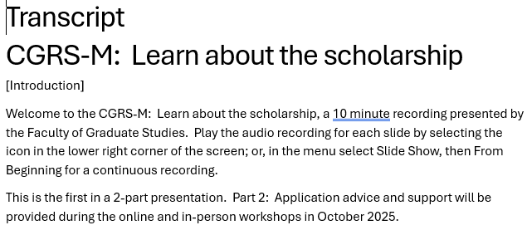
Accessibility Statement
For a copy of these slides and a transcript of this recording please visit the Faculty of Graduate Studies (FGS) Canada Graduate Research Scholarship – Master’s. Content is available in Microsoft Powerpoint, Microsoft Word, and other formats upon request.

Slide 3
What is the CGRS-M?
Research Councils (the “Tri-Agencies”)
Natural Sciences and Engineering Research Council (NSERC)
Social Sciences and Humanities Research Council (SSHRC)
Canadian Institutes of Health Research (CIHR)
Canada Graduate Research Scholarship – Master’s
$27,000 for one year

Slide 4
Am I eligible?
Domestic students
Program includes a significant research component
First class GPA (some exceptions may be available)
No more than 12 months of study in master’s program as of December 31 of the year of application
You may also be eligible if you:
Enrolled in a doctoral program directly from a bachelor’s
Will transfer from a master’s to a doctoral program
Will complete your master’s and continue to a doctoral

Slide 5
How do I apply?
Follow the instructions for completing an application: log in to the Research Portal, select CGRS-M, and begin your application
Follow the instructions for completing a Canadian Common CV: ensure that you choose the CGRS-M version

Slide 6
What are the selection criteria?
50% academic excellence
→ transcripts, GPA, scholarships & awards
30% research potential
→ research proposal, relevant experience & training
20% personal characteristics & interpersonal skills
→ leadership, communication, projects

Slide 7
Your application strategy
Your qualifications
Application Canadian CCV References
Selection criteria

Slide 8
Personal data
Self-identification information
  You may select “I prefer not to answer”
  Information not available to referees and reviewers
Equity initiatives
  Indigenous student researchers
  Black student researchers
Referees can view your application, but you cannot view your reference assessments

Slide 9
Application
Funding supplements
  Listed in application instructions
  Postgraduate programs: scroll down to supplements
Special circumstances
Outline of proposed research & bibliography
  Presentation and attachment standards
Canadian Common CV (CCCV)
Reference Assessments
  Instructions for referees

Slide 10
Transcripts
You must meet the transcript requirements for both
CGRS-M: see application instructions
Each institution that you list in your application
  For UVic, see UVic CGRS-M “Meet the transcript requirements” and use the transcript checklist before you submit
  For other institutions, contact their Graduate Studies office
  If you list more than one institution, ensure that your transcripts meet the strictest requirements

Slide 11
Technical advice
Save your work frequently
Research Portal will be slower near the deadline
Technical support is through the CGRS-M, not UVic
  Troubleshooting tips for uploading attachments
  Contact the Help Desk
CIHR applicants need a PIN: allow at least 1 business day
No changes can be made once you submit
No extensions are possible

Slide 12
Timeline
activity | date
CGRS-M Research Portal opens for applications | Sept 2, 2026
Complete draft of your proposal & CCCV, contact & consult with referees, order official transcripts | October
Seek feedback, make revisions, check transcripts | November
Deadline to submit your application in the Research Portal | December 1, 2026 8:00pm ET/ 5:00pm PT
Campus review of applications | Jan to Mar 2027
Award offers via the Research Portal | April 2027
Successful applicants begin receiving scholarship payments | May 2027, Sept 2027, or Jan 2028

Slide 13
Contacts and resources
UVic
Alexis Ramsdale, Scholarship Officer fgsaward2@uvic.ca
UVic CGRS-M website
UVic CGRS-M coaches
Transcript requirements and checklist
Tri-Agencies
CGRS-M program website
Application instructions
Referee instructions
Tutorial videos
Helpdesk for accessibility and technical support

Slide 14
UVic Faculty Coaches
NSERC Coaches
Dr. Alexandra Branzan Albu,
Dr. Kurt Smith, Dr. Caetano Dorea
SSHRC Coaches
Dr. Frederick Grouzet (A-G), Dr. Alison Shields (H-M),
Dr. Loren McClenachan (N-S), Dr. Athena Madan (T-Z)
CIHR Coaches
Dr. Ryan Rhodes, Dr. Brian Christie

Slide 15

French Research Assistance Service (SARF)

Slide 16
Coach presentations
Coach presentations are not recorded, but the presentation slides from the October 6 & 7 information sessions are available on the following pages. Please note there is no audio for these slides.
This concludes the presentation. Thank you.

Slide 17
Best practices for writing a successful NSERC CGRS M proposal
Alexandra Branzan Albu
Professor, Electrical and Computer Engineering
October 6th 2026

Slide 18
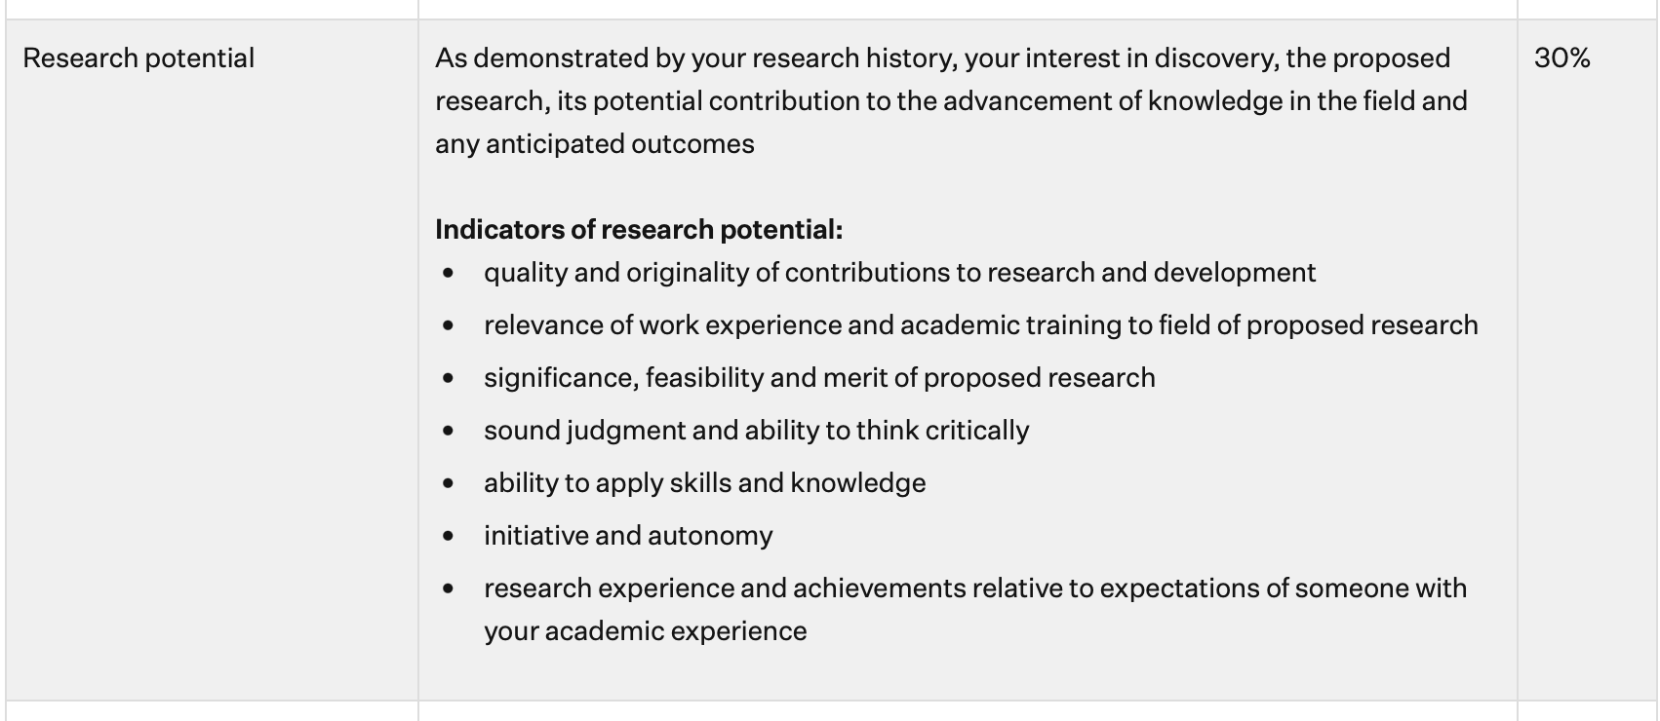


1. Start with the criteria
‘The objective of the Master’s scholarship funding opportunity is to help develop research skills and assist in the training of highly qualified personnel by supporting students who demonstrate potential to contribute to Canadian research.’

Slide 19
2. Structure your proposal
use headings; leave some white space; insert a figure if needed (space is at a premium)
‘Provide a detailed description of your proposed research project for the period during which you will hold the award. Be as specific as possible. Provide background information to position your proposed research within the context of current knowledge in the field. State the objectives and hypothesis and outline the experimental or theoretical approach to be taken (citing literature pertinent to the proposal) and the methods and procedures to be used. State the significance of the proposed research to a field or fields in the health sciences, natural sciences and/or engineering or social sciences and/or humanities, as appropriate.’
background; objective (and hypothesis if applicable); methods; expected outcomes and impact

Slide 20
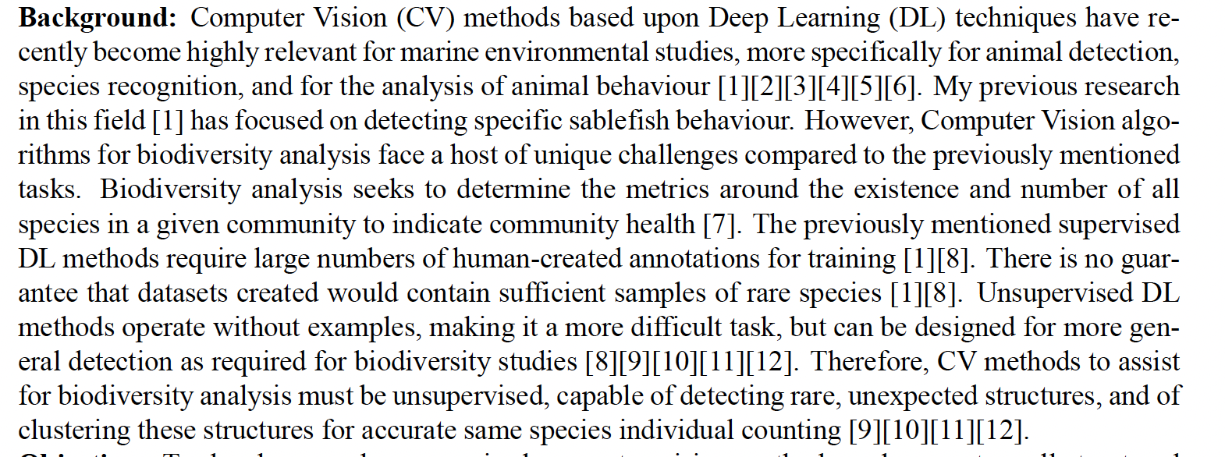







Use acronyms sparingly and define them!

Slide 21
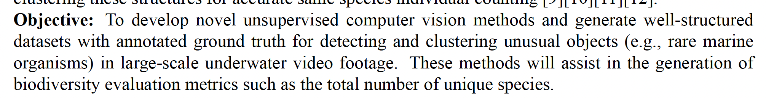




Objective needs to be clear/specific, feasible, and quantifiable.

Slide 22
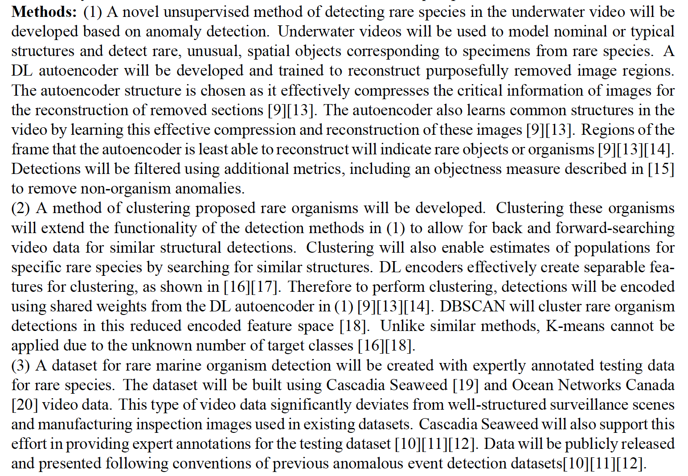



Slide 23
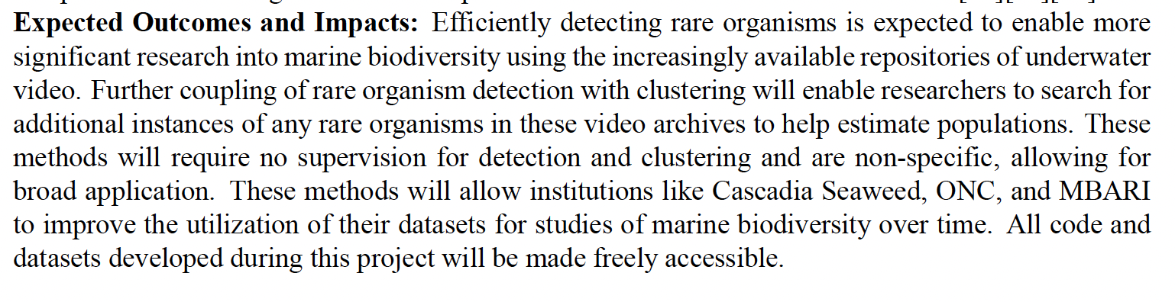

Slide 24
A few more things
Start as early as possible; writing well a one-page proposal is more difficult than writing a longer one;
Iterate, iterate, iterate (with feedback from proposed supervisor, coaches)
Your application needs to demonstrate sound judgment and critical thinking: use genAI sparingly.

